Slide 1


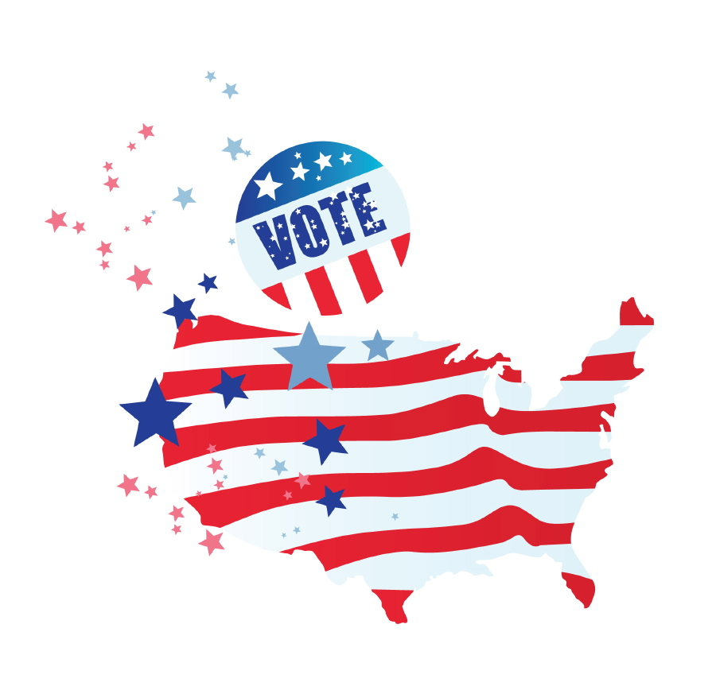



VOTE?
So you think you can
A Brief History of America’s Voting Rights

Slide 2
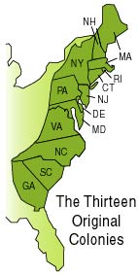
The Early Years
When the colonists came over from England, they brought many of the English political laws and customs with them.

Slide 3
The Early Years
In most of the thirteen colonies, only adult white males that owned land (usually at least 50 acres) could vote.

Slide 4
The Early Years
Many people believed that land owners were the only ones responsible enough to make political decisions!

Slide 5
The Early Years
This left poor white men…
women…
American Indians…
and Africans
(free and slave)
OUT
of the voting process!

Slide 6
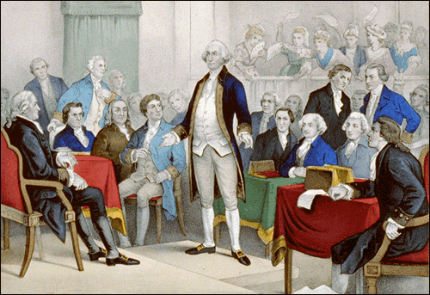
Independence and the Vote
Thomas Jefferson
George Washington
Benjamin Franklin
John Adams
The Framers of the Constitution couldn’t agree on who should have the right to vote.
They gave each state the power to decide what its own voting rights would be.
Do you recognize anyone in the image?

Slide 7
Over time , states dropped the requirement that voters must own property.
Some states acted faster than others. New York got rid of the property requirement in 1821.
Rhode Island did not change until 1880!

Slide 8
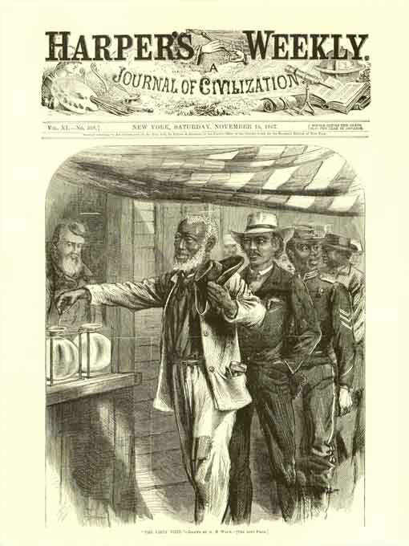
The African American Vote
The 15th Amendment was passed in 1870, five years after the end of the Civil War.
The Amendment states, “The right of citizens of the United States to vote shall not be denied … on account of race, color or previous condition of servitude.”

Slide 9
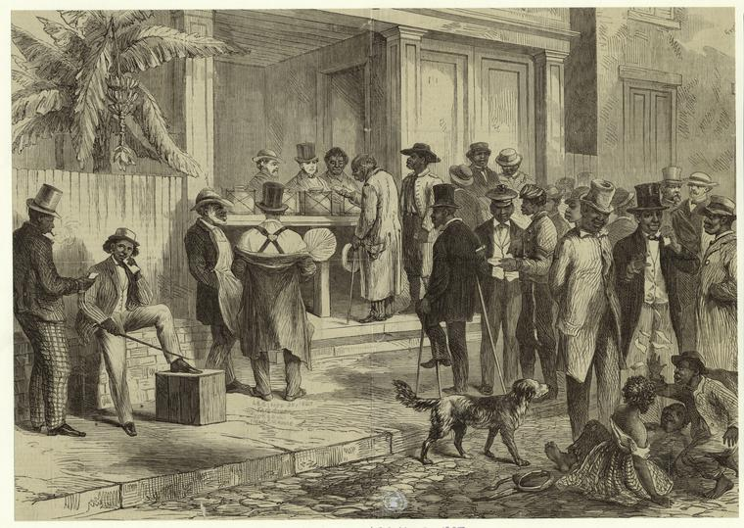
The African American Vote
The 15th Amendment said that former slaves could not be turned away from the polls due to the color of their skin or the fact that they had been slaves.
We will see that this rule wasn’t always followed…

Slide 10
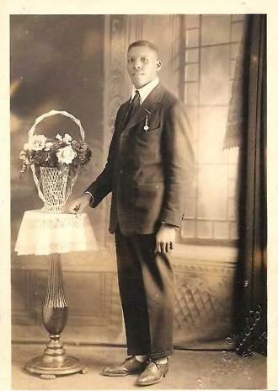

So you think you can VOTE?
Can I vote?
The year is 1915. I am a single African American man living in Chicago, Illinois.
YES YOU CAN!

Slide 11
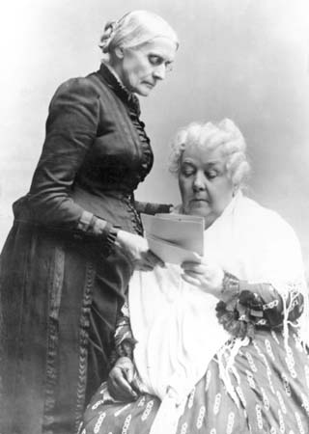
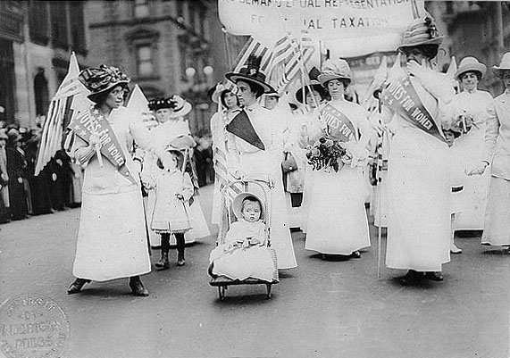
The Women’s Vote
Women gained voting rights after a long hard fight. Wyoming gave women the vote in 1869, but it took the work of Susan B. Anthony, Elizabeth Cady Stanton and many others to get the job done!

Slide 12
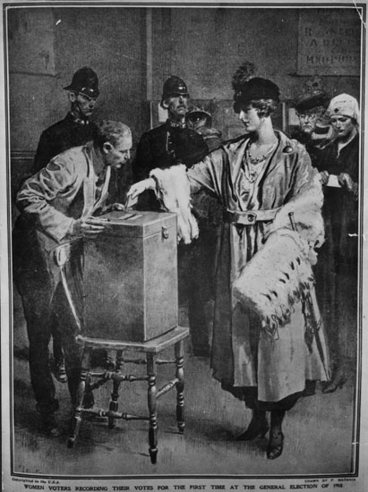
The Women’s Vote
Women won the right to vote in August of 1920!
The 19th Amendment said, “The right of citizens of the United States to vote shall not be denied … on account of sex.”

Slide 13
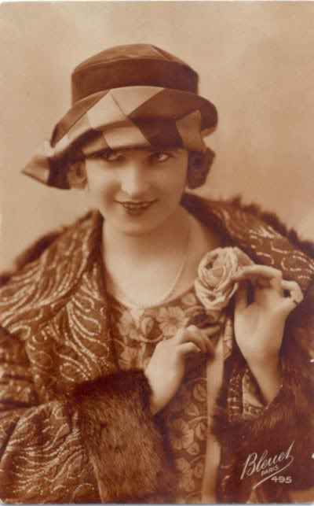
So you think you can VOTE?
Can I vote?
I am a woman living in New York City in the year 1924. I am 25, married and have two children.
YES YOU CAN!

Slide 14
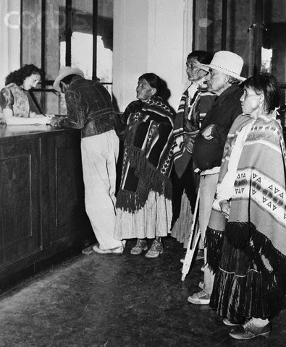
The American Indian Vote
American Indians were not considered citizens of the United States until 1924. Before that, they were considered members of their own tribal governments.

Slide 15
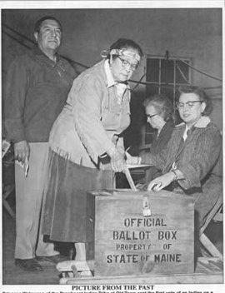
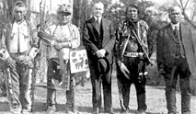
The American Indian Vote
In 1924, President Calvin Coolidge signed the Indian Citizenship Act.
This gave American Indians the rights and privileges of American citizenship. This includes voting, of course!

Slide 16
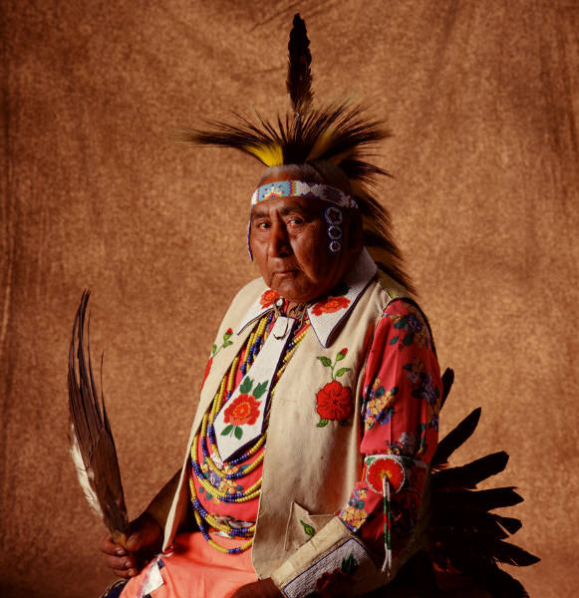

So you think you can VOTE?
Can I vote?
I am an American Indian living in Montana in the year 1910. I’m 65 years old, married and have three kids and seven grandkids.
You can ‘t vote yet.

Slide 17
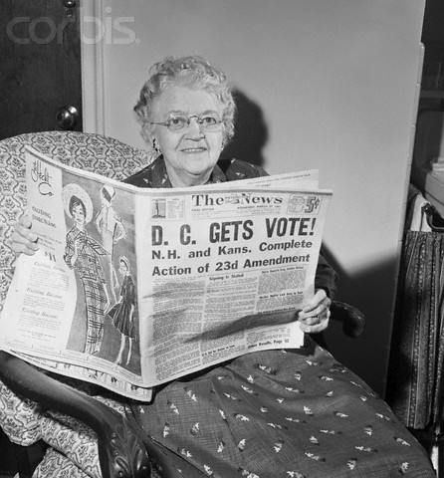
DC Voting Rights
Residents of the District of Columbia did not get the right to vote in presidential elections until the 23rd Amendment was ratified in 1961.

Slide 18
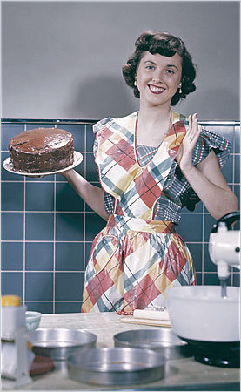
So you think you can VOTE?
Can my husband and I vote for my neighbor, the President?
I live in Washington, D.C. just down the street from the White House. The year is 1955. I am a 35 year old woman with two children.
You can ‘t vote yet.

Slide 19
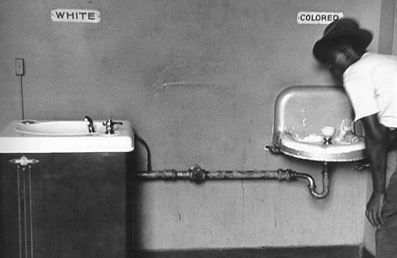
Voting is a Civil Right!
Even after the Civil War, many people in the South did not want African Americans to have the same rights as white Americans. This included the right to vote or hold office.
Some states and counties passed laws that made voting almost impossible!

Slide 20
Barriers to the African American Vote
Limited opportunities to register to vote
Arrest and beatings by police
Threats of violence toward voter’s family and home
Personal information shared with groups like the KKK and employers
Unfair tests at the polls
States and individual counties used many different methods to prevent African Americans from voting.

Slide 21
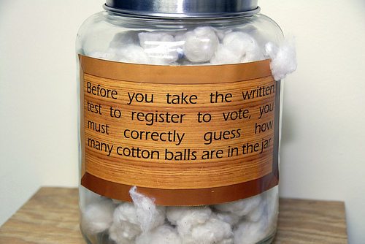


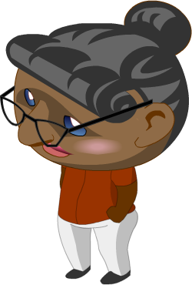

This poll test asks voters to correctly guess the number of cotton balls in a jar before they are allowed to vote.
?
?
?
Other tests asked voters to guess the number of bubbles in a bar of soap!

Slide 22
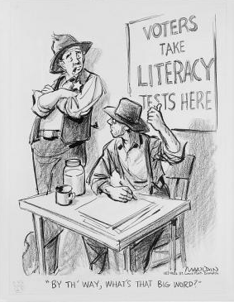
The literacy test was one type of poll test that was given in some locations. Voters were tested on their reading skills.
Like with the other tests, white voters always passed while African American voters usually failed.

Slide 23
Voting Requirements in the South
Alabama | Louisiana
1) Read a section of the Constitution out loud.
2) Tell what the section says in your own words.
3) Write out another section of the Constitution.
4) Answer eight questions on the Constitution.
Voters who could not prove a 5th grade education had to:
1) Complete a 30 question test
2) Finish the test in 10 minutes!
Many African Americans in these states lacked a quality education, and the tests were meant to exclude blacks from the voting process.

Slide 24
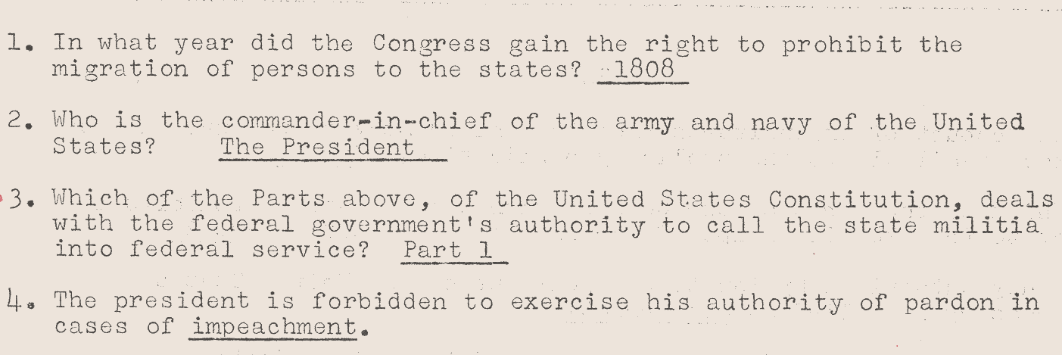
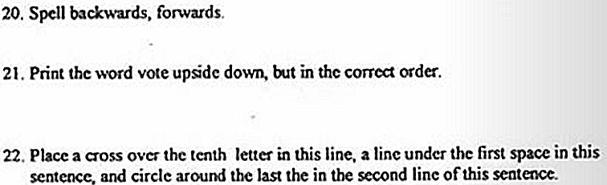
Alabama Literacy Test
Examples of Literacy Tests
Louisiana Literacy Test

Slide 25
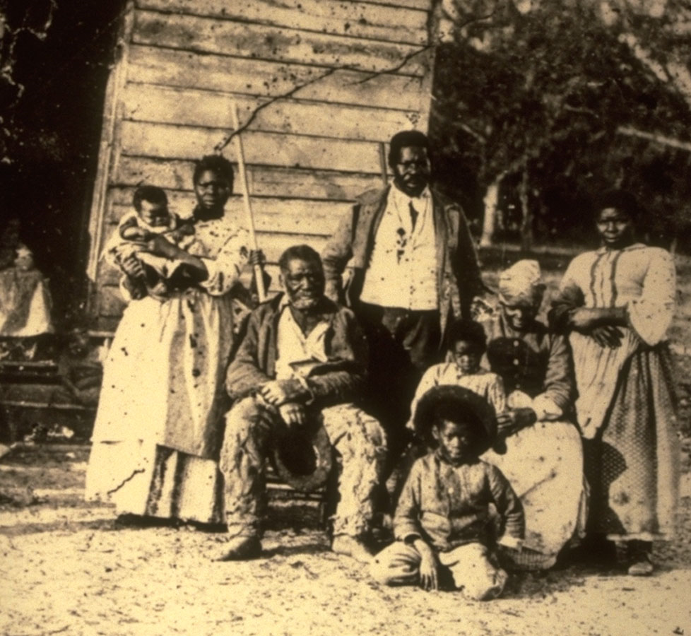
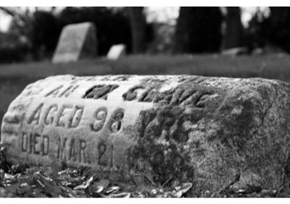
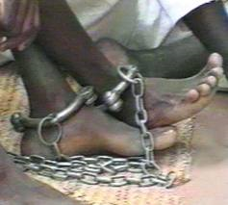
The Grandfather Clause stated that you only had the right to vote if your grandfather also had the right to vote.

Slide 26
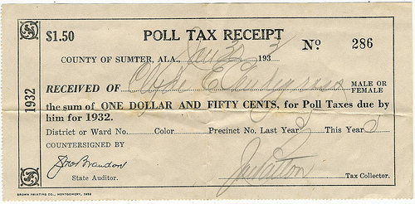
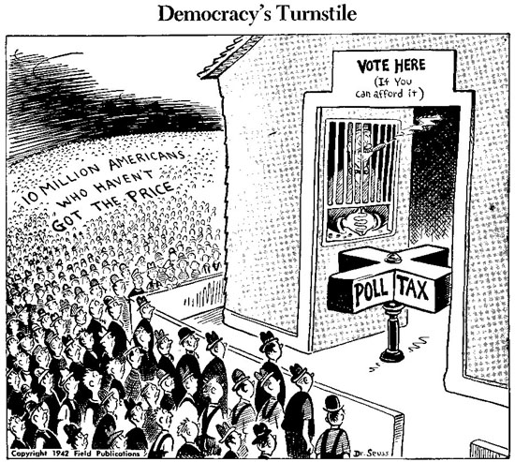
  The Poll Tax required voters to pay for the ability to vote.
Most Southern African Americans were poor sharecroppers that were heavily in debt to landowners.
$1.50
1932
=
$23.00
Today

Slide 27
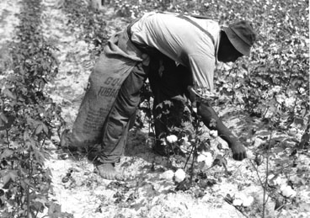
So you think you can VOTE?
Can I vote?
I am a 22 year old African American man living in the deep South in 1948. I work in the cotton fields and cannot read or write.
It’s not likely that you’d get to vote.

Slide 28
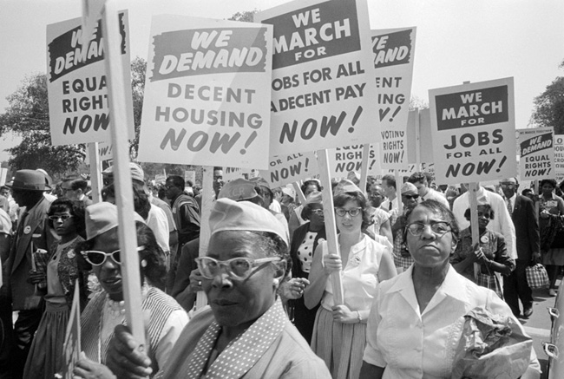
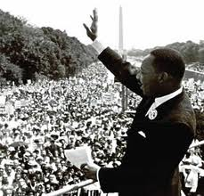
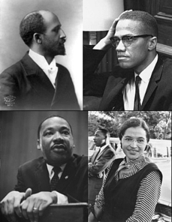
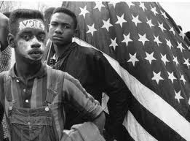
The Civil Rights Movement
Over time, more and more people demanded civil rights for all Americans.
The marches, speeches, sit-ins, freedom rides and activities all added up to what we know as the Civil Rights Movement.

Slide 29
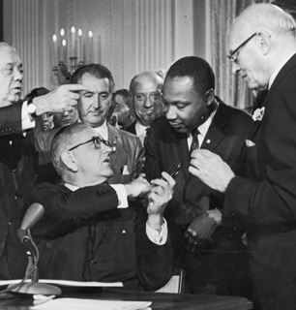
Voting Laws Change
President Lyndon B. Johnson
Dr. Martin Luther King, Jr.
The 24th Amendment was added to the Constitution in 1964.
It banned the use of poll taxes in elections.
Can you name two people in this image?

Slide 30
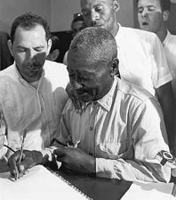
Voting Laws Change
The Voting Rights Act was signed by President Johnson in 1965.
This law:
  protected the right to vote for all citizens
  forced the states to obey the Constitution
  reinforced the 15th Amendment.

Slide 31
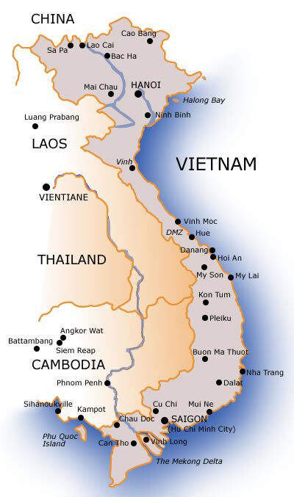
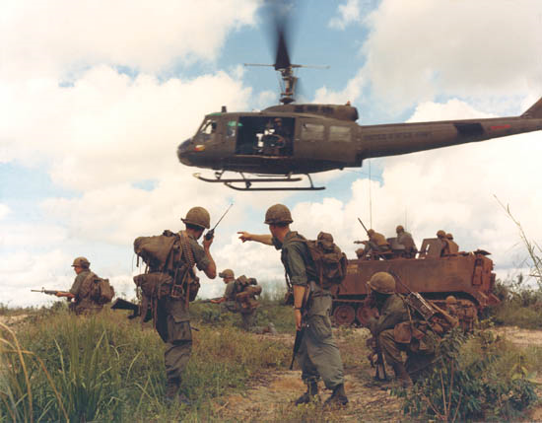
Changing the Voting Age
In the 1960s and 1970s thousands of young men were drafted to fight in the Vietnam War. Many were too young to vote.

Slide 32
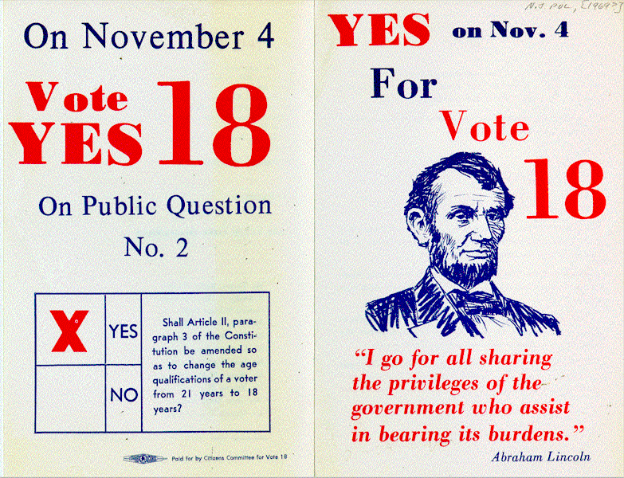
Changing the Voting Age
The 26th Amendment was passed in 1971.
It says, “The right of citizens of the United States, who are 18 years of age or older, to vote shall not be denied… on account of age.”
Supporters of this amendment chanted,
“Old enough to fight, old enough to vote!”

Slide 33
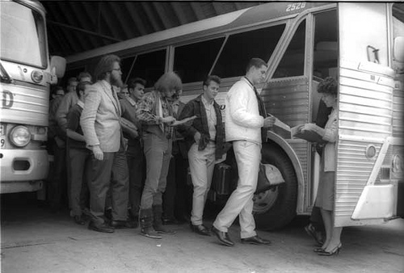
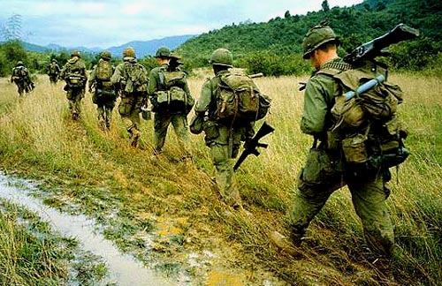
So you think you can VOTE?
I just graduated from high school in Maryland, Class of 1972! I am 18 years old and just got drafted to fight in the war in Vietnam.
Can I vote?
YES YOU CAN!

Slide 34
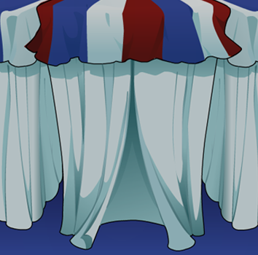




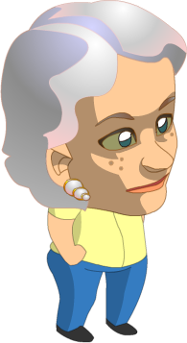
Review Time!
Vote Here!

Slide 35
Do you have to own land to vote in the United States?
Yes
Or
NO
All land ownership requirements ended by 1880!

Slide 36
Rhode Island was the first state to give women the vote.
TRUE
Or
FALSE
Wyoming gave women the right to vote in 1869.

Slide 37
Forcing people to pay for the right to vote was called a _________?
Literacy
Test
Or
Poll Tax
Poll taxes were used to keep poor African Americans from voting.

Slide 38
Are Native Americans US citizens?
Yes
Or
NO
The Indian Citizenship Act was passed in 1924.

Slide 39
The Voting Rights Act reinforced the 15th Amendment.
After the 15th Amendment, many states and counties still prevented African Americans from voting. The Voting Rights Act was written to remove these barriers.
True
Or
false

Slide 40
Which war led to the passage of the 26th Amendment?
Many of the soldiers fighting in the Vietnam War were too young to vote. The 26th Amendment moved the voting age from 21 to 18.
World War Two
Or
The Vietnam War

Slide 41
Are residents of Washington, D.C. banned from voting for the President?
Yes
Or
NO
The 23rd Amendment was passed in 1961. Now people can vote in D.C!

Slide 42
Susan B. Anthony worked to give Native Americans the right to vote.
True
Or
False
Susan B. Anthony fought for the right of women to vote!

Slide 43
Our earliest ideas about voting came from which country?
France
Or
England
When the colonists came to America from England, they brought all of the ideas and customs along.

