Slide 1
The Presidency and the Executive Branch
Article II in the US Constitution

Slide 2
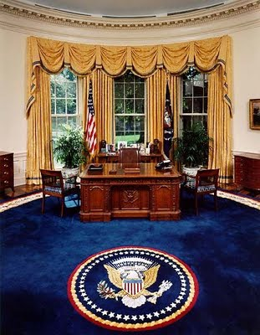
The President’s Roles
Chief of State
Ceremonial head of the national government
Symbol of all the people of the nation

Slide 3
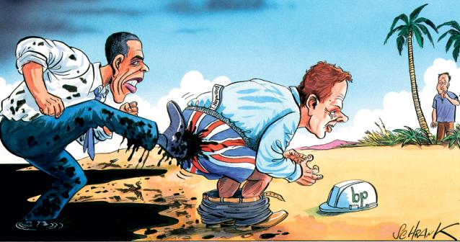
The President’s Roles
Chief executive
The President has “executive power”
Very broad power both in both domestic and foreign affairs

Slide 4
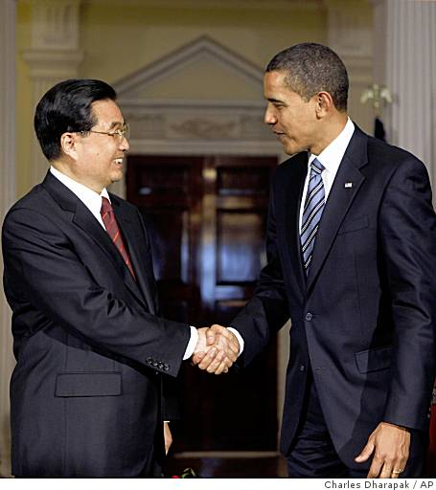
The President’s Roles
Chief Diplomat
The President designs the foreign policy for our country
Spokesman for the country

Slide 5
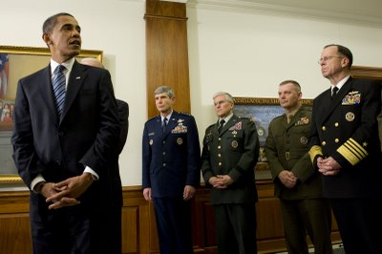
The President’s Roles
Commander – in – Chief
Controls the nations military forces

Slide 6
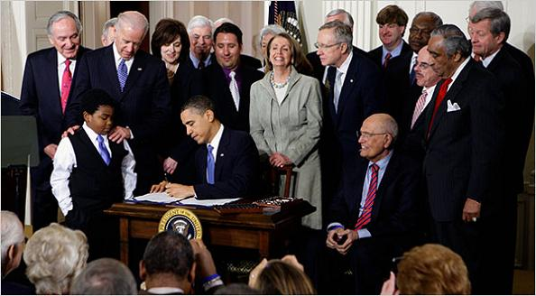
The President’s Roles
Legislative Leader
Main architect for the country’s public policy
Shape the congressional agenda
The President initiates, suggests, requests, insists, and demands that Congress enact much of its major legislation

Slide 7
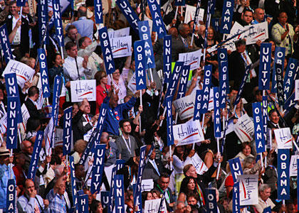
The President’s Roles
Party Leader
The President is the acknowledged leader of his political party

Slide 8
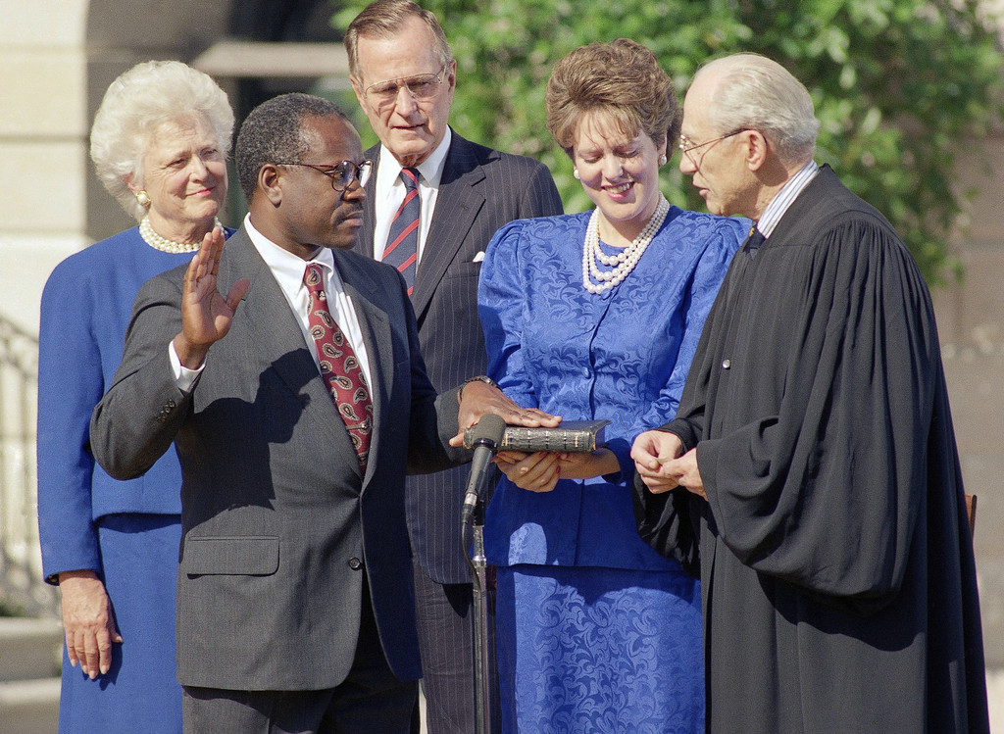
The President’s Roles
Judicial Leader
The president will appoint Federal Court Judges, grant pardons and reprieves.

Slide 9
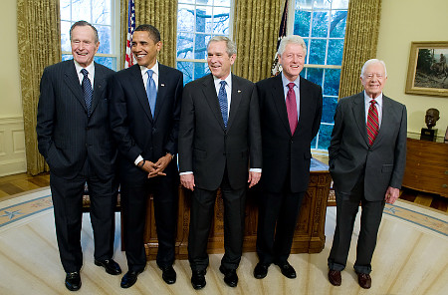
Formal Qualifications for the Presidency
A natural born citizen
At least 35 years of age
Lived in the United States for at least 14 years

Slide 10
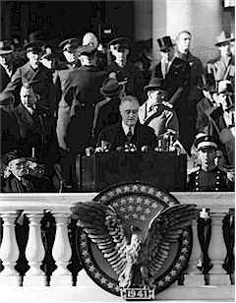
President’s terms
The President serves a term of four years
The 22nd Amendment prevents any person from being elected to more than two terms

Slide 11
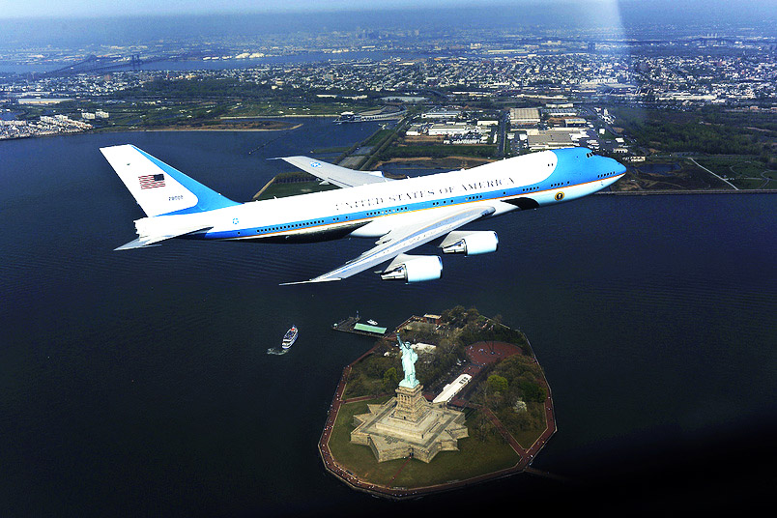
President’s Pay and Benefits
Congress determines the President’s salary
$400,000 per year
$50,000 per year expense allowance
Use of the White House and Camp David
Use of Air Force One and several other planes and helicopters
The finest medical, dental, and other health care available
Many other fringe benefits

Slide 12
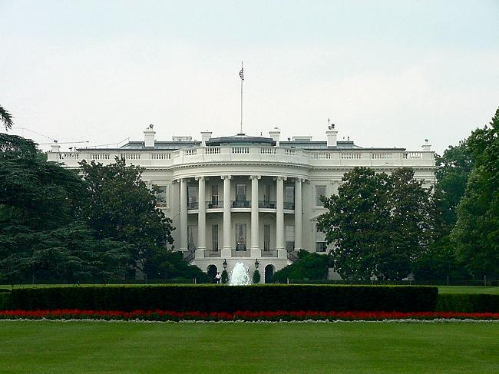
Presidential Succession
Presidential succession is the scheme by which a presidential vacancy will be filled
This was not written into the Constitution, but was added through the 25th Amendment and the Presidential Succession Act of 1947
1st Vice – President
2nd Speaker of the House
3rd President Pro Tempore of the Senate
The chart is listed on page 359 in your textbook

Slide 13
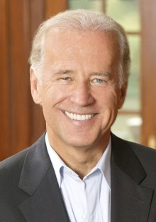
Vice President
The Vice President has two powers listed in the Constitution
1st to preside over the Senate
2nd to help decide the question of presidential disability
The Vice President’s role has expanded over time. Now the Vice President’s role is much more involved as a candidate who balances the ticket and a true assistant to the President

Slide 14
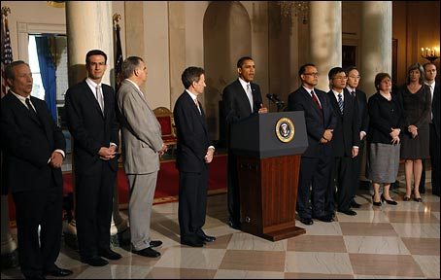
Article II of the Constitution
The 2nd Article of the Constitution gives the blueprint to the executive branch
Section 1 deals with the office of the President and the Vice President
It lists the powers, terms, election process, qualifications, and vacancy issues
It provides the steps necessary for the President to select the members of his cabinet
15 members
Approved by the Senate

Slide 15
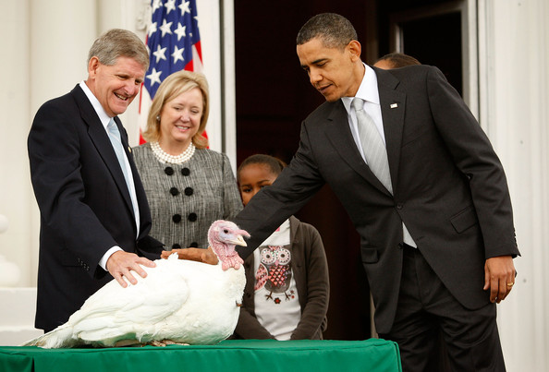
Article II of the Constitution
Section 2 deals with the President’s Powers and Duties
Military and Civil Powers – it states the President is the commander – in chief of the military and the president has the power to grant reprieves and pardons, and select a cabinet

Slide 16
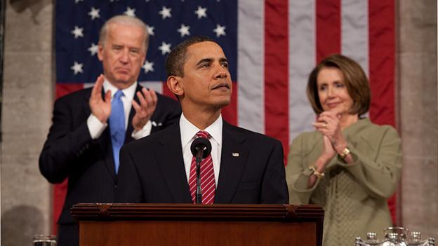
Article II of the Constitution
Section 3 deals with the State of the Union address and all other powers the President has in addressing and calling into session Congress

Slide 17
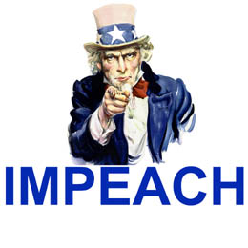
Article II of the Constitution
Section 4 deals with the impeachment of the President related back to Article 1 of the Constitution

Slide 18
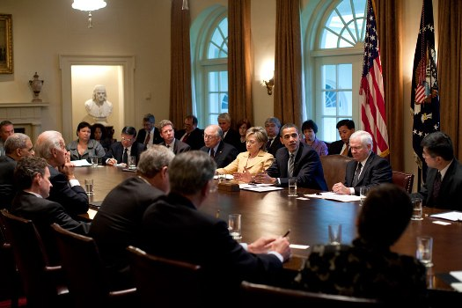
United States Cabinet
board to advise the President; members are the secretaries of executive departments; the United States constitution does not provide for the Cabinet

Slide 19
United States Cabinet
The Cabinet is a part of the executive branch of the U.S. federal government consisting of the heads of federal executive departments. Despite having evolved as one of the most powerful organs of the contemporary U.S. government, the term "Cabinet" does not appear in the U.S. Constitution, where reference is made only to the heads of departments

Slide 20
United States Cabinet
“The Big Four“
Secretary of State
Secretary of the Treasury
Secretary of Defense
Attorney General

Slide 21
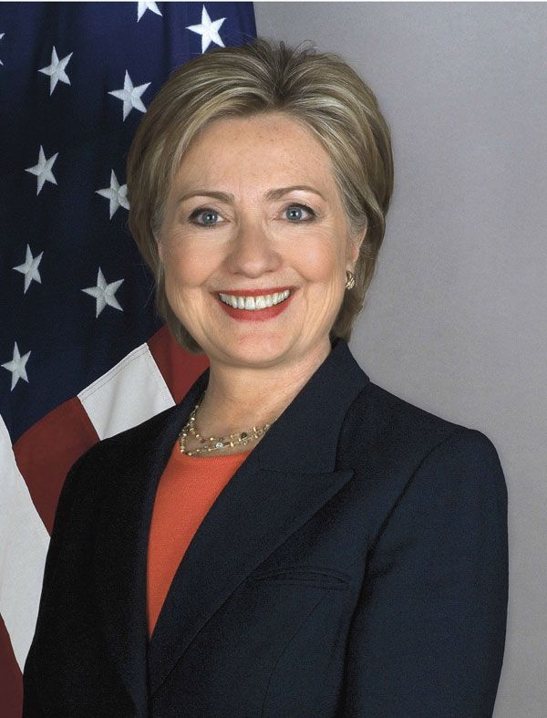
United States Cabinet
United States Secretary of State
The United States Secretary of State is the head of the United States Department of State, concerned with foreign affairs.
Secretary of State Hillary Clinton

Slide 22
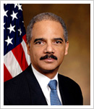
United States Cabinet
Attorney General
Chief law-enforcement officer of a state and legal adviser to the chief executive. In the U.S., the position dates to the Judiciary Act of 1789. Head of the Department of Justice and a member of the cabinet, the attorney general oversees all the government's law business and acts as the president's legal adviser.
Attorney General Eric Holder

Slide 23
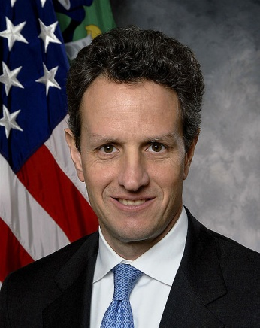
United States Cabinet
United States Secretary of the Treasury
The United States Secretary of the Treasury is the head of the United States Department of the Treasury, concerned with finance and monetary matters, and, until 2003, some issues of national security and defense. This position in the Federal Government of the United States is analogous to the finance ministers of other nations.
Secretary of the Treasury Timothy Geithner

Slide 24
United States Cabinet
United States Secretary of Defense
The United States Secretary of Defense is the head of the United States Department of Defense, concerned with the armed services and military matters. The Secretary of Defense is sixth in the United States presidential line of succession
Secretary of Defense Robert Gates

Slide 25
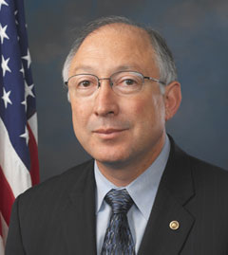
United States Cabinet
United States Secretary of the Interior
The United States Secretary of the Interior is the head of the United States Department of the Interior. The Department of the Interior oversees such agencies as the Bureau of Indian Affairs, the United States Geological Survey, and the National Park Service.
Secretary of the Interior Ken Salazar

Slide 26
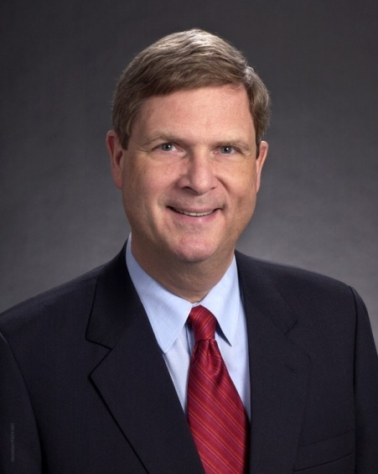
United States Cabinet
United States Secretary of Agriculture
The United States Secretary of Agriculture is the head of the United States Department of Agriculture concerned with land and food as well as agriculture and rural development.
Secretary of Agriculture Tom Vilsack

Slide 27
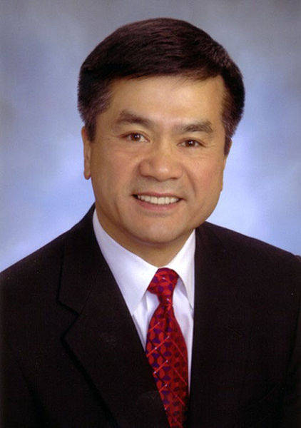
United States Cabinet
United States Secretary of Commerce
The United States Secretary of Commerce is the head of the United States Department of Commerce concerned with business and industry.
Secretary of Agriculture Gary Locke

Slide 28
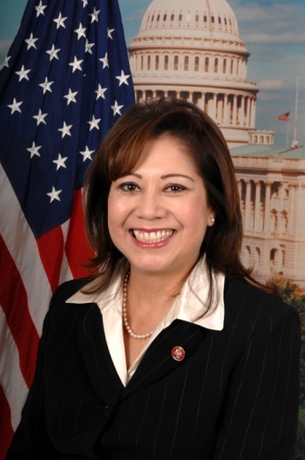
United States Cabinet
United States Secretary of Labor
The United States Secretary of Labor is the head of the United States Department of Labor.
Secretary of Labor Hilda Solis

Slide 29
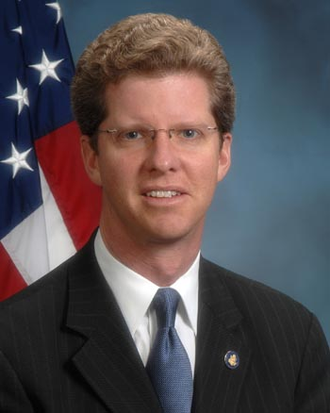
United States Cabinet
United States Secretary of Housing and Urban Development
The United States Secretary of Housing and Urban Development is the head of the United States Department of Housing and Urban Development, concerned with urban housing matters.
Secretary of Housing and Urban Development Shaun Donovan

Slide 30
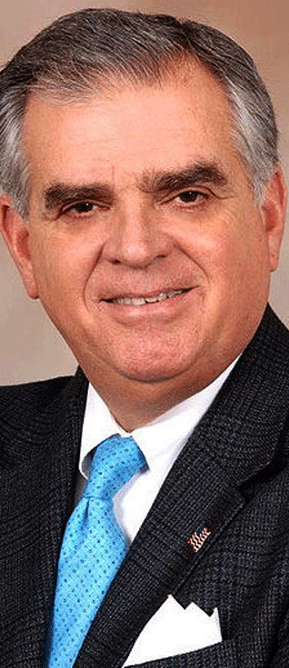
United States Cabinet
United States Secretary of Transportation
The United States Secretary of Transportation is the head of the United States Department of Transportation.
Secretary of Transportation Ray LaHood

Slide 31
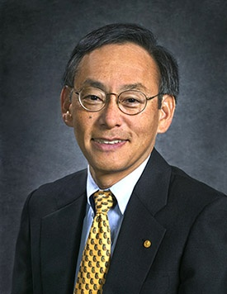
United States Cabinet
United States Secretary of Energy
The United States Secretary of Energy, the head of the United States Department of Energy, is concerned with energy production and regulation
Secretary of Energy Steven Chu

Slide 32
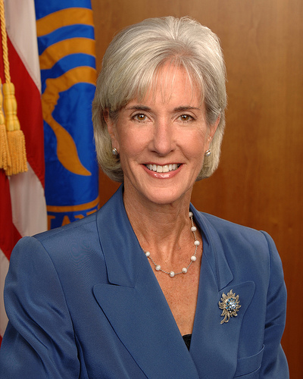
United States Cabinet
United States Secretary of Health and Human Services
The United States Secretary of Health and Human Services is the head of the United States Department of Health and Human Services, concerned with health matters.
Secretary of Health and Human Services Kathleen Sebelius

Slide 33
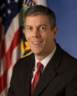
United States Cabinet
United States Secretary of Education
The United States Secretary of Education is the head of the Department of Education.
Secretary of Education Arne Duncan

Slide 34
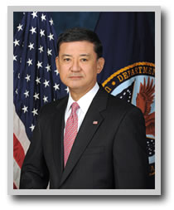
United States Cabinet
United States Secretary of Veterans Affairs
The United States Secretary of Veterans Affairs is the head of the United States Department of Veterans Affairs, the department concerned with veterans' benefits and related matters.
Secretary of Veterans Affairs Eric Shinseki

Slide 35
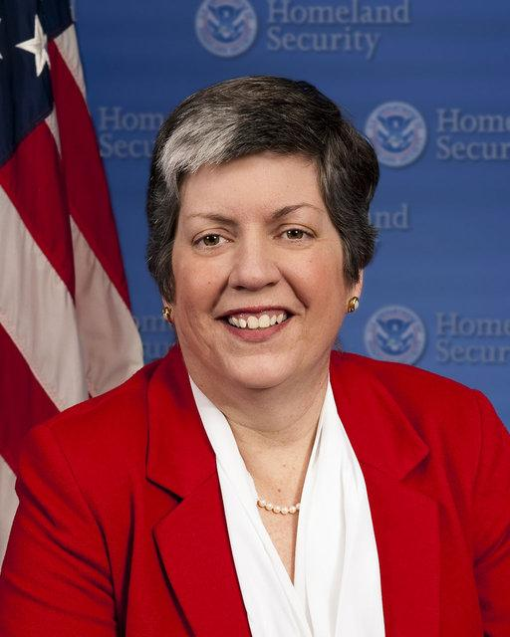
United States Cabinet
United States Secretary of Homeland Security
The United States Secretary of Homeland Security is the head of the United States Department of Homeland Security, the body concerned with protecting the American homeland and the safety of American citizens.
Secretary of Homeland Security Janet Napolitano

