Slide 1
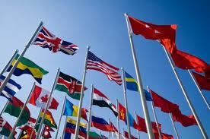
Types of Governments
CL.C&G.2.4 Compare the federal government of the United States to various types of government around the world in terms of balancing security and the protection of rights.

Slide 2
Bell Ringer:
Brainstorm and list the ways that government has affected your morning.
Is government necessary? Justify your response
Agenda: Bell Ringer, Types of governments, Analogy, Island Assignment and Scenarios, Vocabulary Exit Ticket
CL.C&G.2.4 Compare the federal government of the United States to various types of government around the world in terms of balancing security and the protection of rights.
EQ: What are the different types of governments around the world and how do they compare to the Government of the United States?

Slide 3
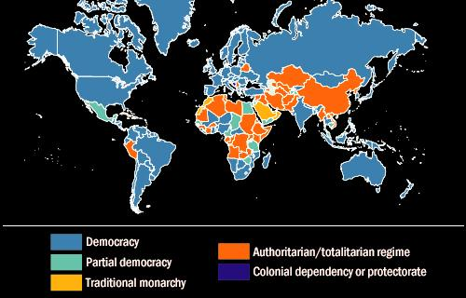
Governments of today

Slide 4
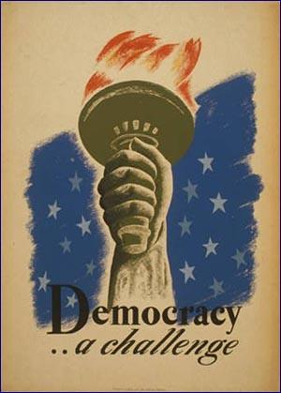
Democracy
Originated in ancient Greece
A system of government where power comes from the people.
Two types of democracy are Representative Democracy and Direct Democracy.
Power is usually taken through peaceful means in the form of voting by the people.

Slide 5
Direct Democracy
A form of democracy where the people vote on all matters.
This is not practical in large countries with millions of people.
This system works best in small groups or even corporations

Slide 6
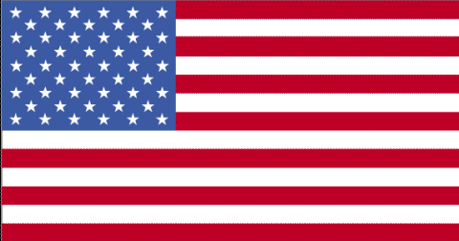
Representative Democracy / Republic
People elect the government in order to have decisions made for them.
The United States maintains representative democracy.
Advantage is that everyone has a voice.
Disadvantage is that those who support a candidate that loses will not always feel represented.

Slide 7
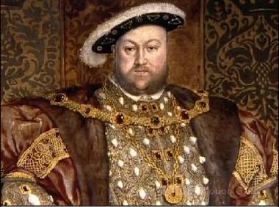
Monarchy
A system of government where power belongs to a ruling family.
Power is obtained by heredity (birthright)
Power is justified by Divine Right- God has given this family the authority to rule.
Monarchs are often called King/Queen, Emperor, Empress.
The two types of monarchies are absolute monarchy and limited monarchy.

Slide 8
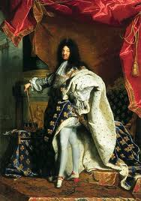
Absolute Monarchy (Option One)
Referred to as Absolutists
The rulers have total authority of the government
Citizens have very few rights and cannot question it.
Example: Louis XIV France

Slide 9
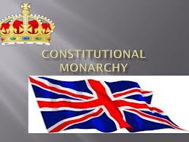
Constitutional Monarchy (Option Two)
Power of the monarch is limited by a constitution and or parliament.
Citizens have more rights than in an absolutist state.
Some monarchs have no real power at all and are figure heads.
Example: Great Britain today

Slide 10
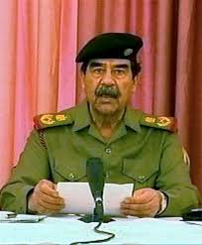
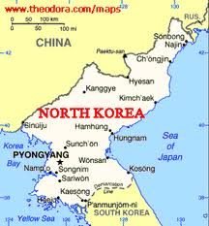
Dictatorship
A form of government where the nations is ruled by one ruler.
Is a form of totalitarianism.
Power is taken by force and requires military support.
At the end of the leader’s period of rule (death, resignation or overthrow), violence usually occurs in the nation.

Slide 11
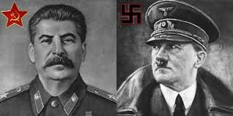
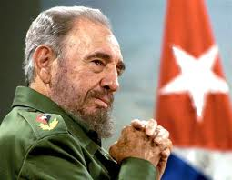
Totalitarianism
A system of government where the rulers have total unchecked control of the nation.
Citizens have only the rights that the ruler chooses to give them.
This type of power is usually taken by force.

Slide 12
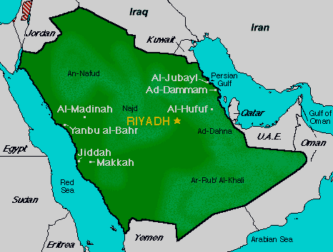
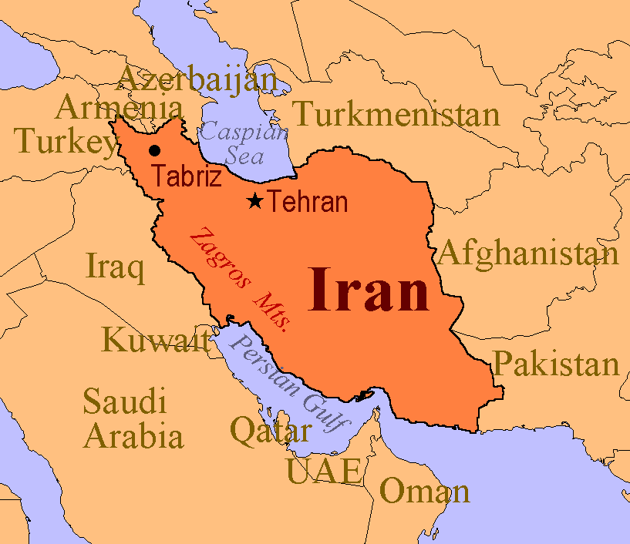
Theocracy
A form of government based on religious law.
Typically ruled by a religious council such as clerics.
Laws are traditionally based on the holy books.
Is most common in the Middle East (Iran, Saudi Arabia)
Vatican City is also considered a theocracy
Punishments for violating laws are often harsh.

Slide 13
Oligarchy
A system of government where a group of people rule and have power to serve their own interests.
Power could be identified by royalty, wealth, family ties, education, corporate, race or military control
Power is usually passed from generation to generation.
South Africa was an example with apartheid (white Africans 10% controlled all of the nation)

Slide 14
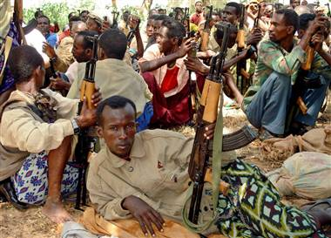
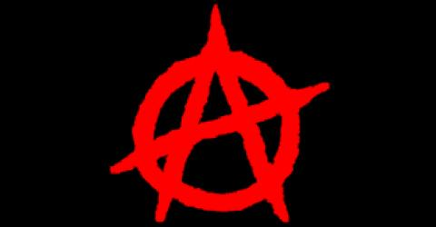
Anarchy
Lack of government
Example: Somalia

Slide 15
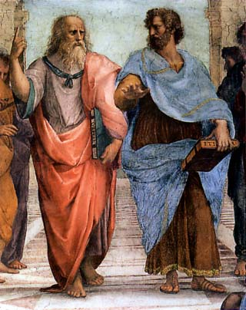
Aristocracy
Aristocracy is a kind of government that puts power in the hands of a small, privileged ruling class.
In Ancient Greek, the word aristocracy means the rule of the best, but it has come to be linked with rule by royal families.

Slide 16
Which government is it??
Complete the table for each scenario.
Scenario 1: Melissa turned 18 and is going to city hall to vote in the presidential election for the first time. She will vote for candidates running for President, NC Governor and NC Senator.
Type of Government | Who/what controls decision making? | Explain why

Slide 17
Which government is it??
Complete the table for each scenario.
Scenario 2: King Abdullah of Saudi Arabia makes all the decisions for his country. He does not consult advisors and he never holds elections.
Type of Government | Who/what controls decision making? | Explain why

Slide 18
Which government is it??
Complete the table for each scenario.
Scenario 3: The citizens of Hampton, New Hampshire hold 4 annual town meetings where they discuss town policies and make decisions regarding laws and the town budget.
Type of Government | Who/what controls decision making? | Explain why

Slide 19
Which government is it??
Complete the table for each scenario.
Scenario 4: The government in Iran enforces religious laws contained in the ancient Islamic text, the Koran. The political leaders are also highest religious leaders, who claim they are chosen by God.
Type of Government | Who/what controls decision making? | Explain why

Slide 20
Which government is it??
Complete the table for each scenario.
Scenario 5: In the ancient Greek city of Sparta a small group of elders made all the decisions. They even would decide which babies were strong enough to live in Sparta and which babies should be disposed.
Type of Government | Who/what controls decision making? | Explain why

Slide 21
Which government is it??
Complete the table for each scenario.
Scenario 6: Adolph Hitler ruled over Nazi Germany with an “iron fist.” He controlled all the media and used his military and secret police (the SS) to exterminate any opponents.
Type of Government | Who/what controls decision making? | Explain why

Slide 22
Which government is it??
Complete the table for each scenario.
Scenario 7: When Lenin came to power in Russia he tried to split all the property equally between the people by giving the government control over all property. He believed there should not be social classes and everyone should be equal.
Type of Government | Who/what controls decision making? | Explain why

Slide 23
PIT: Island Assignment
Imagine that you and twenty of your classmates survived the crash of Oceanic flight 815. You landed on a remote island somewhere in the Pacific Ocean. You don’t know when you’ll be rescued and as far as you can tell there is no one else on the island. You have no way to communicate with the outside world as your cell phones do not work on the island and all GPS and radar was destroyed in the crash.
With your group make an “Island Survival Plan” for all of the survivors of the crash. You must ultimately determine what the best system of government will be for the survivors on the island. Be sure to use your knowledge of different types of economic and government systems. In the space below write down your answers to the following questions which will make up your “Island Survival Plan.”
Notes:
Possible scenarios for students to respond to.
Stranded! Students will be faced with the GRASP activity to put their new knowledge to the test. Teacher will present original situation (being stranded- how will they survive?) and record the class decisions. Then the students will be face with PART II: the group of stranded students come across another group of stranded students on the other side of the island- record findings of what will they do? And finally, PART III: a highly effective pirate is raiding the island; what will they do. What elements from the different types of government will be considered in the solution to their predicament? Findings recorded.

