Slide 1
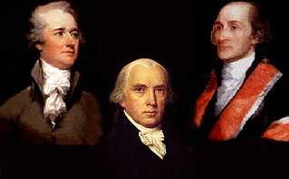
Unit 3.3 – Ratifying the U.S. Constitution, & Federalists and Anti-Federalists
(DisCh 4.2)
EQ:
1. Who were the Federalists and Anti-Federalists AND how did their beliefs on the US Constitution and national government differ

Slide 2
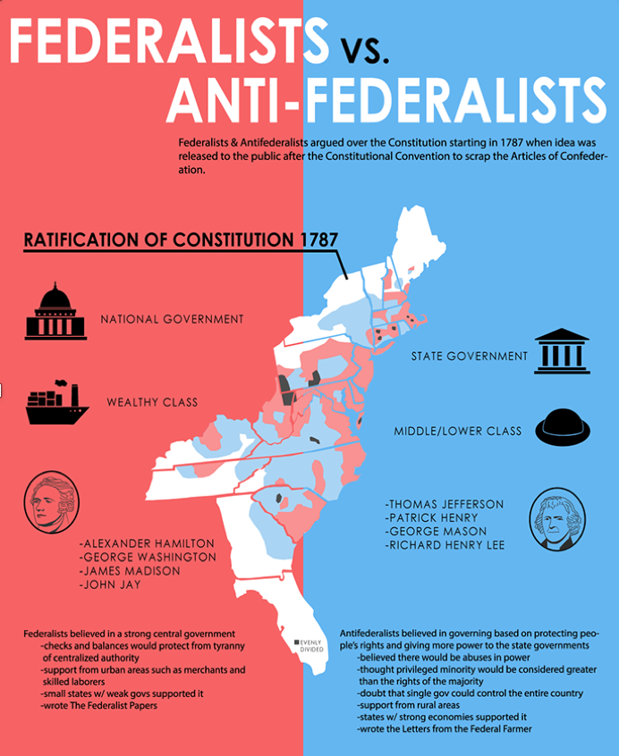
Q1: Debate Over the Constitution
As new Constitution became public, ppl all over country disagreed whether new govt would be too powerful or not
Because “federal” refers to national govt, ppl who supported Constitution became known as Federalists, those who didn’t became known as Anti-Federalists
9 of 13 states had to agree to ratify (to give formal, signed consent) in order for the U.S. Constitution to become official

Slide 3
Video Clip:
1.5 Minutes, History Illustrated: Ratify Definition (turn up volume): https://www.youtube.com/watch?v=e1C6vC2LFFk&list=PLkfZOP2_jHb40ukfkzSpNQ9LcpUC8JW1R&index=40

Slide 4
Q2: Anti-Federalist Arguments
Famous Anti-Federalists included: Thomas Jefferson, Patrick Henry, John Hancock, Samuel Adams
Argued no federal govt could pass laws that would be suitable for all states
Believed federal govt took too much power away from states, and too much power in executive branch would lead to tyranny
Any constitution not protecting Americans’ basic rights (such as freedom of speech and religion, and trial by jury) was unacceptable
Refused to vote for Constitution until a Bill of Rights was added
  Bill of Rights = A set of rules that defines fundamental liberties (a person’s individual rights)

Slide 5
Antifederalist Positions
Fears | Suggestions
Tyranny “Special Interests” Aristocracy Excessive Taxation Autocratic Government (absolute power) | Term Limits (Rotation in Office) Bill of Rights States’ Rights Support Agrarianism (farming)

Slide 6
Q3: Federalist Arguments
Famous Federalists included: James Madison, Alexander Hamilton, John Jay, Ben Franklin
Favored the U.S. Constitution, believing national govt should have more power than state or local govts
Realized need to educate people about why they should support Constitution
Anonymously wrote Federalist Papers, a collection of essays describing why people should support ratification (Authored by Madison, Hamilton, Jay)
Essays helped explained branches of new govt, and checks-and-balances
Argued naming individual rights in a Bill of Rights would only serve to limit those very rights, and that it would serve no purpose once it is agreed that all of govt power comes from people

Slide 7
Federalist Positions
Fears | Platform
“The Mob” Unstable Government Rebellions Civil War Humiliation Abroad | Strong Central Government National Greatness (Working together) Commerce (business and trade)

Slide 8


Ratification
(or Approval)
Federalists
Antifederalists
Supported
Opposed

Slide 9
The Ratification Debate
Federalists | Antifederalists
 | Reservationists | Irreconcilables
Ratify Constitution “as is” | Ratify Constitution with Amendments (add the Bill of Rights) | Don’t Ratify Constitution

Slide 10
Q4: Struggle Over Ratification
For U.S. Constitution to become new law of the land, 9 of 13 states needed to ratify, or approve it
In Dec. of 1787 Delaware was first to ratify, within a month 4 others joined – still four states short
Lack of a list of basic rights remained serious problem for many – After Massachusetts voted against ratifying, Federalists realized a Bill of Rights would need to be added for document to be approved by 9 states
Federalists pledged if MA voted for ratification, Congress would add list of rights as amendments (or changes) to Constitution, leading MA to vote for ratification
June 1788 - New Hampshire became ninth state to ratify, agreed March 1789, Constitution would officially take effect – In Sept of 1789 Congress officially proposed list of individual rights be added (Bill of Rights approved and added in 1792)

Slide 11
Video Clip:
1 Minute, History Illustrated – Amendment Definition (turn up volume): https://www.youtube.com/watch?v=sw3SKdAXGgQ&list=PLkfZOP2_jHb40ukfkzSpNQ9LcpUC8JW1R&index=41
4 Minutes, FL PASS Program, Federalists vs Anti-Federalists: https://www.youtube.com/watch?v=XbaQ56nL19Y
5 Minutes, Hip Hughes, Federalists vs Anti-Federalists: https://www.youtube.com/watch?v=DnDh9-X12Gc

Slide 12
To Summarize:
FEDERALISTS | ANTI-FEDERALISTS
Supported removing some powers from the states and giving more powers to the national government | Wanted important political powers to remain with the states
Favored dividing powers among different branches of government | Wanted the legislative branch to have more power than the executive
Proposed a single person to lead the executive branch | Feared that a strong executive might become a king or tyrant
Wanted power shared between central government and the states | Believed a bill of rights needed to be added to the Constitution to protect people’s rights

Slide 13
Video Clip:
4.5 Minutes, Ted-Ed, Why wasn’t the Bill of Rights originally in the US Constitution?: https://www.youtube.com/watch?v=aMCDikASE4o

Slide 14
Q5: Reasons to Add a Bill of Rights
1) Most states would not sign for ratification of the Constitution without it
2) It protected natural rights and freedoms, which was a goal of the writers of the Constitution
3) People believed it helped limit the power of the national government

Slide 15
Ratification of the Constitution
 | Date | State | Votes
 |  |  | Yes | No
1 | December 7, 1787 | Delaware | 30 | 0
2 | December 12, 1787 | Pennsylvania | 46 | 23
3 | December 18, 1787 | New Jersey | 38 | 0
4 | January 2, 1788 | Georgia | 26 | 0
5 | January 9, 1788 | Connecticut | 128 | 40
6 | February 6, 1788 | Massachusetts | 187 | 168
7 | April 28, 1788 | Maryland | 63 | 11
8 | May 23, 1788 | South Carolina | 149 | 73
9 | June 21, 1788 | New Hampshire | 57 | 47
10 | June 25, 1788 | Virginia | 89 | 79
11 | July 26, 1788 | New York | 30 | 27
12 | November 21, 1789 | North Carolina | 194 | 77
13 | May 29, 1790 | Rhode Island | 34 | 32

Slide 16

IT’S OFFICIAL! LET’S PARTY!

Slide 17
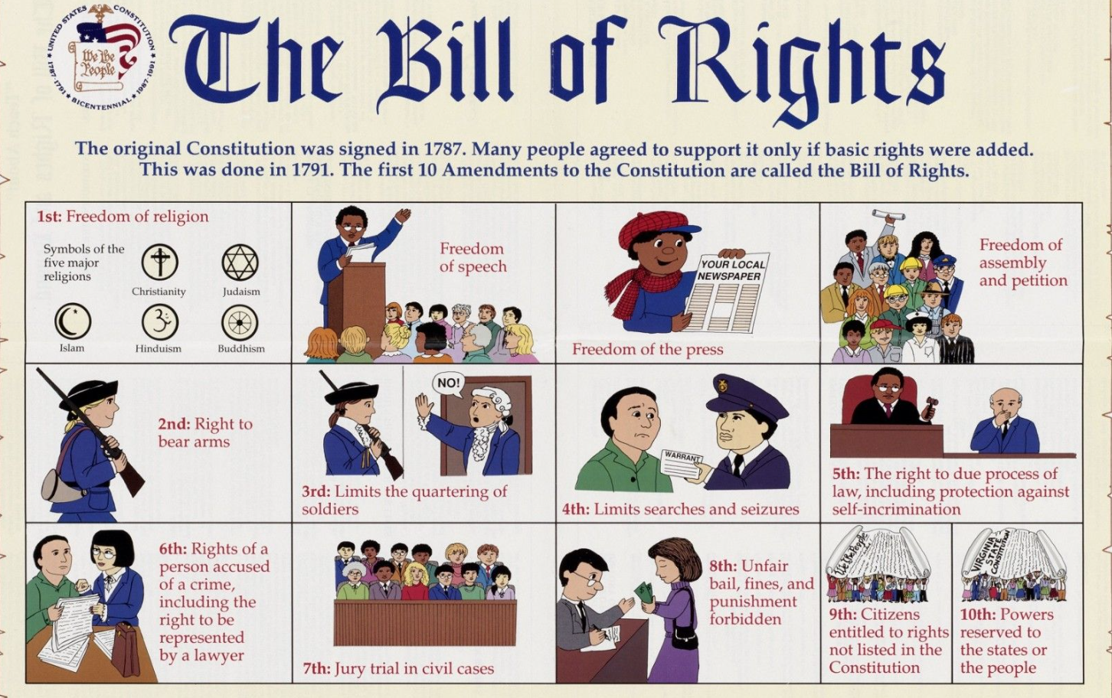

Slide 18
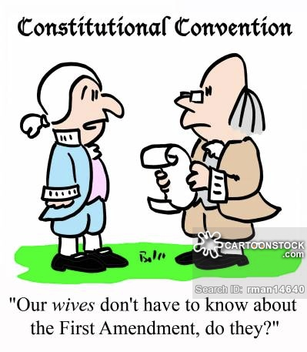


Slide 19
Video Clip:
1.5 Minutes, Studies Weekly – Constitution: Convention and Ratification https://www.youtube.com/watch?v=X7jRFbvPcGI&list=PLkfZOP2_jHb40ukfkzSpNQ9LcpUC8JW1R&index=35
5 Minutes, Shmoop – The Constitution https://www.youtube.com/watch?v=9mP-nkFg5_E&list=PLkfZOP2_jHb40ukfkzSpNQ9LcpUC8JW1R&index=66
3.3 Minutes, Smart Songs – Constitution Rap: https://www.youtube.com/watch?v=UCJ2of4kx5E&list=PLkfZOP2_jHb40ukfkzSpNQ9LcpUC8JW1R&index=62
9.5 Minutes, Mr. Heimler – Ratification of the Constitution: https://www.youtube.com/watch?v=oiT2-yweWZQ&t=256s

