Slide 1
Trade, Development and Resources in the US and Global Economy

Slide 2
Resources in the US Economy
Human Resource
Migrant Worker – move around to follow work
Example: agricultural workers move throughout the country to pick fruits and vegetables as various crops come in season
Immigrants – come to the US to find work. Many immigrants work in low paying jobs that are unwanted by Americans

Slide 3
Resources in the US Economy
Capital Resource
Business locate their companies where their can maximize profit
Example: cheap labor, high demand for product
Many companies have found it profitable to locate their headquarters in a central location
Example: Research Triangle Park, Silicon Valley
Research Triangle Park – an industrial park near Raleigh, Durham, and Chapel Hill, in the Research Triangle region of NC
Silicon Valley – a region in California south of San Francisco that is noted for its concentration of high-technology industries

Slide 4
Terms to know…
Outsourcing
Goods and services are provided by someone outside of the company
Outsourcing is done to save money, improve quality, or free company resources for other activities
Critics argue that outsourcing decreases the quality of a good or service
Downsizing
The selling off, closure of some plants, combination of business operation that perform the same functions, and/or cost cutting of an enterprise, usually deals with a decrease in labor

Slide 5
Leading Economic Indicators
GDP – Gross Domestic Product
Measures the output of the entire economy
Personal Income
Measures the total income of families in one year, higher the income the more money they have to spend
Stock Market, Averages (S & P 500, The Dow)
Reflects investor attitudes and movement of interest rates

Slide 6
Leading Economic Indicators
Unemployment Rate
Reflects layoffs of workers; how many unemployed at one time
Building Permits
Indicates construction activity
Manufacturer new orders
Predicts actual production change
Consumer Price Index and CPI Market Basket
Measures the rate of change in the price of 400 consumer goods

Slide 7
Measuring the Economy
GDP: Gross Domestic Product
The dollar value of all final goods and service produced within a country’ borders in a given year
Nominal GDP – GDP measured in current prices
Real GDP – GDP measured in constant unchanging prices
GDP = Consumption + Investment + Government Spending + Net Exports (exports – imports)

Slide 8
Measuring the Economy
Per Capita GDP: a country’s GDP divided by population
2005 US GDP: $12.77 Trillion
Population - 295,734,134
Per Capita GDP - $41,800
2005 China GDP: $8.158 Trillion
Population – 1,306,313,812
Per Capita GDP - $6,200
Per capita GDP can often be used to compare countries and their standard of living (economic prosperity)

Slide 9
Measuring the Economy
GNP: Gross National Product
Value of goods and service produced within a country in one year, plus income earned by citizens abroad, minus income earned by foreigners in the country
GNP – goods and services produced + money earned by citizens abroad – income earned by foreigners in the US
CPI: Consumer Price Index
An average of a specified set of goods and services
Measures the purchasing power of the dollar

Slide 10
Economic Development
Historically, economists divided the world’s nations into 3 categories:
1st World Countries: The wealthiest countries (industrialized)
2nd World Countries: Communist countries
3rd World Countries: The poorest countries (primarily agricultural

Slide 11
Economic Development
Now, economists just use 2 categories
Developed Countries – the wealthiest countries (US, Canada, western European Countries, Australian, New Zealand, Japan, etc.)
Less Developed Countries (LDCs) or Developing Countries – poorer countries (this includes the poorest countries in the world and other countries like Mexico, Saudi Arabia, and former Soviet countries that haven’t reached a high standard of living for most citizens)

Slide 12
Economic Development
The primary measure is per capita GDP (nation’s GDP/population). Other measures include:
Energy Consumption – more energy consumption, more developed (b/c more industrial)
Labor Force – more industrial jobs (vs. agricultural), more developed
Consumer Goods – more consumer goods produced per capita, more developed
Literacy – higher literacy rates, more developed
Infant mortality rate – lower infant mortality rate, more developed
Infrastructure – more infrastructure , more developed

Slide 13
Economic Development
Several countries have made dramatic recent economic improvement including:
Mexico, Brazil, Malaysia, and the “four Asian tigers,” Singapore, Hong Kong, South Korea, and Taiwan

Slide 14
Economic Development Organizations
The World Bank is an international organization devoted to assisting development. Uses per capita GNP to categorize countries
The International Monetary Fund (IMF) is an international organization (almost all UN nations belong) that monitors exchange rates and balance of payments, and provides technical and financial assistance as needed

Slide 15
Economic Development
As our economy has become more global, several issues are of recent concern:
Out-sourcing – transferring work to another country (esp. of concern in the computer industry and customer service)
Child Labor, Human Rights and Environmental Violations many developing nations do not protect the rights of workers or the environment. Some feel it is morally wrong to support these nations by buying their products or using their labor and hope that economic pressure may bring about needed reforms. Some products boast a “fair trade” label which means that the product has been produced according to minimum standards for labor, environment, and wages.

Slide 16
Economic Development and concerns
A company’s profit motive often leads to conflicts. These include:
Environmental Concerns
The government must set regulations so that the environment is protected. (Primarily the EPA)
Ex. Clean Air and Water Act – limits the amount of pollution companies are allowed to generate
Toxic materials are also highly regulated (ex. Radioactive materials)
This can lead to the NIMBY debate (Not In My BackYard) – no one wants toxic waste dumped in their state

Slide 17
Economic Development and concerns
Political Concerns
The US and other nations use economic measures to put pressure on other countries for a variety of reasons. (Countries that violate human rights, deny democracy, engage in nuclear weapon proliferation)
Examples
Cuban Economic Embargo
OPEC Oil Embargo
Possible economic sanctions with Iran
Concerns that Protect the Public
Examples
Zoning Laws
Building Codes

Slide 18
International Trade
Why do countries trade?
International trade allows nations to produce a limited number of good based on their resources while consuming a variety of goods
Comparative Advantage
The ability to produce a product most efficiently given all the other products it could produce
Law of Comparative Advantage
A nation is better off producing goods and services for which it has a comparative advantage.

Slide 19
International Trade
Terms
Export
A good sent to another country
Import
A good brought in from another country
Trade Balance
The relationship between a nation’s imports and its exports
Favorable Balance of Trade
A country with a trade surplus
Trade Deficit
Nation imports more than it exports

Slide 20
International Trade
Tariff
A tax on imported goods
Import Quota
A trade barrier that limits the amount of a good that can be imported
Embargo
Complete barrier to trade with a country
NO Trade (ex. Cuba)
Exchange Rates
Allow one to convert prices in one currency to prices in another currency

Slide 21
International Free Trade Agreements
WTO (World Trade Organization): founded in 1995 to ensure countries were reducing tariffs and expanding world trade, also to negotiate new trade agreements and resolve trade disputes.
European Union (EU): formed in 1993 a union of countries that agreed to abolish tariffs and trade restrictions among members and adopt uniform tariffs for non-members. Uniform monetary unit: The Euro

Slide 22
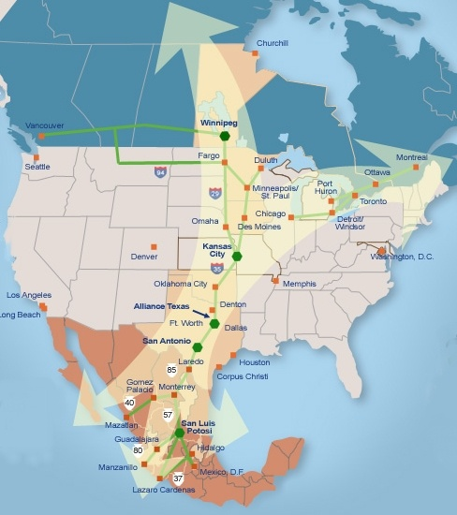
International Free Trade Agreements
NAFTA (North American Free Trade Agreement); a trade region that will eliminate tariffs and trade barriers between Canada, Mexico and the US by 2009 creating the world’s largest free trade zone.

Slide 23
North Carolina’s Role in the Global Economy
North Carolina, with its unique mix of industries, from information technology, biotech, and banking, to the traditional sectors of textiles & apparel, furniture, tobacco, and hog farming, is a microcosm of trends observed elsewhere in the United States.
North Carolina has had to reinvent itself from an economic standpoint multiple times in order to stay relevant in the global economy
Agricultural to Industrial
Textiles and Furniture to White Collar
Change over in White Collar (Banks to Energy and Technology)

