Slide 1
Supply and Demand Production and costs price

Slide 2
Demand
Desire to want something and the ability to pay for it

Slide 3
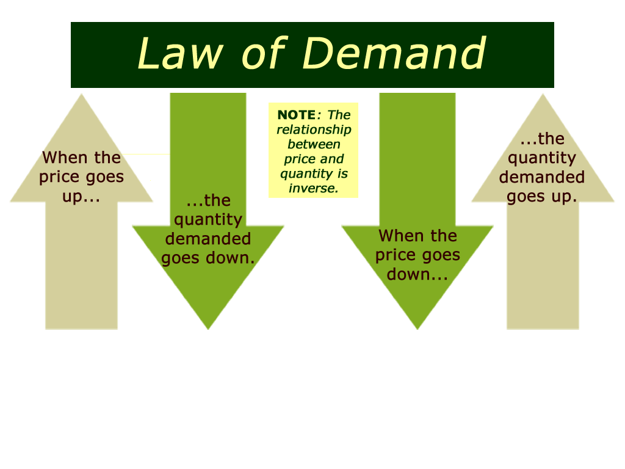
Law of Demand
When the price of goods goes down, then demand goes up and if the price goes up, then demand goes down
Graphing Demand
Demand Schedule – data table of demand and price
Demand Curve – graph representation of demand schedule

Slide 4
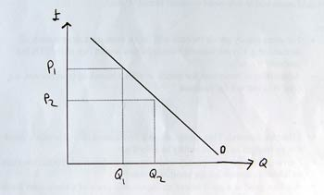
Demand Curve Shifts
If all things are constant in the market, it is called ceteris paribus (Latin for all constant)
What causes shift in demand?
Income/Budget
Consumer Expectations
Consumer Tastes
Advertising
Price of Related Goods

Slide 5
Demand Elasticity
Measurement of consumer reaction to price changes
If continue to buy if price increases = inelastic demand
If limited or stopped buying if price increases = elastic demand

Slide 6
Demand Elasticity
Factors of Elasticity
Available of Substitute goods
Importance of goods
Necessities v. Luxuries
Change over Time

Slide 7
Elasticity and Revenue
Revenue – firms total $$ made from selling goods and services
Elastic demand – as price decreases, revenue increases and as price increases, then revenue decreases
Inelastic demand – as price decreases, revenue decreases and as price increases, then revenue increases

Slide 8
Supply
Amount of goods available

Slide 9
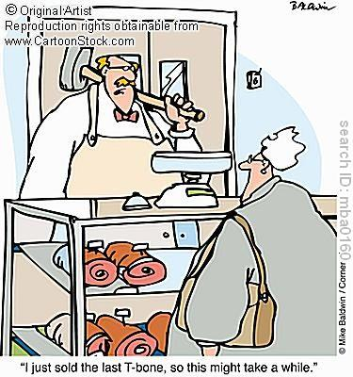
Law of Supply
When price is high, quantity supplied is high, and when price is low, quantity is low
Quantity supplied – the amount a supplier is willing and able to supply at a certain price

Slide 10
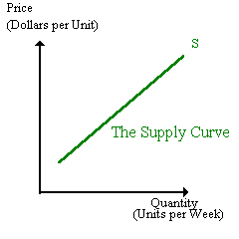
Graphing Supply
Supply Schedule – a chart that lists how much of a good a supplier will offer at different prices
Supply Curve – a graph of the quantity supplied of a good at different prices

Slide 11
Supply Curve Shifts
Input Costs – any change in the cost of an input used to produce a good; such as raw materials, machinery, or labor will affect supply
How does input cost affect supply?
A rise in the cost of an input will cause a fall in supply at all price levels because the good has become more expensive to produce

Slide 12
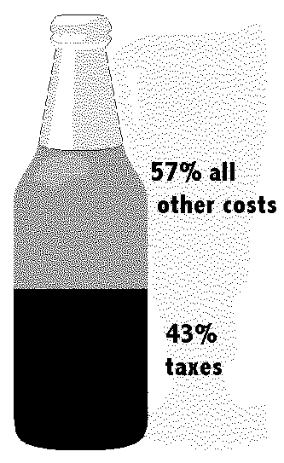
Government Influence
How does each of the following affect supply?
Subsides – a government payment that supports a business or market can either protect or harm supply
Taxes – excise tax – a tax on the production or sale of a good or service – “sin” tax – taxes that inhibit suppliers and make it more difficult to afford – Alcohol, Tobacco, Gas

Slide 13
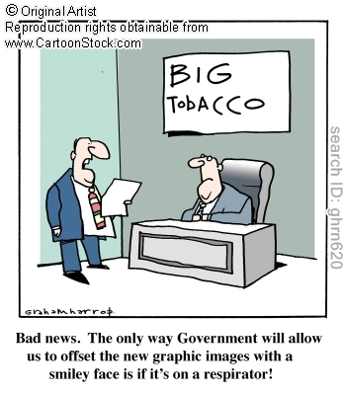
Government Influence
Regulation – Government intervention in a market that affects the production of a good; hurts supply typically because it costs more to supply, because the government is trying to protect the public

Slide 14
Supply Elasticity
Measurement of the way suppliers respond to change in price
Elastic Supply – the price is determined by the amount of supply
Inelastic Supply – increase or decrease in price has NO effect on supply

Slide 15
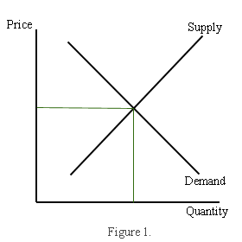
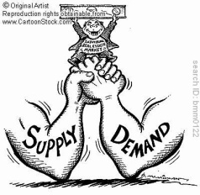
Supply and Demand
Equilibrium Point – the point at which Supply and Demand (quantity supplied and quantity demanded) are equal, a point of balance is reached
Point of balance = Equilibrium Price
Disequilibrium – when there is no point at which the amount supplied = the amount demanded; can have either a excess demand or excess supply

Slide 16
Supply Production
Labor and their Output
How many workers needed to produce?
Basic question business owners must answer everywhere
Marginal Product of Labor
The change in output from hiring one additional unit of labor

Slide 17
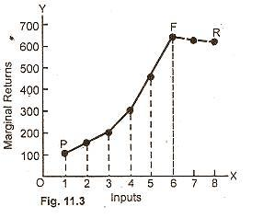
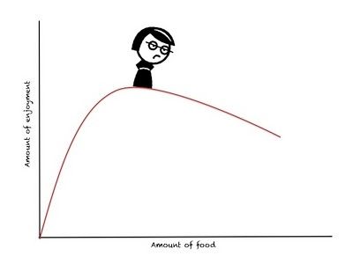
Supply Production
Law of Increasing Marginal Returns
A level of production in which the marginal product of labor increases as the number of workers increases
Law of Diminishing Marginal Returns
A level of production in which the marginal product of labor decreases as the number of workers increases

Slide 18
Production Costs
The factors that contribute to the total cost of creating a good or providing a service

Slide 19
Production Costs
Two major costs
Fixed Costs – a cost that does not change, no matter how much of a good is produced
Ex. Rent, Machinery repairs, Property taxes, salaries
Variable Costs – a cost that rises or falls depending on how much is produced
Ex. Cost of raw materials, heating, electricity

Slide 20
Production Costs
Total Costs – Fixed Costs + Variable Costs
The product will cost more or they will restrict supply because of cost
Marginal Costs – the cost of producing one more unit of a good suppliers will produce
Suppliers will produce the most they can and still be profitable

Slide 21
Production Costs
Operational costs – the cost of operating a facility, such as a store or factory

Slide 22
Setting Output
Firms determine output to maximize profit
Marginal revenue is additional income from selling one more unit of a good
Output is determined by finding a level where marginal revenue = marginal costs
Firms reconsider marginal cost if prices change

Slide 23
Shifts in Equilibrium
Government Intervention
Price Ceilings – highest price allowed by law
Price Floors – lowest price allowed by law
Shifts in supply (either too much of an item or not enough)
Shifts in demand (either too many consumers or not enough)

Slide 24
Role of Price
Tool for distribution of resources
Move factors of production into suppliers’ hands and goods and services in to demanding hands

Slide 25
Types of Goods
Normal Goods – Goods in demand more when income increases
Inferior Goods – Goods in demand less when income increases
Substitution Goods – Goods that replace other goods
Complimentary Goods – Goods that are used together with other goods

Slide 26
Advantages of Prices
Incentives – to make a profit and grow markets
Signals – communication for buyers and sellers
Low Price
Red light to producers that a good is being overproduced
Green light to consumers to buy more of a good because of a low opportunity cost
High Price
Green light to producers that a good is in demand and resources should be used to produce more
Red light to consumers to stop and think very carefully before buying

Slide 27
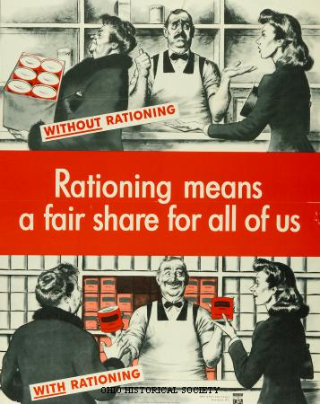
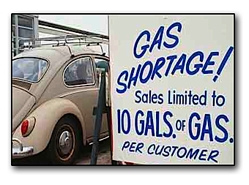
Disadvantages of Price
Rationing – a system of allocating scarce goods and services using criteria other than price
Shortages – a situation in which a good or service is unavailable, or a situation in which the quantity demanded is greater than the quantity supplied

Slide 28
Disadvantages of Price
Both result in the formation of a Black Market
Black Market – a market in which goods are sold illegally

