Slide 1
PERSONAL FINANCIAL LITERACY
Unit 9 Money in the Real World

Slide 2
WAYS TO MAKE MORE MONEY
Savings & Investing

Slide 3
QUESTION: WHAT ARE RATIONAL DECISIONS?

Slide 4
ANSWER
Decisions made after analyzing the trade offs and opportunity costs

Slide 5
IS THIS RATIONAL???
1. Continually raising your credit limit & transferring balances between credit cards.
2. Deciding to not a all get health insurance if you can afford it.
3. Paying above the minimum balance due?
4. Purchasing a house worth $300,000.00 if your combined income is only $70,000.

Slide 6
SAVINGS
Money you set aside that grows with interest.

Slide 7
CHECKING
Account for money you can withdraw to make purchases

Slide 8
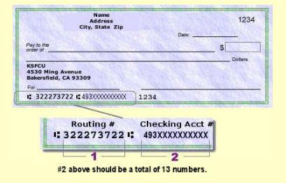

Slide 9
STOCKS
Buying a small piece of a company to make money off the companies’ profits & value

Slide 10
BONDS
You lend money to the government or company, so they will pay you back with interest

Slide 11
MUTUAL FUNDS
Pooling your money with others to buy stocks, bonds or other investments.

