Slide 1
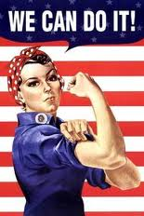

Public Opinion, Propaganda & Interest Groups

Slide 2
Public Opinion – How formed?
  Personal back ground: how you grew up
  Mass Media: communication methods

Slide 3

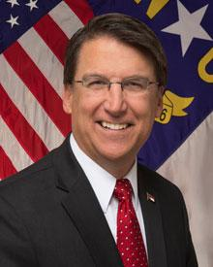
Public Opinion – How formed?
Public Officials – people you trust & vote for
Interest Groups – group you join because you share those interests

Slide 4


Interest Groups
  Economic Interest Groups: An organization that supports economic interests.
Examples: AFL-CIO [labor unions], AMA [for doctors]

Slide 5


Interest Groups
  Public Interest Groups: organizations that support causes that affect the lives of Americans in general.
Examples: Common Cause, League of Women Voters

Slide 6

Interest Groups
Ideological Groups – to promote certain ideas or types of people
Examples: The National Association for the Advancement of Colored People [NAACP], National Organization for Women [NOW], National Rifle Association [NRA], Sierra Club

Slide 7
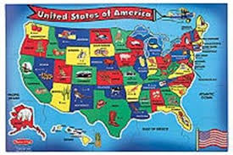
Interest Groups Influence Government
Support candidates favorable to their issue
Bring cases to court to right a wrong
Try to persuade lawmakers to create laws that support their issues

Slide 8
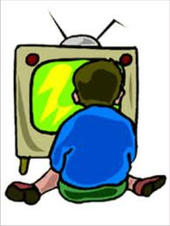
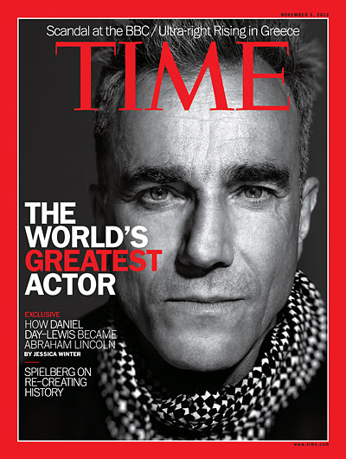
Mass Media
The mass media include both print and electronic modes of communication. Types of these include: newspapers, magazines, books, news letters, radio, TV, movies, and the internet.

Slide 9
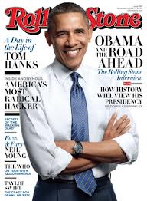
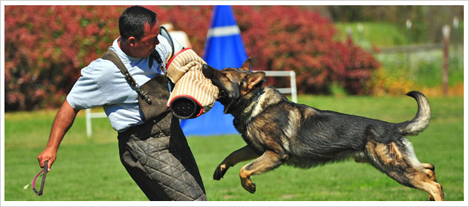
Media’s Impact?
Set public agenda – help show ‘important’ issues
Watchdog role – keep government from doing wrong
Candidates – seen as celebrities

Slide 10
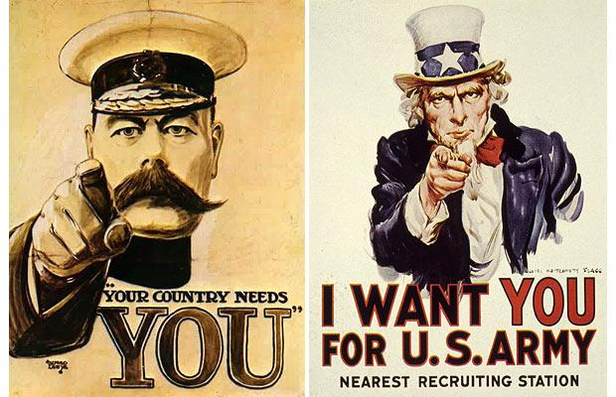
What is Propaganda?
A method used to persuade you to do something.

Slide 11

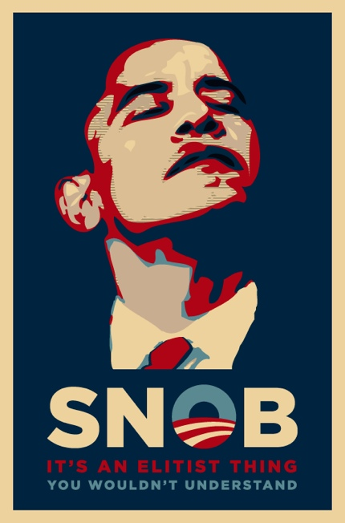
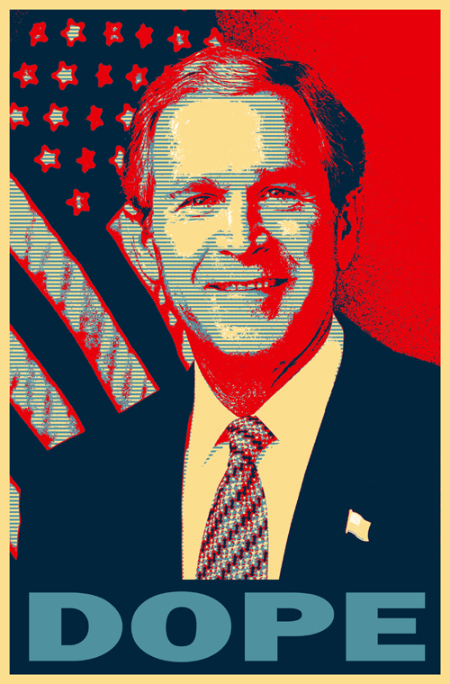
Name Calling & Card Stacking
Name calling is giving an opponent a bad name
http://www.youtube.com/watch?v=WV6mZfR258s
Stacked Cards: presenting only one side of an argument and telling all that is good or bad about something/someone
http://www.youtube.com/watch?v=U7SztN23Tsw

Slide 12

Bandwagon & Glittering Generality
  Bandwagon: persuading people to do something by letting them know others are doing it.
  http://www.youtube.com/watch?v=jvCTaccEkMI
  Glittering Generality: a statement that sounds good but is meaningless
http://www.youtube.com/watch?v=tdnD3-nArRU

Slide 13
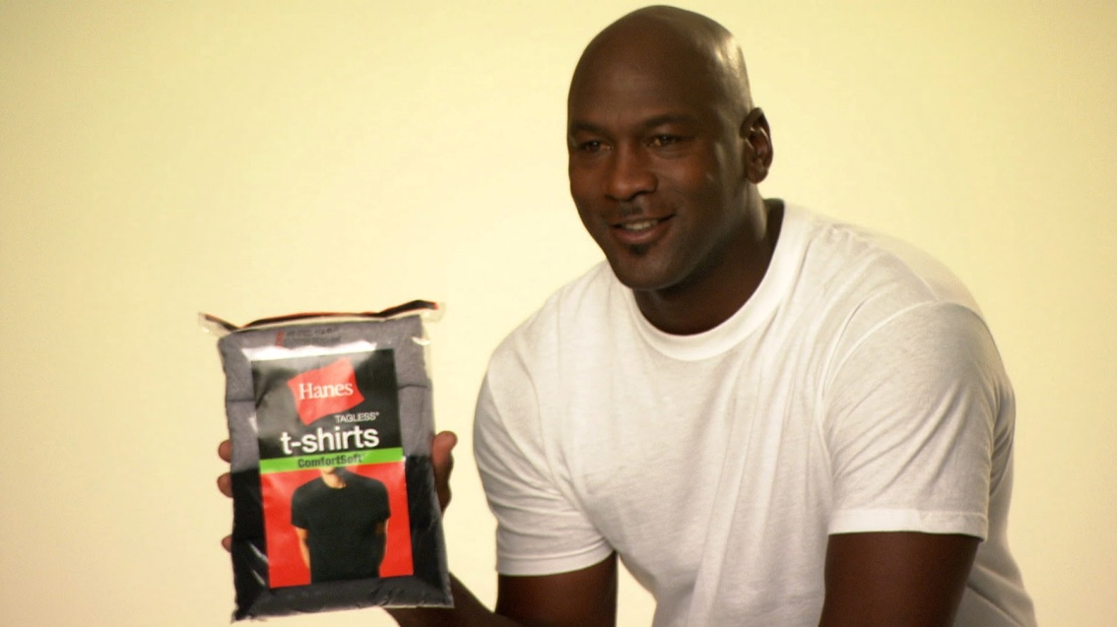
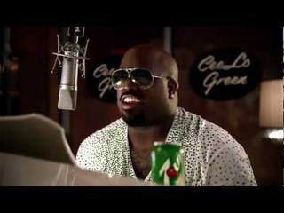
Testimonials & Endorsements
  using the words or a picture of a famous person to persuade you.
  http://www.youtube.com/watch?v=uDO9hP-xKL8

Slide 14
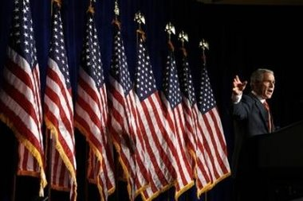
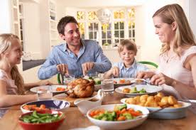
Symbols & Just Plain Folks
  Symbols: using symbols in commercials for appearances sake.
  Just Plain Folks: showing that a candidate is simply a ‘normal person’ like everyone else

