Slide 1
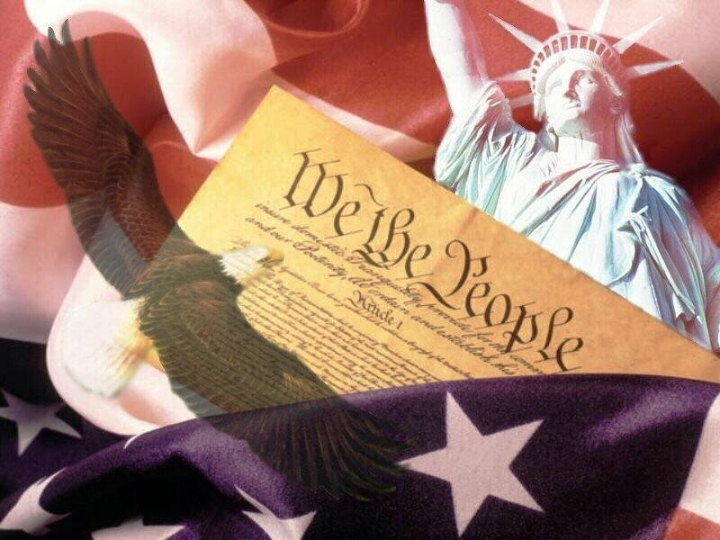
Principles of the Constitution

Slide 2
Warm UP
Based on our discussions to date, what do you suggest are the core values of the American democratic republic?

Slide 3
How do these ideals guide our government?
Principles guide the Constitution, just as principles guide people.
Principles are the values and beliefs of the country and help us make decisions.

Slide 4
Popular Sovereignty
Basic principle of the American system of government which asserts that the people are the source of any and all governmental power, and government can exist only with the consent of the governed

Slide 5
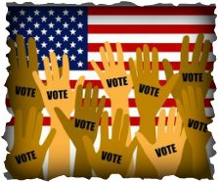
Popular Sovereignty
Popular Sovereignty means the government is controlled by the people.
Example(s) – People can run for office, campaign for individuals who run, protest decisions made by others, and vote.

Slide 6
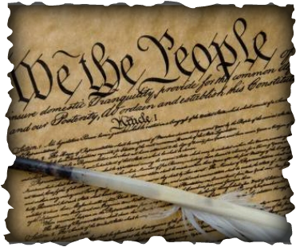
Where is Popular Sovereignty found in the Constitution?
Popular Sovereignty is found in the Preamble of the Constitution.
“We the People” means the people are in charge.

Slide 7
Related Concept: Consent of the Governed
■A condition urged by many as a requirement for legitimate government: that the authority of a government should depend on the consent of the people, as expressed by votes in elections.
■
■How elections are conducted becomes a meaningful question in light of this Constitutional principle.

Slide 8
Limited Government
Basic principle of the American government which states that government is restricted in what it may do, and each individual has rights that government cannot take away

Slide 9
Related concept: Rule of Law
What is the rule of law United States?
The rule of law implies that every person is subject to the law, including people who are lawmakers, law enforcement officials and judges. In this sense, it stands in contrast to tyranny or oligarchy, where the rulers are held above the law. Instead, the power of government and officials is limited.

Slide 10
Rule of Law
…requires measures to ensure adherence to the principles of supremacy of the law, equality before the law, accountability to the law, fairness in the application of the law, separation of powers, participation in decision-making, legal certainty, avoidance of arbitrariness, and procedural and legal transparency.

Slide 11
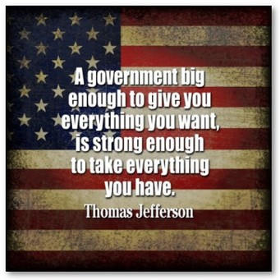
Where is limited government found in the Constitution?
Articles 1, 2, and 3 explain why/how each member of government and branch of government is limited.
The Bill of Rights explains
what the government
cannot do.

Slide 12
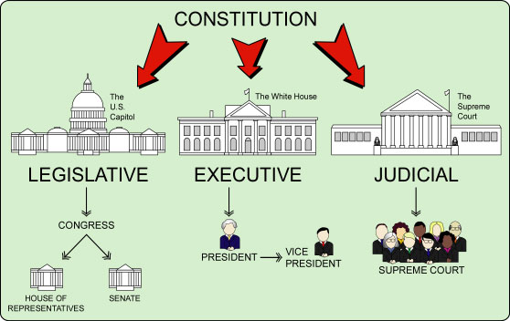
Separation of Powers
Basic principle of the American system of government, that the executive, legislative, and judicial powers are divided among three independent and coequal branches of government

Slide 13
The Legislative Branch
The Legislative Branch is also called Congress.
The Legislative Branch passes laws.
The Legislative Branch has two houses: The House of Representatives and the Senate.
The Senate is the “upper house” of the Senate.
It has 100 members. Each state gets two members.
-------------------------------------
The House is the “lower house” of Congress.
The House has 435 members.
House membership is based on the population of each state.

Slide 14
The Executive Branch
The Executive Branch is the President, Vice President, the Cabinet, executive departments, independent agencies, regulatory commissions, and others (federal bureaucracy).
The Executive Branch enforces the laws. They make sure the laws are followed.

Slide 15
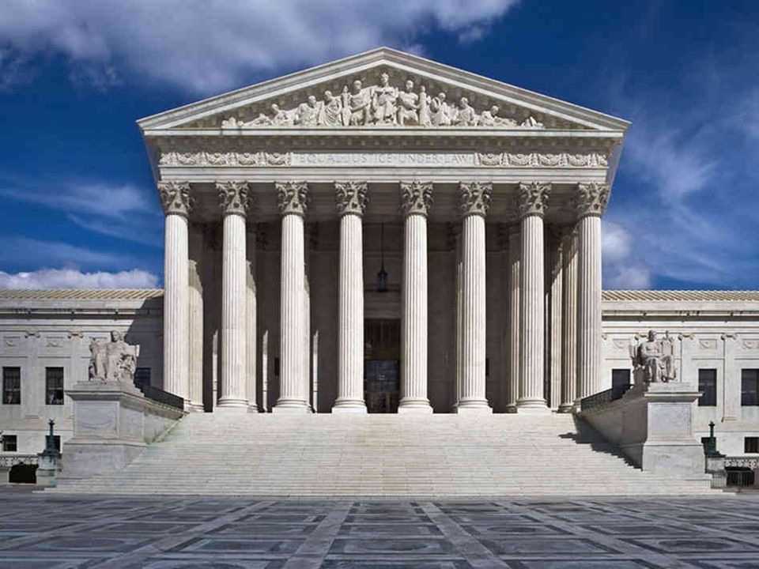
The Judicial Branch
The Judicial Branch is the Supreme Court and the lower federal courts.
The Judicial Branch interprets the laws.

Slide 16
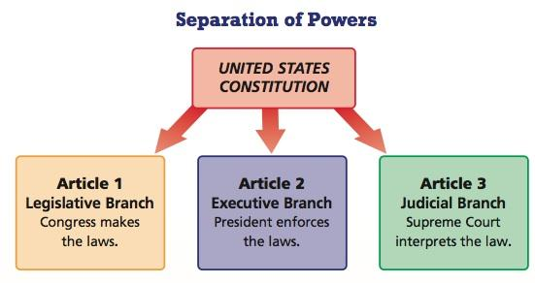
Where is the Separation of Powers found in the Constitution?
Separation of Powers is in Articles 1, 2, and 3 of the Constitution where each branch is given its roles and responsibilities.

Slide 17
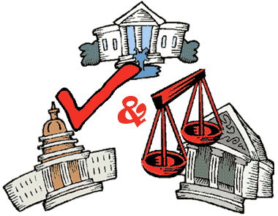
Checks and Balances
System of overlapping the powers of the legislative, executive, and judicial branches to permit each branch to check the actions of the others

Slide 18
Checks and Balances
Each of the 3 branches of government has some control, or check, on the other 2 branches.
Example – Federal judges are nominated by the President, but have to be approved by Congress.

Slide 19
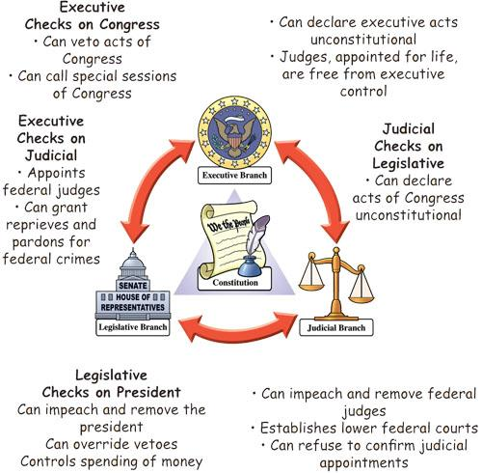
Checks and Balances
Checks and Balances are found in Articles 1, 2, and 3 of the Constitution. Where each branch is given power over the others.

Slide 20
Where are Checks and Balances found in the Constitution?
Checks and Balances are found in Articles 1, 2, and 3 of the Constitution. Where each branch is given power over the others.

Slide 21
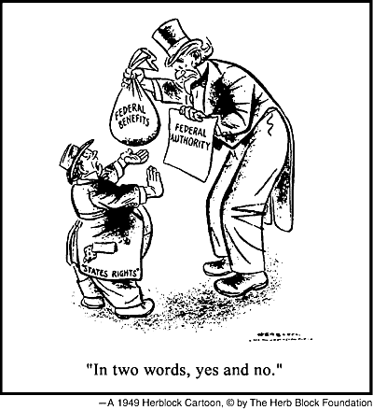
Federalism
A system of government in which a written constitution divides power between a central, or national, government and several regional, or state, governments
Some powers are reserved to
the Federal government, some
are given to the States, and
some are concurrent or
shared!

Slide 22
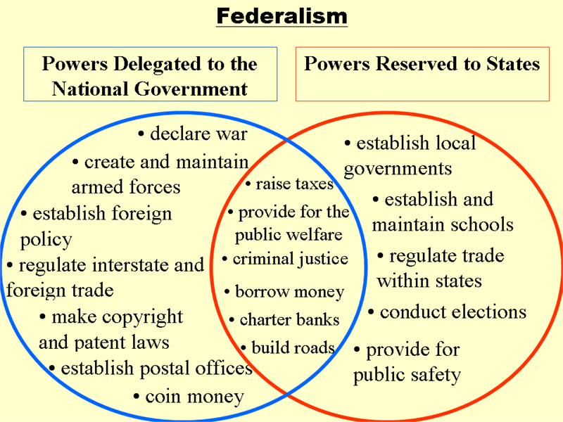
Federalism

Slide 23
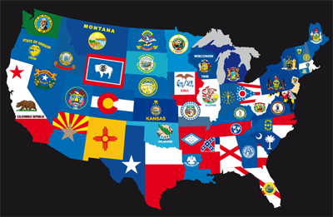
Where is Federalism found in the Constitution?
The 10th amendment
is called the federalism
amendment.
Article 4 explains
how federalism
works.

Slide 24
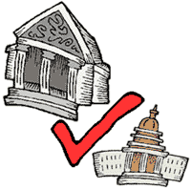
Judicial Review
The powers of a court to determine the constitutionality of a governmental action. Judges can declare a law unconstitutional and stop laws that have already passed.

Slide 25
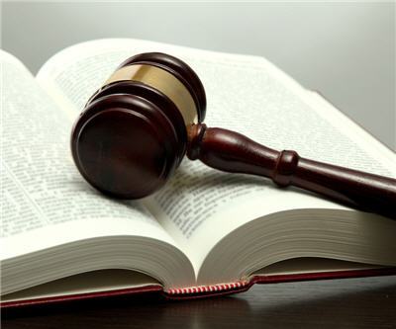
Where is Judicial Review found in the Constitution?
It isn’t! This power comes from a Supreme Court Case – Marbury v. Madison, 1803

Slide 26
Underlying democratic concepts...
A democratic government needs to be based on MAJORITY RULE but it must also take action to respect the RIGHTS AND VOICES OF THE MINORITY.
INQUIRY ASSIGNMENT

