Slide 1
PERSONAL FINANCIAL LITERACY
Unit 9 Money in the Real World

Slide 2
INSURANCE

Slide 3
HOW INSURANCE WORKS:
Insurance – essentially a bet between you and your insurance company.
Your bet – you will get sick / have an accident
Their bet – You will not get sick / have an accident
The risk (various factors that affect your health) you have plays into the cost of your insurance

Slide 4
INSURANCE VOCABULARY
Premium – money paid to the insurance company for your policy. (If you remain accident free and healthy, the insurance company makes money)
Deductible – the amount of money you must pay before the insurer will cover any expenses.
Replacement cost – the cost it would take to replace the damaged item
Actual Cash Value – worth of the item before the accident.

Slide 5
EXAMPLE-
Itemized Bill:
Surgical Removal: $1,087
Hospital Admission & Stay: $9,866
(includes the ER visit and 4 days)
Surgical Anesthesia: $537
Total Bill : $11, 490
You feel a sudden sharp pain on your right side, its agonizing so you go to the ER. Turns out your appendix is rupturing and must be removed. 4 Day hospital stay
Your Responsible for:
@ 70/30= .
@ 80/20= .

Slide 6
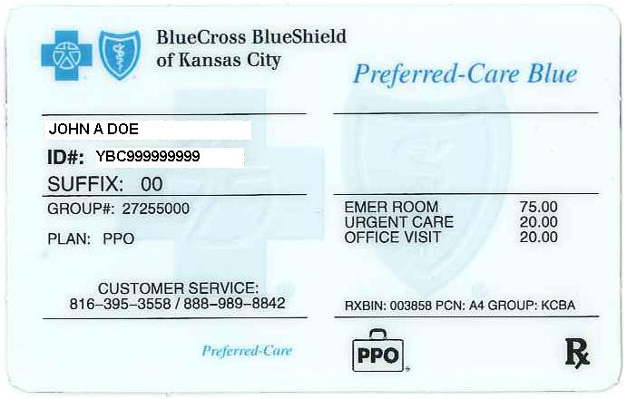
SAMPLE HEALTH INSURANCE CARD

