Slide 1
Free Market

Slide 2
The Free Market
What is a market?
A market is an “arrangement” that allows people to buy and sell items
Why are markets important?
No one is self-sufficient; as a result, people must exchange goods and services
In our society, people specialize. As a result, everyone does their own thing in hopes of being more efficient with the resources available

Slide 3
Free Market Economy
Free market economies are based on voluntary exchanges of goods and services
Factors of production are owned by individuals and businesses
Individuals answer the 3 basic economic questions
What to Produce?
How to Produce?
For whom to Produce?

Slide 4
Circular Flow
The flow of payments in an economy is a circular flow. Individuals--people living in households--work for businesses, rent their property (or their capital) to businesses, and manage and own the businesses. All these activities generate incomes--flows of payments from businesses to households. But households then spend their incomes--on consumption goods, in taxes paid to governments (that then spend the money on goods and services), and on assets like stock certificates and bank CDs that flow through the financial sector and are then used to buy investment and other goods. All these are expenditures
The two flows--of incomes and of expenditures--are equal: all expenditures on products are ultimately someone's income, and every piece of total income is also expended in some way

Slide 5
Circular Flow

Slide 6
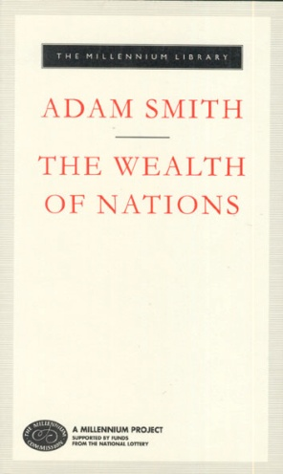
Free Market Economy
Self-Regulating nature of the Marketplace
Self-Interest is key – Adam Smith – The Wealth of Nations – because we all are looking out for our best interests, we are the motivating force of the free market
Competition – the regulating force – to sell as much as a company can, they must have the best price or the best item to sell

Slide 7
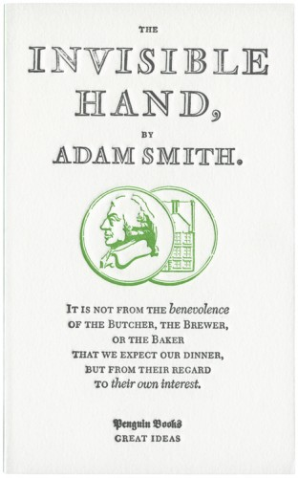
Free Market Economy
The Invisible Hand – a term coined by Adam Smith – term economists use to describe the self-regulating nature of the marketplace
The self-interest of people combined with the competition from businesses causes the market to work without any outside help

Slide 8
Advantages of a Free Market
Economic Efficiency – producers make only what consumers want, when they want, and at prices willing to be paid
Economic Freedom – including freedom to work where you want, firms to produce what they want and consumers to buy what they want

Slide 9
Advantages of a Free Market
Economic Growth – innovations and growth encouraged, entrepreneurs are trying to find new ways to do things
Additional Goals – consumer sovereignty the power of consumers to decide what gets produced – Wide variety of goods and services offered

Slide 10
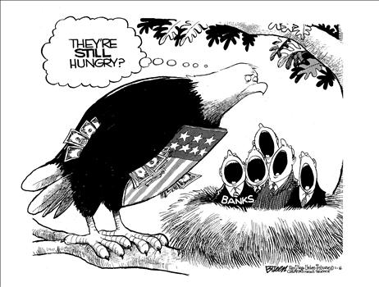
Free Market
NO PURE MARKET EXISTS ON ANY MEANINGFUL SCALE
Much of what makes a free market so attractive can also be a weakness

Slide 11
Free market vocabulary

Slide 12
Incentives
An expectation that encourages people to behave in a certain way

Slide 13
Laissez-Faire
The doctrine that states that government generally should not intervene in the marketplace

Slide 14
Innovation
something new or different introduced
something newly introduced, such as a new method or device

