Slide 1
5.6- Demonstrate how to be a responsible consumer in the 21st century.
What are common threats to your financial peace of mind and how do you spot them?

Slide 2
Identity Theft
Identity theft- crime which someone wrongfully obtains and uses another person’s info
Types of ID theft:
1- Phishing
2- Skimming
3- Credit Card theft

Slide 3
Phishing
Phishing- an attempt to acquire someone else’s identity by asking for sensitive information
Username, password, credit card, SN # etc.
What to watch for:
Generic greeting
Being asked to update personal information
www.espn.com
Forged link
Sense of urgency

Slide 4
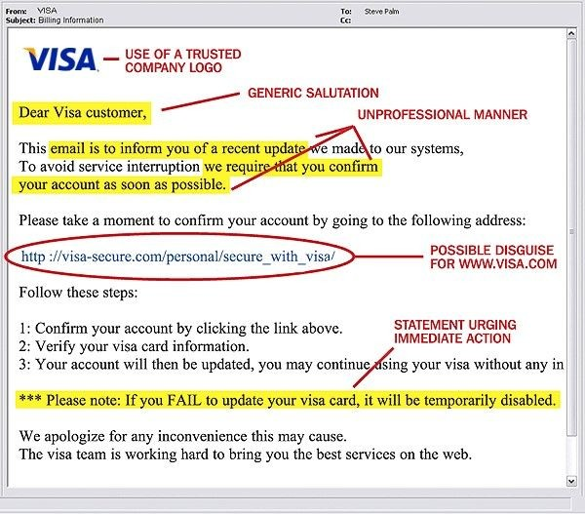
PHISHING

Slide 5
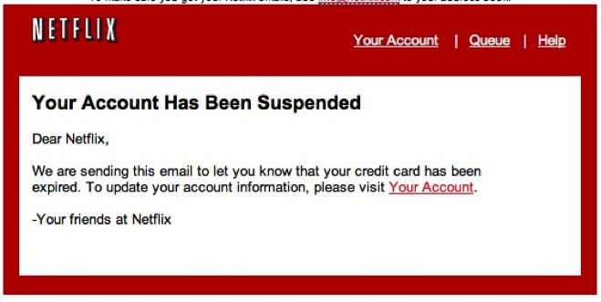
Phishing

Slide 6
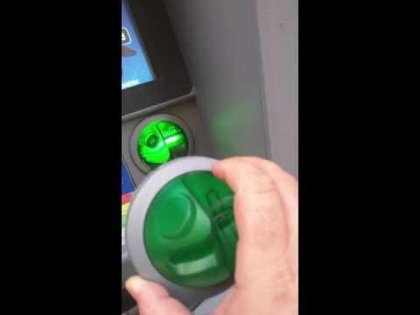
Skimming
Skimming- illegal copying of information from the magnetic strip of a credit or ATM card
What to watch for:
Unusual devices on the ATM swipe machine
Skimmer

Slide 7
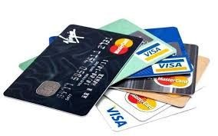
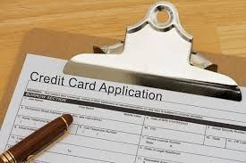
2 types of Credit Card Fraud
Account Takeover
Criminal hijacking of an existing credit card account
Application Fraud
Opening of credit card accounts in another person’s name

Slide 8
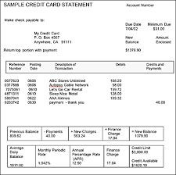
Credit and Debit Card Theft
Fraud spree: unauthorized charges on existing accounts
What to watch for:
Charges on your debit or credit card statement that you haven’t made
Hackers can steal account information from personal computers, business computers, or PUBLIC computers

Slide 9
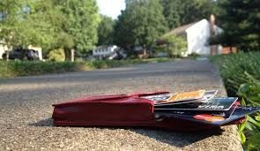
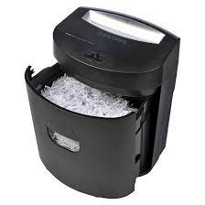
Ways thieves steal your information
Lost or stolen cards
Your mailbox
Stealing your PIN during a purchase or withdrawal
Your trash!
Hacking Email
Over the phone
Personnel records
Employees of a business stealing card info

Slide 10
Fraud
Fraud- deliberate deception for economic gain
Examples of Fraud:
1- Ponzi Schemes
2- Pyramid Schemes
3- Online Scams

Slide 11
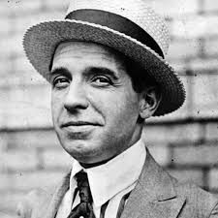
Ponzi Scheme
What is it?
People are convinced to invest in a fake company for great economic returns
Once the scheme artist feels that enough money has been collected, he disappears with the money
Named after Charles Ponzi in the early 1920s

Slide 12
Want to start your own ponzi scheme? Here’s how:
Convince a few people to invest
Return SOME money to investors
Convince more people to invest based on your original success
Many original investors will invest again
Repeat steps I-III a number of times
A. Then before step II in the cycle……..
V. Disappear without a trace
IV.

Slide 13
Madoff Ponzi Scheme Simulation
Madoff collects funds from individuals with the promise of making them 10% returns each year
Madoff takes a cut off the top
To pay off that 10% to clients, Madoff simply uses the money they have already given him and claims it as “returns” from stock investments.
What does he do when that money runs out and people are still expecting 10% returns each year?
Collects other clients funds, takes some more money off the top, and uses remaining funds from new clients to pay off returns with money he was raising from new customers.

Slide 14
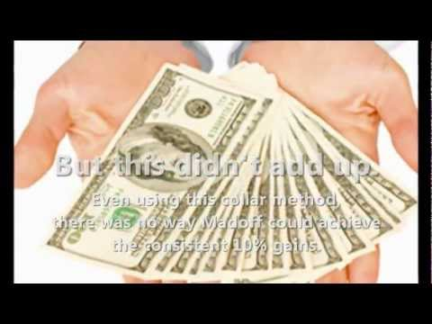

Slide 15
Pyramid Scheme
What is it?
Investment where each paying investor recruits (at least) two other investors. The first investor makes money from his recruits… they make money by recruiting more.
People at the top, make money from people at the bottom
Main characteristic: participants only make money by recruiting other members

Slide 16
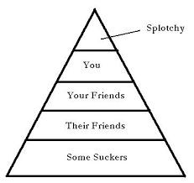
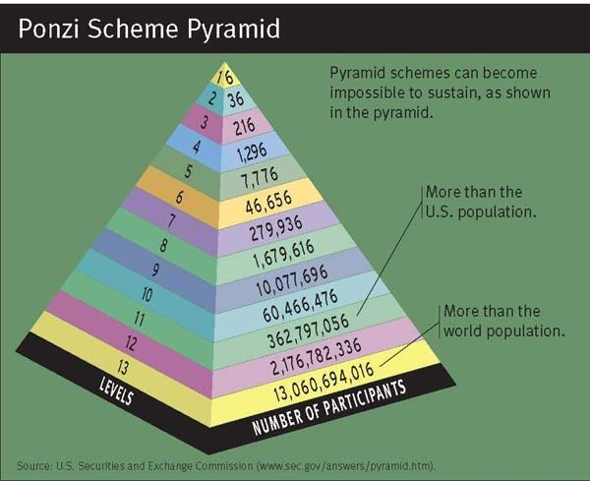
Pyramid Scheme displayed visually:

Slide 17
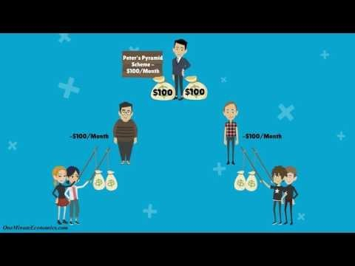
Ponzi Pyramid vs. Pyramid Scheme

Slide 18
Online Scams/Internet Fraud-
What to look for:
Work at Home Ads
Too good to be true
Fake charity organizations
Natural disaster relief funds are popular
“Be part of one of America’s fastest growing industries.”
“Be your own Boss.”
“Earn thousands of dollars a month from home, with minimal time commitment!”

Slide 19
Malware
“Malicious Software”
Includes viruses or spyware that gets installed on your computer, phone, mobile device, without your consent.
Can be used for fraud.

Slide 20
Phone Scams
Social Security Number has been suspended
There is no such thing, they are trying to get your personal information.
Threat of arrest if you don’t contact them
The IRS has a warrant for your arrest
The government contacts you by mail, not over the phone.
If you are unsure of a phone call being legit, ask to send them the info by mail. Don’t give them your address. If they are official, they will already have it.
Hang Up
https://vimeo.com/352056081

