Slide 1
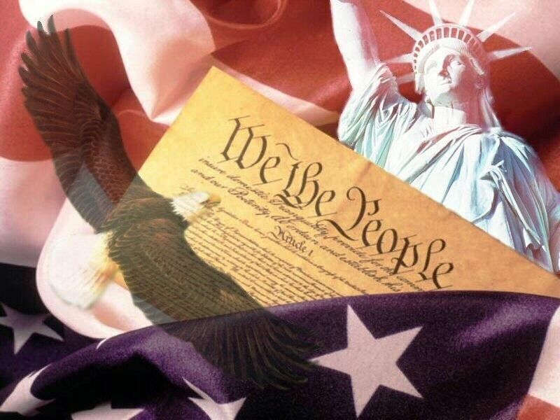
Four Principles of the Constitution

Slide 2
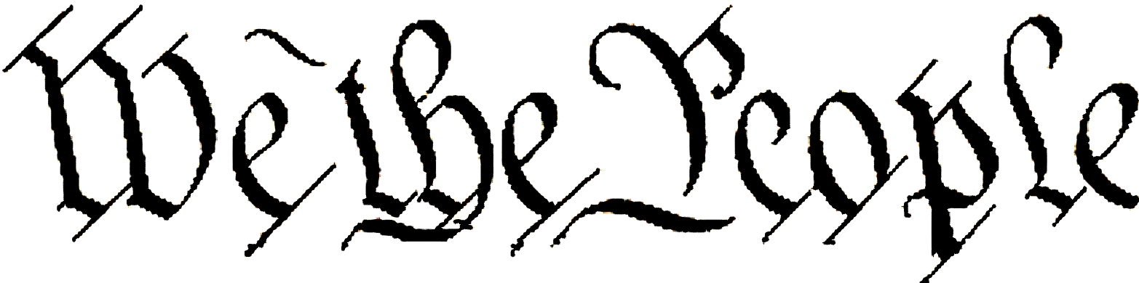
Popular Sovereignty
Basic principle of the American system of government which asserts that the people are the source of any and all governmental power, and government can exist only with the consent of the governed

Slide 3
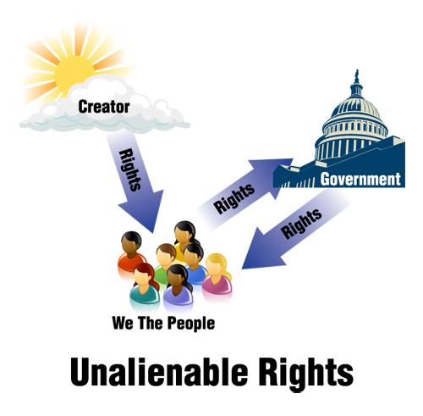
Limited Government
Basic principle of the American government which states that government is restricted in what it may do, and each individual has rights that government cannot take away

Slide 4
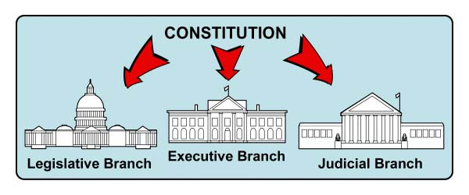
Separation of Powers
Basic principle of the American system of government, that the executive, legislative, and judicial powers are divided among three independent and coequal branches of government

Slide 5
As Part of Separation of Powers, there are Checks and Balances
System of overlapping the powers of the legislative, executive, and judicial branches to permit each branch to check the actions of the others

Slide 6
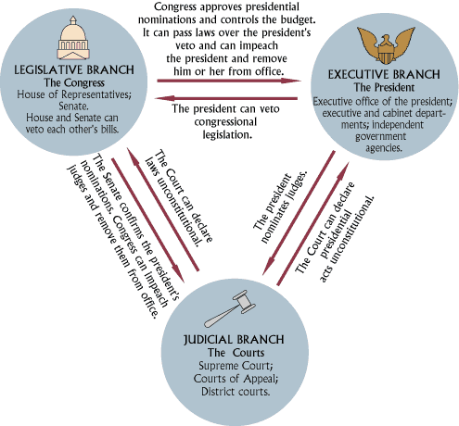
Checks and Balances

Slide 7
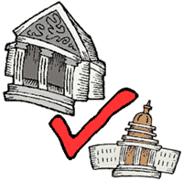
As part of Separation of Powers, there is also Judicial Review
The powers of a court to determine the constitutionality of a governmental action

Slide 8
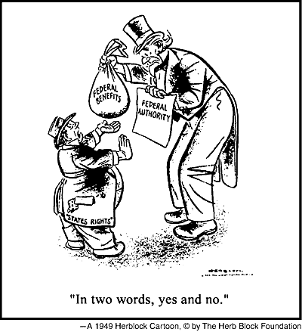
Federalism
A system of government in which a written constitution divides power between a central, or national, government and several regional, or state, governments

