Slide 1
The Executive Branch (Article II)
President
Vice President
Cabinet
Executive Depts. & Bureaucracy

Slide 2
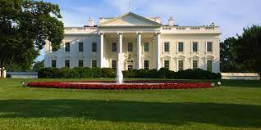
Warm up: 2 Truths and a Lie - Executive Branch Edition
The White House wasn’t officially given its name until the 20th century - and before that was called by various names like the Executive Mansion
George Washington lost all his teeth in childhood and wore dentures made of wood
Jimmy Carter was a peanut farmer before becoming President
Notes:
#2 is the lie - Washington had numerous full and partial dentures that were constructed of materials including human, and probably cow and horse teeth, ivory (possibly elephant), lead-tin alloy, copper alloy (possibly brass), and silver alloy

Slide 3
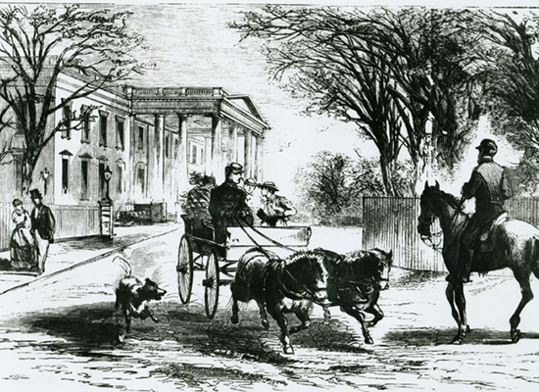
Warm up: 2 Truths and a Lie - Executive Branch Edition
John Adams and Thomas Jefferson died on the same day - July 4, 1826
There have been over 700 attempts made to abolish or change the Electoral College system
Hoover brought his prize-winning horse Liberty with him to live at the White House, and had a stable constructed on the East Lawn
Notes:
#3 is the lie

Slide 4
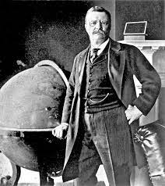
Warm up: 2 Truths and a Lie - Executive Branch Edition
The Department of Homesteading which created our national parks system was only abolished recently (2019)
Teddy Roosevelt was the first president to ride in a government car in office. His distant cousin Franklin Delano Roosevelt was the first to ride in an official state airplane while President.
Ronald Reagan was a famous movie star before becoming President
Notes:
#1 is the lie

Slide 5
The Executive Branch (Article II)

Slide 6
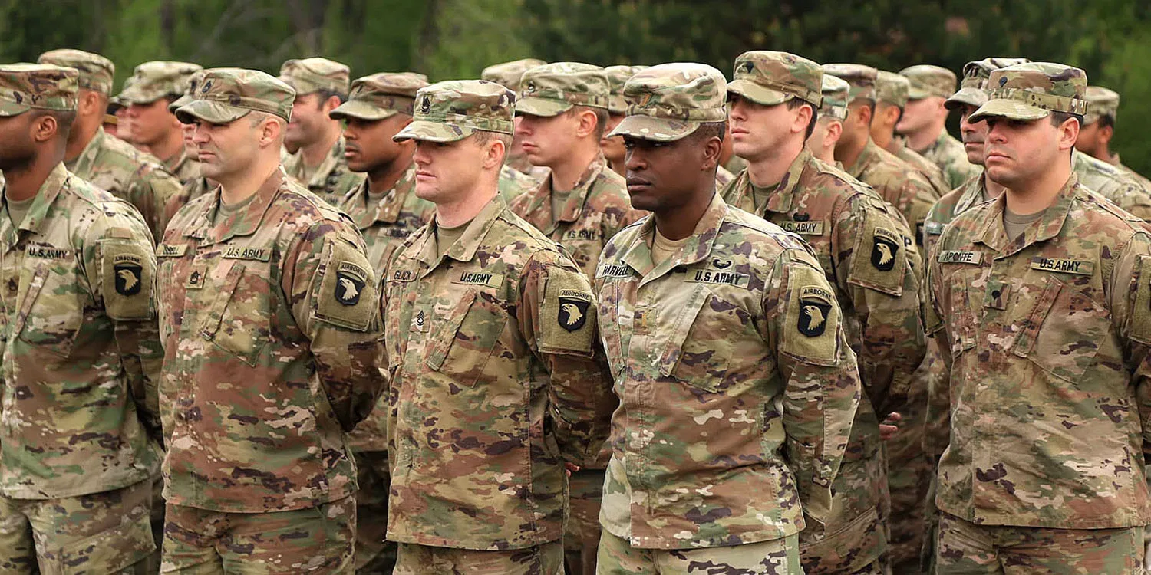
Executive Branch - Federal Government
Role is to enforce laws the of the US
Includes:
President
Vice President
Cabinet
Executive Departments & Federal Agencies
Over 4 million Americans are employed by the Executive branch (this includes the military, which is a part of the Department of Defense)

Slide 7
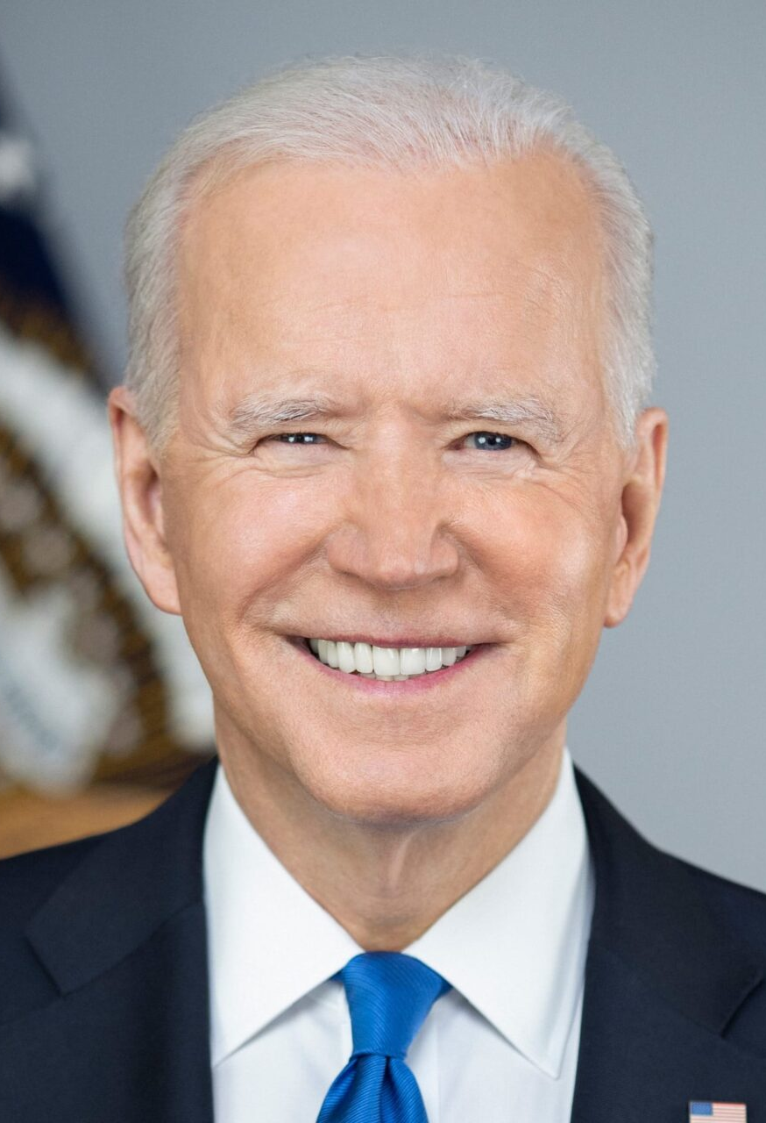
President of the United States
As leader of the executive branch, the President’s duties are to:
• Implement and enforce federal laws
-Appoints cabinet and other officials to
enforce laws
• Serve as head of state and Commander-in-Chief of the armed forces
• Meet with leaders of other countries

Slide 8
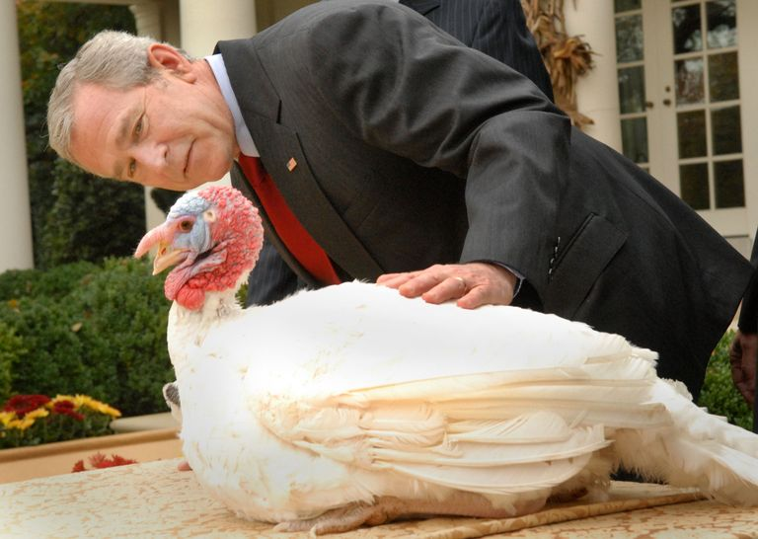
Other Presidential Powers
Receive ambassadors
Call special sessions of Congress
Grant reprieves & pardons for federal offenses (and to one lucky turkey each November!)
Executive Orders
These have force of law and are carried out as such, although they can be overturned by congressional legislation or the Supreme Court

Slide 9
Shared Powers
With Senate:
Make treaties
Appoint ambassadors, judges, other officials
With Congress:
President must approve legislation by signing into law
If presidential veto is used, bill will not become law unless Senate overrides veto (⅔ vote)

Slide 10
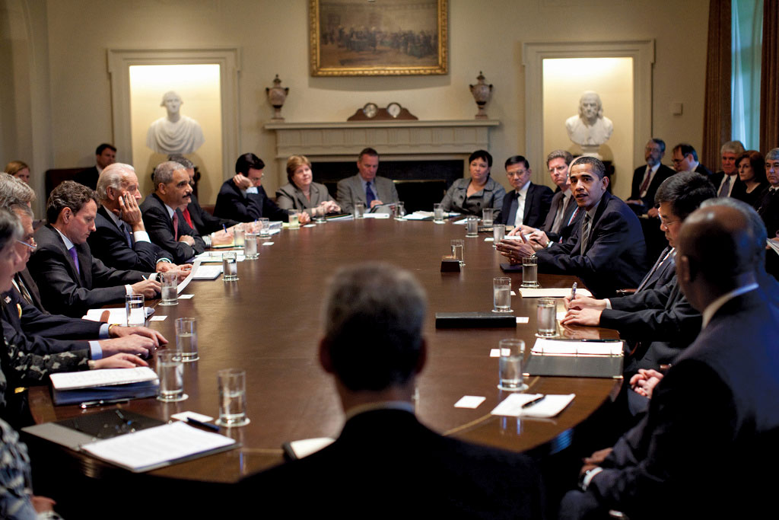
Cabinet
Advise and support the President in carrying out laws of the US
Made up of the Vice President and heads of 15 executive departments (called Secretaries)
Vice President also serves as President of the Senate and becomes President if the President can no longer do the job.

Slide 11
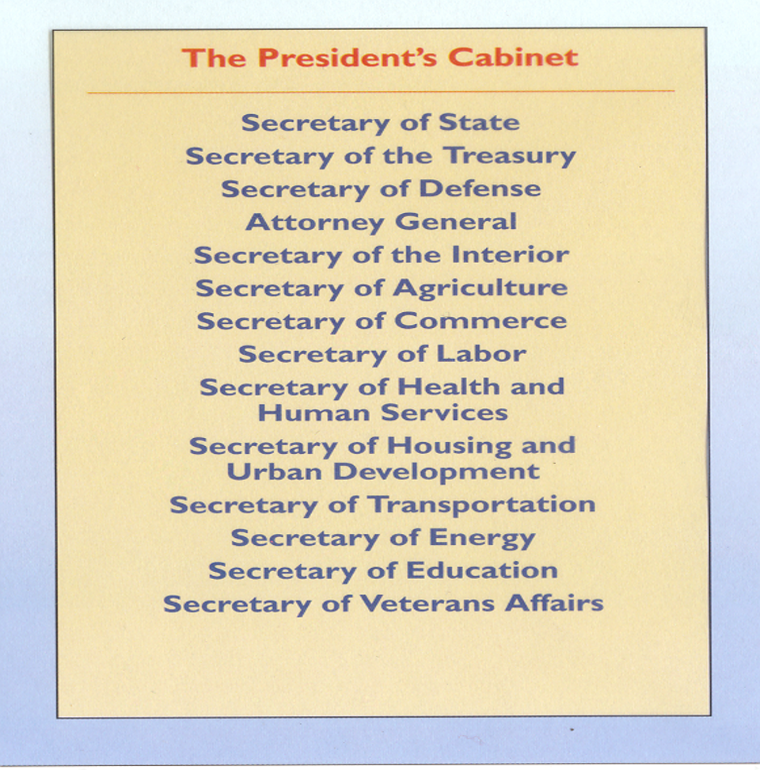

Slide 12
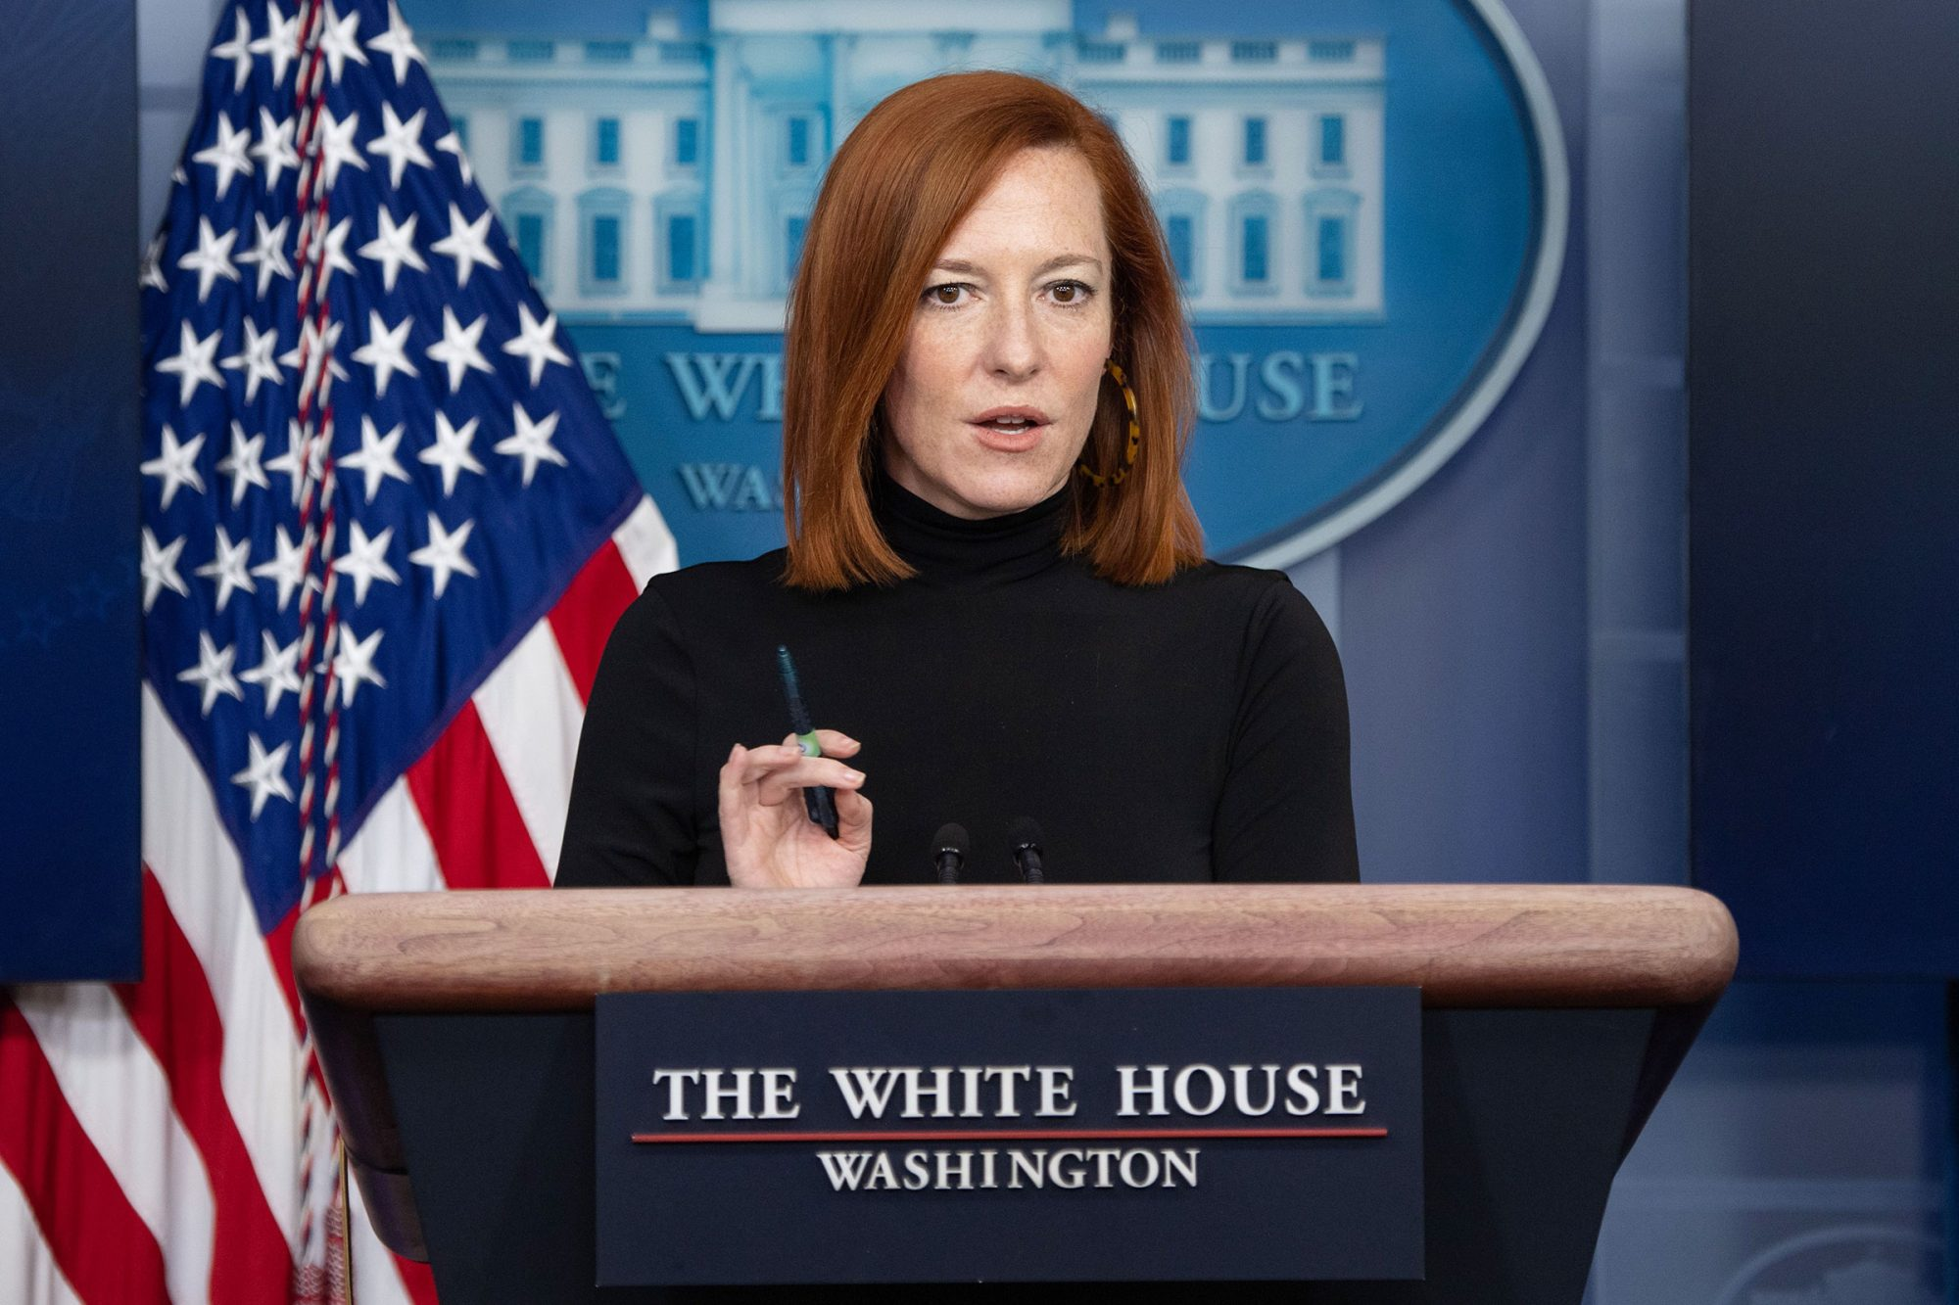
Executive Office of the President (EOP)
Often referred to as the “West Wing” (although many work in the Eisenhower exec office building) these are others who support the president in carrying out their duties
Led by Chief of Staff and includes:
White House Communications Office
Press Secretary’s Office
National Security Council
White House Military Office
and others

Slide 13
12th Amendment & the Electoral College

Slide 14
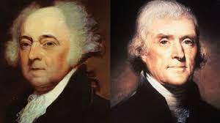
Election of 1800
Adams v. Jefferson for Pres.
Running mates:
Adams - Thomas Pinckney
Jefferson - Aaron Burr
Jefferson and Burr tied - who is President?
Tie goes to the House, Hamilton convinces them to vote for Jefferson
Jefferson becomes 3rd president, Burr becomes VP
Sparks change in presidential elections - candidates select running mates, electors pledged to parties, not candidates
12th Amendment added: electors designate votes as for Pres and VP separately

Slide 15
The Electoral College
Arose as a compromise between Founding Fathers who wanted popular vote to determine Pres and those who wanted Congress to choose
Each state will have electors equal to number of Senators (2 each) + Representatives in the House (based on population)
Electors vote for Pres/VP ticket - 270 votes is magic number to win
most states have a “winner take all” setup - so the party which wins majority of popular vote in that state get all the electoral votes (NE and ME are exceptions)
In practice this means Pres/VP candidates can win popular vote but still lose the election - has happened in 1824, 1876, 1888, 2000, and 2016

