Slide 1
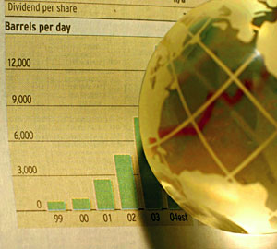
Economic Notes

Slide 2
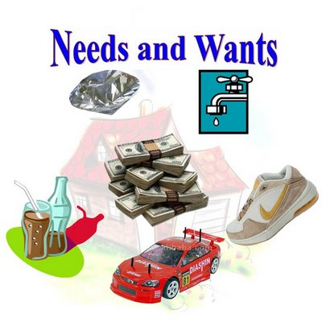
What is Economics?
The study of how people seek to satisfy their needs and wants by making choices

Slide 3
Scarcity and The Factors of Production
What is a need?
Something that is necessary for survival
What is a want?
An item that we desire but is not essential to survival

Slide 4
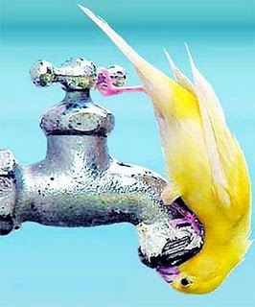
Scarcity and The Factors of Production
What is scarcity?
Scarcity is the idea that quantities of resources are limited to meet the unlimited wants of humans.
Scarcity can be temporary or long term
Scarcity is brought about by wars, famines, floods, fires, etc.

Slide 5
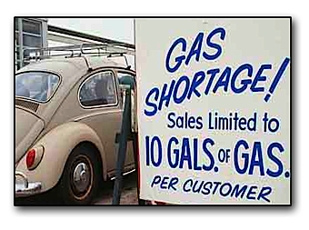
Scarcity and The Factors of Production
What is a shortage?
A situation in which a good or service is unavailable

Slide 6
Scarcity and The Factors of Production
What are the four factors of Production?
Land – the natural resources that are used to make goods and services
Labor – the effort that people devote to a task for which they are paid
Capital – any human made resource that is used to create other goods and services
There is human and physical capital
Entrepreneurs – ambitious leaders who combine the land, labor, and capital to create and market new goods and services

Slide 7
Trade – Offs and Opportunity Costs
What is a trade-off?
Trade offs are alternatives that we sacrifice when we make a decision.
What is an Opportunity cost?
The most desirable alternative given up as the result of a decision is an opportunity cost.
Example: If you buy a Big Mac Combo, you cannot go buy a Chicken McNugget Combo

Slide 8
The Free Market
What is a market?
A market is an “arrangement” that allows people to buy and sell items
Why are markets important?
No one is self-sufficient; as a result, people must exchange goods and services
In our society, people specialize. As a result, everyone does their own thing in hopes of being more efficient with the resources available

Slide 9
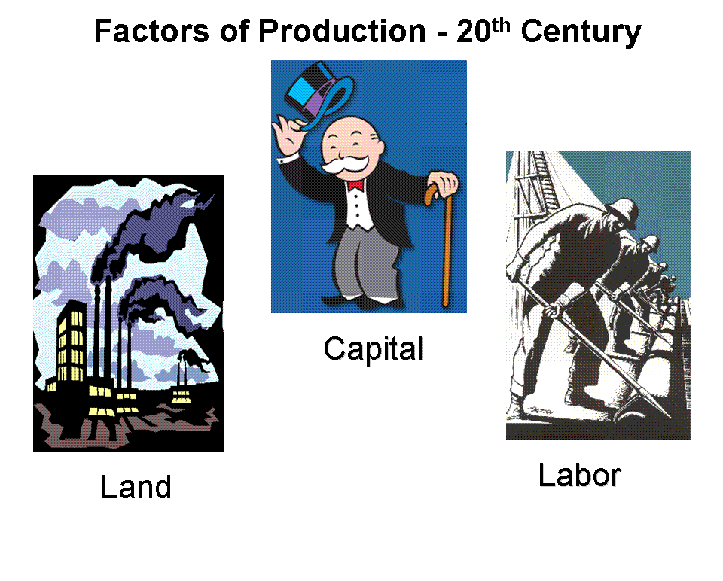
Free Market Economy
Free market economies are based on voluntary exchanges of goods and services
Factors of production are owned by individuals and businesses
Individuals answer the 3 basic economic questions

Slide 10
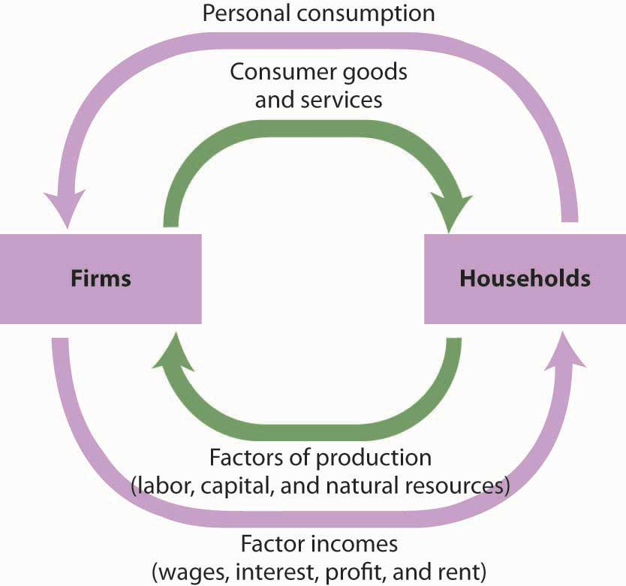
Free Market Economy
Who are the players in a free market economy?
Households – a person or group of people living in the same residence
Firms – an organization that uses resources to produce a product which it then sells (firms transform resource/factors of production into products or good/service)

Slide 11
Circular Flow
The flow of payments in an economy is a circular flow. Individuals--people living in households--work for businesses, rent their property (or their capital) to businesses, and manage and own the businesses. All these activities generate incomes--flows of payments from businesses to households. But households then spend their incomes--on consumption goods, in taxes paid to governments (that then spend the money on goods and services), and on assets like stock certificates and bank CDs that flow through the financial sector and are then used to buy investment and other goods. All these are expenditures
The two flows--of incomes and of expenditures--are equal: all expenditures on products are ultimately someone's income, and every piece of total income is also expended in some way

Slide 12
Circular Flow

Slide 13
Free Market Economy
Self-Regulating nature of the Marketplace
Self-Interest is key – Adam Smith – The Wealth of Nations – because we all are looking out for our best interests, we are the motivating force of the free market
Competition – the regulating force – to sell as much as a company can, they must have the best price or the best item to sell

Slide 14
Free Market Economy
The Invisible Hand – a term coined by Adam Smith – term economists use to describe the self-regulating nature of the marketplace
The self-interest of people combined with the competition from businesses causes the market to work without any outside help

Slide 15
Advantages of a Free Market
Economic Efficiency – producers make only what consumers want, when they want, and at prices willing to be paid
Economic Freedom – including freedom to work where you want, firms to produce what they want and consumers to buy what they want

Slide 16
Advantages of a Free Market
Economic Growth – innovations and growth encouraged, entrepreneurs are trying to find new ways to do things
Additional Goals – consumer sovereignty the power of consumers to decide what gets produced – Wide variety of goods and services offered

Slide 17
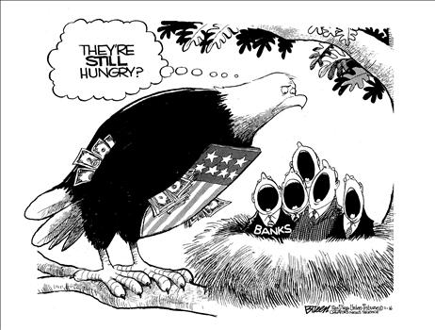
Free Market
NO PURE MARKET EXISTS ON ANY MEANINGFUL SCALE
Much of what makes a free market so attractive can also be a weakness

Slide 18
Demand
Desire to want something and the ability to pay for it

Slide 19
Law of Demand
When the price of goods goes down, then demand goes up and if the price goes up, then demand goes down
Graphing Demand
Demand Schedule – data table of demand and price
Demand Curve – graph representation of demand schedule

Slide 20
Demand Curve Shifts
If all things are constant in the market, it is called ceteris paribus (Latin for all constant)
What causes shift in demand?
Income/Budget
Consumer Expectations
Consumer Tastes
Advertising
Price of Related Goods

Slide 21
Demand Elasticity
Measurement of consumer reaction to price changes
If continue to buy if price increases = inelastic demand
If limited or stopped buying if price increases = elastic demand

Slide 22
Demand Elasticity
Factors of Elasticity
Available of Substitute goods
Importance of goods
Necessities v. Luxuries
Change over Time

Slide 23
Elasticity and Revenue
Revenue – firms total $$ made from selling goods and services
Elastic demand – as price decreases, revenue increases and as price increases, then revenue decreases
Inelastic demand – as price decreases, revenue decreases and as price increases, then revenue increases

Slide 24
Supply
Amount of goods available

Slide 25
Law of Supply
When price is high, quantity supplies is high, and when price is low, quantity is low
Quantity supplied – the amount a supplier is willing and able to supply at a certain price

Slide 26
Graphing Supply
Supply Schedule – a chart that lists how much of a good a supplier will offer at different prices
Supply Curve – a graph of the quantity supplied of a good at different prices

Slide 27
Supply Curve Shifts
Input Costs – any change in the cost of an input used to produce a good; such as raw materials, machinery, or labor will affect supply
How does input cost affect supply?
A rise in the cost of an input will cause a fall in supply at all price levels because the good has become more expensive to produce

Slide 28
Government Influence
How does each of the following affect supply?
Subsides – a government payment that supports a business or market can either protect or harm supply
Taxes – excise tax – a tax on the production or sale of a good or service – “sin” tax – taxes that inhibit suppliers and make it more difficult to afford – Alcohol, Tobacco, Gas

Slide 29
Government Influence
Regulation – Government intervention in a market that affects the production of a good; hurts supply typically because it costs more to supply, because the government is trying to protect the public

Slide 30
Supply Elasticity
Measurement of the way suppliers respond to change in price
Elastic Supply – the price is determined by the amount of supply
Inelastic Supply – increase or decrease in price has NO effect on supply

Slide 31
Factors of Supply Elasticity
Time
How does it affect supply?
In the short term it is inelastic, but in the long term it becomes more elastic

Slide 32
Supply and Demand
Equilibrium Point – the point at which Supply and Demand (quantity supplied and quantity demanded) are equal, a point of balance is reached
Point of balance = Equilibrium Price
Disequilibrium – when there is no point at which the amount supplied = the amount demanded; can have either a excess demand or excess supply

Slide 33
Supply Production
Labor and their Output
How many workers needed to produce?
Basic question business owners must answer everywhere
Marginal Product of Labor
The change in output from hiring one additional unit of labor

Slide 34
Supply Production
Law of Increasing Marginal Returns
A level of production in which the marginal product of labor increases as the number of workers increases
Law of Diminishing Marginal Returns
A level of production in which the marginal product of labor decreases as the number of workers increases

Slide 35
Production Costs
The factors that contribute to the total cost of creating a good or providing a service

Slide 36
Production Costs
Two major costs
Fixed Costs – a cost that does not change, no matter how much of a good is produced
Ex. Rent, Machinery repairs, Property taxes, salaries
Variable Costs – a cost that rises or falls depending on how much is produced
Ex. Cost of raw materials, heating, electricity

Slide 37
Production Costs
Total Costs – Fixed Costs + Variable Costs
The product will cost more or they will restrict supply because of cost
Marginal Costs – the cost of producing one more unit of a good suppliers will produce
Suppliers will produce the most they can and still be profitable

Slide 38
Production Costs
Operational costs – the cost of operating a facility, such as a store or factory

Slide 39
Setting Output
Firms determine output to maximize profit
Marginal revenue is additional income from selling one more unit of a good
Output is determined by finding a level where marginal revenue = marginal costs
Firms reconsider marginal cost if prices change

Slide 40
The Shutdown Decision
Firms losing money decide whether to shut down
Even if a factory is losing money, they must compare revenue with operating costs
Operating costs includes variable costs needed to keep factory running
The decision must be mad based upon the amount of money the firm would lose if the factory closed or if it remained open while still losing money

Slide 41
Shifts in Equilibrium
Government Intervention
Price Ceilings – highest price allowed by law
Price Floors – lowest price allowed by law
Shifts in supply (either too much of an item or not enough)
Shifts in demand (either too many consumers or not enough)

Slide 42
Role of Price
Tool for distribution of resources
Move factors of production into suppliers’ hands and goods and services in to demanding hands

Slide 43
Types of Goods
Normal Goods – Goods in demand more when income increases
Inferior Goods – Goods in demand less when income increases
Substitution Goods – Goods that replace other goods
Complimentary Goods – Goods that are used together with other goods

Slide 44
Advantages of Prices
Incentives – to make a profit and grow markets
Signals – communication for buyers and sellers
Low Price
Red light to producers that a good is being overproduced
Green light to consumers to buy more of a good because of a low opportunity cost
High Price
Green light to producers that a good is in demand and resources should be used to produce more
Red light to consumers to stop and think very carefully before buying

Slide 45
Disadvantages of Price
Rationing – a system of allocating scarce goods and services using criteria other than price
Shortages – a situation in which a good or service is unavailable, or a situation in which the quantity demanded is greater than the quantity supplied

Slide 46
Disadvantages of Price
Both result in the formation of a Black Market
Black Market – a market in which goods are sold illegally

Slide 47
Banking and Money

Slide 48
The History of Banking
1791: The First Bank of the US was established to hold the government’s $$, help the government to tax, regulate commerce, and issue a single currency
1861: The Second Bank of the US was established to restore stability and order to the monetary system.
1837 – 1863: During the “Wildcat” Era there many state-chartered banks, it was common for bank runs to occur, and there was wide spread panics
1907: The Panic of 1907 led Congress to create the National Monetary commission in 1908
1913: congress created the Federal Reserve System by passing the Federal Reserve Act. The Fed was the nation’s first true central bank; the notes it issued are the currency we use today.
1930 – 1933: congress forced the Fed to take action too late, meaning that recovery from the recession took a long time.
1935: congress adjusted the Federal Reserve’s structure so that the system could respond more effectively to future crises.

Slide 49
Federal Reserve Functions
Serve as banker for the US government and maintains a checking account for the Treasury Department
Regulates and stabilizes the nation’s money supply
Regulates and Supervises the banking system of the US

Slide 50
Federal Reserve Functions
Serves banks Nationwide: provides check-clearings services, safeguards banks reserves, and lends reserves to banks that need to borrow
Serves as financial agent for the Treasury Department and Other Government Agencies

Slide 51
Federal Reserve Functions
Issues currency and makes sure that fresh bills are always in circulation

Slide 52
Money
Commodity money – objects that have value in themselves and that are also used as money. Cattle, salt, gems/rocks
Representative money – objects that have value because the holder can exchange them for something else of value. IOU, paper receipts for gold/silver

Slide 53
Money
Fiat money – money that has value because the government has ordered that it is an acceptable means to pay all debts. US currency, Australian dollar

Slide 54
Stabilization of the Banking System
1861 – US Treasury issued the Continental [demand note - greenback] Civil War brought about several changes
National Banking Acts of 1863 & 1864 gave the fed. government 3 powers:
1. the power to charter banks
2. the power to require banks to hold adequate gold & silver reserves to cover
their bank notes
3. the power to issue a single national currency – this eliminated state individual
currencies and was one of the main stabilizers

Slide 55
Stabilization of the Banking System
1870 – national adoption of the gold standard which had 2 advantages
1. it set a definite value for the dollar, 1 oz. gold = $20, so people could get gold anytime they wanted which freed their minds to carry the lighter paper $$
2. The government could only issue currency if it had the gold necessary to back it, causing a more stable environment for banking.

Slide 56
Stabilization of the Banking System
1907 – Panic in the nation’s banking system spurred more reforms

Slide 57
Stabilization of the Banking System
1913 - The Federal Reserve System was created (Fed) as our nations central bank
It reorganized the federal banking system as follows:
Member Banks – 12 regional banks – stored cash reserves
Federal Reserve Board – each regional supervised by a board
Short-term Loans – each regional allows member banks to borrow money to meet short term demands to prevent bank failures
Federal Reserve Notes – created the national currency

Slide 58
Banking
The Great Depression: risky loans, crop failures, and the stock market crash shook the US for a decade.
1933: FDR – ‘bank holiday’ to shut down banks as a last resort to help restore calm later that same year FDIC [Federal Deposit and Insurance Corporation] was established by Congress.

Slide 59
Banking
Close regulations from 1930s to 1960s: restrictions on interest rates banks could pay depositors and what they could charge customers

Slide 60
Banking
1970s & 1980s deregulation wanted by the banks: caused problems for the Savings and Loans –
1. Deregulation allowed for competition-- S & L’s were unprepared for competition
2. High Interest Rates—long term loans has low rates for return, yet S & Ls had to pay high rates to members who had $$ in their banks.
3. Bad Loans – risky loans issued and many weren’t paid back
4. Fraud – some banks made bad loans intentionally and hurt the FSLIC[1989: Financial Institutions Reform, Recovery, & Enforcement Act abolished the independence of S & L’s, and transferred the insurance responsibility to FDIC]

Slide 61
Functions of Financial Institutions
Storing Money – safe, convenient place for people to store money.
Saving Money – many ways to save money – savings accounts, checking accounts, money market accounts, and certificates of deposit
Loans – provide loans to those with good ideas

Slide 62
Functions of Financial Institutions
Mortgages – provide loans so people can purchase homes
Credit Cards – provide cards so goods will be paid for by bank, but card holder must pay the bank when due
Simple and Compound Interest – price paid for the use of money

Slide 63
Types of Financial Institutions
Commercial Banks – offer a wide variety of services – Bank of America
Savings and Loan Associations – very similar to commercial banks
Savings Banks – for people who are depositing $$ but not enough for a CB
Credit Unions – cooperative lending associations for particular groups, usually employees of a specific firm

Slide 64
Types of Financial Institutions
Finance Companies – installment loans to customers [like when you buy a car]

Slide 65
Electronic Banking
ATMs – very convenient for bank and customer since they are 24 hour operations, you can do many things at the ATM – check balance, withdraw money and sometimes deposit money
Debit Cards – very much like a credit card [but not as protected] to help protect customer, PIN numbers may be used – this allows the bank to directly take $$ from your account and give it to the store where you purchased something

Slide 66
Electronic Banking
Home Banking – many institutions allow for people to use their computer to direct deposit, pay bills on-line, shift $$ from one account to another via computer
Automatic Clearing Houses – automatically transfer $$ from person to creditor via Fed. Reserve Banks
Stored Value Cards – used on college campuses and other locations that have a magnetic strip or a computer chip with the amount of $$ in an account.

Slide 67
Business Cycle

Slide 68
The business cycle is a period of macroeconomic expansion followed by a period of contraction. During the expansion phase, a period of economic growth as measured by a rise
in real GDP occurs. Once a peak is reached, this is the height of the economic expansion, when the real GDP stops
rising. Then a contraction occurs where there is a decline marked by falling real GDP. Which ends in an economic
trough, which is the lowest point in an economic contraction, when the real GDP stops falling.

Slide 69
Business Cycles
An economic expansion is a period of economic growth measured by a rise in real GDP. In the expansion phase, the economy enjoys plentiful jobs, a falling employment rate, and business prosperity
Contraction is a period of economic decline marked by the falling real GDP. Unemployment rises in this period.
The peak is the height of an economic expansion. This is the point when the real GDP stops rising.
In the trough period the economy bottoms out. This is the lowest point in an economic contraction, when the real GDP stops falling.
If real GDP falls for two consecutive quarters, the economy is said to be in a recession. A recession is a prolonged economic contraction.
When a recession is especially long and severe, it can be called a depression. During a depression there is high unemployment and low factory output.
Stagflation occurs when there is a decline in real GDP combined with a rise in the price level.

Slide 70
Market Structures

Slide 71
Perfect Competition
Perfect competition is also called pure competition, few examples of perfect competition exist today. Examples include the markets for farm products and stocks traded on the NYSE.

Slide 72
Four Conditions to Perfect Competition
1. Many buyers and sellers participate in the market.
2. Sellers offer IDENTICAL products.
3. Buyers and sellers are will informed about products.
4. Sellers are able to enter and exit the market freely.

Slide 73
Why are there so few perfectly competitive markets?
There are many barriers to entry, or factors that make it difficult for a new firm to enter the market.
1. Start –Up Costs: the expenses a firm must pay before it can begin to produce and sell goods
2. Barriers of technology and know-how can keep a market from being perfectly competitive

Slide 74
Why are commodities usually perfectly competitive?
Commodities are termed as ‘identical’ products, and in a perfectly competitive market, all products are identical

Slide 75
Monopoly
What is a monopoly?
a market dominated by a single seller

Slide 76
What are some characteristics of monopolies?
All monopolies have a single seller in the market.
It is VERY difficult to enter a market, cost prohibitive.
All monopolies have economies of scale [factors that cause a producers average cost per unit to fall as output rises]

Slide 77
What are some characteristics of monopolies?
Hydroelectric dams are examples of monopolies.
Natural Monopolies – a market that runs most efficiently when one large firm provides all of the output – public water is an example of natural monopoly
Technology can change natural monopolies – telephones were once a natural monopoly, because think copper wire was needed to provide service, when this was no longer the case, many companies were able to enter the market

Slide 78
Government Monopolies
Government Monopolies – a monopoly created by the government

Slide 79
Labor

Slide 80
Occupational Trends
A labor union is an organization of workers that tries to improve working conditions, wages, and benefits for its members.
Less than 14% of US workers belong to a labor union.

Slide 81
Labor Force Trends
The union movement took shape over the course of more than a century.
The 1935 National Labor Relations Act, also known as the Wagner Act, gave workers the right to organize and required the companies to bargain in good faith with the Unions.

Slide 82
Key Events in US Labor Movement
Year Event
1869 Knights of Labor founded
1911 Fire in the Triangle Shirtwaist Factory in New York kills 146, spurring action on workplace safety

Slide 83
Key Events in US Labor Movement
Year Event
1932 Norris-La Guardia Act outlaws ‘yellow dog’ contracts, gives other protection to unions
1935 Wagner Act gives workers rights to organize

Slide 84
Key Events in US Labor Movement
Year Event
1938 AFL splinter group becomes the independent Congress of Industrial Organizations headed by John L. Lewis
1955 AFL and CIO merge to create AFL-CIO

Slide 85
Key Events in US Labor Movement
Year Event
1970s Rise in anti-union measures by employers
1990s Increase in public sector unions, including teaching assistants at some universities

Slide 86
Labor Terms
Collective Bargaining
Collective bargaining is the process in which union and company representatives meet to negotiate a new labor contract.
Wages and Benefits
The Union negotiates on behalf of all members for wage rate, overtime rates, planned raises, and benefits.

Slide 87
Labor Terms
Working Conditions
Safety, comfort, worker responsibilities, and other workplace issues are negotiated and written into the final contract.
Job Security
One of the union’s primary goals is to secure its members’ jobs. The contract spells out the conditions under which a worker may be fired.

Slide 88
Labor Strikes and Settlements
Strikes
If no agreement is met between the union and the company, the union may ask its members to vote on a strike. A strike is organized work stoppage intended to force an employer to address union demands. Strikes can be harmful to both the union and the firm.

Slide 89
Labor Strikes and Settlements
Mediation
To avoid the economic losses of a strike, a third party is sometimes called in to settle the dispute. Mediation is a settlement technique in which a neutral mediator meets with each side to try and find an acceptable solution that both sides will accept.

Slide 90
Labor Strikes and Settlements
Arbitration
If mediation fails, talks may go into arbitration, a settlement technique in which a third party reviews the case and imposes a decision that is legally binding for both sides.

Slide 91
Declines in Union Membership
Several factors have led to declines in union membership since the 1950s:
‘Right to work’ Laws
The Taft-Hartley Act (1947) allowed states to pass right to work laws.
These laws ban mandatory union membership at the workplace.

Slide 92
Declines in Union Membership
Economic Trends
Unions have traditionally been strongest in the manufacturing sector, representing blue-collar workers, or workers who have industrial jobs. Blue collar jobs have been declining in number as the American economy becomes more service oriented.

Slide 93
Declines in Union Membership
Fulfillment of Union Goals
With the government setting standards for workplace safety, and with more benefits being provided by both private and government sources, some claim that the union membership has decreased simply because their goals have been fulfilled by other organizations.

Slide 94
Fiscal Policy

Slide 96
Debt and Deficit
Deficit
-The amount of money
the government
borrows
for one budget,
representing
one fiscal year
-Can rise or fall
because
of forces beyond the
government’s control
-Borrowing money affects both debt and deficit
-Budget deficits add to debt
-Debt and deficit contribute to unbalanced budgets
Debt
-The sum of all the
government borrowing
up to that time, minus
the borrowings that
have been repaid
-The total of all deficits
and surpluses

Slide 97
Business Organizations

Slide 98
Business Organizations
Sole Proprietorship
A business owned and managed by a single individual. According to the IRD 75% of all businesses in the IS are sole proprietorships but these generate only about 6% of US sales
Advantages | Disadvantages
Easy start-up | Unlimited person liability *liability is a legally bound obligation to pay debts. Sole proprietors are bound to all of their debts
Sole receiver of profit | Limited access to resources
Full control of business | Limited life – business lack permanence beyond the life of the sole proprietor
Easy to discontinue
Not subject to special business taxes

Slide 99
Business Organizations
Partnership
A business organization owned by tow or more persons who agree on a specific division of responsibilities and profits
Advantages | Disadvantages
Easy Start-up | Unlimited liability *Each general partner is bound to debt incurred and responsible for paying his debt
Shared Decision making | General partners do not have absolute control over their business
Specialization – each partner can bring his or her talents | Potential for conflict
Larger pool of assets – helpful when the business needs to borrow money
Not subject to special business taxes

Slide 100
Business Organizations
Corporations
A legal entity owned by individual stockholders
Stockholders own shares of stock
Shares – a certificate of ownership in a corporation
Stockholders are part owners of the corporation

Slide 101
Business Organizations
Corporations
Advantages | Disadvantages
Limited liability for owners | Expensive and difficult to start up
Transferable ownership – owners can sell stock and get money in return | Double taxes *Corporation pay taxes on income *Stockholders receive dividends (profits paid out to stockholders)
Long Life – business does not end with the death of the owners | Potential loss of control by the founders *Board of Directors usually run corporations
More potential for growth | More legal requirements and regulations

Slide 102
Business Organizations
Horizontal Merger
Joining of two or more firms competing in the same market with the same good or service
Examples:
Verizon and Alltel
Wells Fargo and Wachovia
Vertical Merger
Joining of two or more firms involved in different stages of producing the same good or service
Examples:
KFC buys a Chicken Farm

Slide 103
Business Organizations
Conglomerate
Merging of more than three businesses that make unrelated products
Example:
General Electric
Multinational Corporation
A large corporation that produces and sells its goods and services throughout the world
Advantages | Disadvantages
Provides jobs and products around the world | Low wages
Efforts to spread new technology around the world | Poor working conditions
Increased standard of living in many poor countries

Slide 104
Keynesian economics

Slide 105
Keynesian economics
Keynesian Economics
A form of demand-side economics that encourages government action to increase and decrease demand and output
Demand-side Economics
The idea that government spending and tax cuts help an economy by raising demand
John Maynard Keynes
Developed this theory after the Great Depression. His ultimate goal was to tell economists and politicians how to get out of and avoid economic crisis

Slide 106
Keynesian economics
Keynes believe that 2 things needed to happen to end the Great Depression
1. Consumers need to spend more money
Keynes thought that the spender should be the government. According to his theory, the government should buy goods and services. This would encourage production and increase employment.
2. Businesses need to increase output
As a result of this theory, people go back to work and then spend the money they make on goods and services – this increases production.

Slide 107
Fiscal Policy
Fiscal Policy
The use of government spending to influence the economy
Fiscal policy can be used to fight two macroeconomic problems, according to Keynes

Slide 108
Fiscal Policy
Expansionary Policy
1. Recession (decline in economic prosperity)/Depression (long recession)
Government should increase spending OR government should decrease taxes
Contractionary Policy
2. Inflation (general increase in prices)
Government should decrease spending OR government should increase taxes

Slide 109
Supply Side Economics
Supply-side Economics
A school of economics that believes that tax cuts can help an economy by raising supply
Those that agree with supply-side economics believe that taxes have strong negative influences on economic output
Trickle down effect
Investing money in companies and giving them tax breaks will benefit the economy. Eventually individuals (consumers) will experience the effects thus trickle down to the households

Slide 110
Karl Marx

Slide 111
Karl Marx
Marx was born in Germany in 1818 and died in London in 1883. He was a philosopher and political economist but was known best as a revolutionary communist. Marx along with Friedrich Engels wrote the Communist Manifesto

Slide 112
Karl Marx
Communist Manifesto
History should be described as social classes struggling with one another
19th Century social classes
Proletariat – those that own very little and therefore must sell labor to the capitalists
Bourgeois (capitalists) – the person that owns the factories and buys labor
The conflict between these two classes will eventually lead to revolution by the working class (proletariat). With this revolution there would cease to be a struggle
“Workers of all lands, unite” – the final words of the Communist Manifesto
This document lays out the foundations of communism

Slide 113
Karl Marx
Since the collapse of the Soviet Union, few countries would describe themselves as having a Marxist government. Political parties throughout the world still maintain Marxist ideologies.
Despite Marx’s predictions, capitalism is still thriving! We still see the existence of a working class and entrepreneurs.

Slide 114
Movement of Resource in the US Economy

Slide 115
Movement of Resource in the US Economy
Human Resource
Migrant Worker – move around to follow work
Example: agricultural workers move throughout the country to pick fruits and vegetables as various crops come in season
Immigrants – come to the US to find work. Many immigrants work in low paying jobs that are unwanted by Americans

Slide 116
Movement of Resource in the US Economy
Capital Resource
Business locate their companies where their can maximize profit
Example: cheap labor, high demand for product
Many companies have found it profitable to locate their headquarters in a central location
Example: Research Triangle Park, Silicon Valley
Research Triangle Park – an industrial park near Raleigh, Durham, and Chapel Hill, in the Research Triangle region of NC
Silicon Valley – a region in California south of San Francisco that is noted for its concentration of high-technology industries

Slide 117
Terms to know…
Department of Homeland Security: A federal agency whose primary mission is to help prevent, protect against, and respond to acts of terrorism on US soil
Created by Bush after Sept 11th
Responsible for providing immigration-related services and benefits
USA Patriot Act: Uniting and Strengthening America by Providing Appropriate Tools Required to Intercept and Obstruct Terrorism Act of 2001
Formed in response to Sept 11th
Dramatically expanded the authority of American law enforcement for the purpose of fighting terrorism in the US and abroad

Slide 118
Terms to know…
Outsourcing
Goods and services are provided by someone outside of the company
Outsourcing is done to save money, improve quality, or free company resources for other activities
Critics argue that outsourcing decreases the quality of a good or service
Downsizing
The selling off, closure of some plants, combination of business operation that perform the same functions, and/or cost cutting of an enterprise, usually deals with a decrease in labor

Slide 119
Economic Indicators

Slide 120
Leading Economic Indicators
GDP – Gross Domestic Product
Measures the output of the entire economy
Personal Income
Measures the total income of families in one year, higher the income the more money they have to spend
Stock Market, Averages (S & P 500, The Dow)
Reflects investor attitudes and movement of interest rates

Slide 121
Leading Economic Indicators
Unemployment Rate
Reflects layoffs of workers; how many unemployed at one time
Building Permits
Indicates construction activity
Manufacturer new orders
Predicts actual production change
Consumer Price Index and CPI Market Basket
Measures the rate of change in the price of 400 consumer goods

Slide 122
The Federal reserve and government economic policy

Slide 123
The Federal reserve and government economic policy
Monetary Policy
The Fed’s power over interest rates and amount of $ in reserve
Fiscal Policy
The Government power over taxes and spending

Slide 124
The Federal reserve and government economic policy
Contractionary Policy (Tight $$) – during inflation
1. Increase interest rates
2. Increase reserve requirement ($$ banks must have in reserve)
3. Increase taxes
4. Decrease government spending

Slide 125
The Federal reserve and government economic policy
Expansionary Policy (Easy or Loose $$) – during recession/depression
1. decrease interest rate (easy to buy)
2. decrease taxes
3. decrease reserve requirements (banks have more $$ to loan)
4. increase government spending

Slide 126
Review Taxes
Progressive Tax
The higher one’s income the higher the percentage of tax (ex. Income tax)
Regressive Tax
Tax imposed at a flat rate (ex. Sales tax)
Excise – tax on manufacture, sale, and consumption of goods; often called “hidden tax” (ex. Tax on fuel, alcohol, tobacco)

Slide 127
Measuring the Economy

Slide 128
Measuring the Economy
GDP: Gross Domestic Product
The dollar value of all final goods and service produced within a country’ borders in a given year
Nominal GDP – GDP measured in current prices
Real GDP – GDP measured in constant unchanging prices
GDP = Consumption + Investment + Government Spending + Net Exports (exports – imports)

Slide 129
Measuring the Economy
Consumption and investment = expenditure on final goods and services
Government Spending: government expenditures on final goods and services
Net Exports: imports are subtracted because they are included in C, I and G
GDP: C + I + G + NX

Slide 130
Measuring the Economy
Per Capita GDP: a country’s GDP divided by population
2005 US GDP: $12.77 Trillion
Population - 295,734,134
Per Capita GDP - $41,800
2005 China GDP: $8.158 Trillion
Population – 1,306,313,812
Per Capita GDP - $6,200
Per capita GDP can often be used to compare countries and their standard of living (economic prosperity)

Slide 131
Measuring the Economy
GNP: Gross National Product
Value of goods and service produced within a country in one year, plus income earned by citizens abroad, minus income earned by foreigners in the country
GNP – goods and services produced + money earned by citizens abroad – income earned by foreigners in the US
CPI: Consumer Price Index
An average of a specified set of goods and services
Measures the purchasing power of the dollar

Slide 132
The Business Cycle
Business Cycle
A period of macroeconomic expansion followed by a period of macroeconomic contraction
4 Phases
1. Expansion: a period of economic growth, real GDP rises
2. Peak: When GDP stops rising
3. Contraction: a period of economic decline, real GDP falling
4. Trough: When GDP stops falling

Slide 133
The Business Cycle
During the Contraction Phase…
Recession: prolonged economic contraction, real GDP decreases and unemployment increases
Depression: long and severe recession

Slide 134
Business Regulation
The government regulates business in several ways
Antitrust laws (FTC)
Environmental Protection Agency (EPA)
Workplace Safety (OSHA)
Consumer Protection (CPSC, FDA)
Communication (FCC)
Transportation (FAA)
Employment (EEOC)
Labor disputes
Affirmative action

Slide 135
Business Regulation
Deregulation is the removal of some government controls over the market. This supports the ideas of laissez faire
1970’s and 1980’s – period of deregulation
Deregulation encourages competition
Deregulation can lead to businesses cutting corners
Examples: Airlines relaxing security measure before 9-11

Slide 136
Economic Development

Slide 137
Economic Development
Historically, economists divided the world’s nations into 3 categories:
1st World Countries: The wealthiest countries (industrialized)
2nd World Countries: Communist countries
3rd World Countries: The poorest countries (primarily agricultural)

Slide 138
Economic Development
Now, economists just use 2 categories
Developed Countries – the wealthiest countries (US, Canada, western European Countries, Australian, New Zealand, Japan, etc.)
Less Developed Countries (LDCs) or Developing Countries – poorer countries (this includes the poorest countries in the world and other countries like Mexico, Saudi Arabia, and former Soviet countries that haven’t reached a high standard of living for most citizens)

Slide 139
Economic Development
The primary measure is per capita GDP (nation’s GDP/population). Other measures include:
Energy Consumption – more energy consumption, more developed (b/c more industrial)
Labor Force – more industrial jobs (vs. agricultural), more developed
Consumer Goods – more consumer goods produced per capita, more developed
Literacy – higher literacy rates, more developed
Infant mortality rate – lower infant mortality rate, more developed
Infrastructure – more infrastructure , more developed

Slide 140
Economic Development
Several countries have made dramatic recent economic improvement including:
Mexico, Brazil, Malaysia, and the “four Asian tigers,” Singapore, Hong Kong, South Korea, and Taiwan

Slide 141
Economic Development
The World Bank is an international organization devoted to assisting development. Uses per capita GNP to categorize countries
The International Monetary Fund (IMF) is an international organization (almost all UN nations belong) that monitors exchange rates and balance of payments, and provides technical and financial assistance as needed

Slide 142
Economic Development
As our economy has become more global, several issues are of recent concern:
Out-sourcing – transferring work to another country (esp. of concern in the computer industry and customer service)
Child Labor, Human Rights and Environmental Violations many developing nations do not protect the rights of workers or the environment. Some feel it is morally wrong to support these nations by buying their products or using their labor and hope that economic pressure may bring about needed reforms. Some products boast a “fair trade” label which means that the product has been produced according to minimum standards for labor, environment, and wages.

Slide 143
Economic Conditions and Policy Decisions
A company’s profit motive often leads to conflicts. These include:
Environmental Concerns
The government must set regulations so that the environment is protected. (Primarily the EPA)
Ex. Clean Air and Water Act – limits the amount of pollution companies are allowed to generate
Toxic materials are also highly regulated (ex. Radioactive materials)
This can lead to the NIMBY debate (Not In My BackYard) – no one wants toxic waste dumped in their state

Slide 144
Economic Conditions and Policy Decisions
Political Concerns
The US and other nations use economic measures to put pressure on other countries for a variety of reasons. (Countries that violate human rights, deny democracy, engage in nuclear weapon proliferation)
Examples
Cuban Economic Embargo
OPEC Oil Embargo
Possible economic sanctions with Iran
Concerns that Protect the Public
Examples
Zoning Laws
Building Codes

Slide 145
International trade

Slide 146
International Trade
Why do countries trade?
International trade allows nations to produce a limited number of good based on their resources while consuming a variety of goods
Comparative Advantage
The ability to produce a product most efficiently given all the other products it could produce
Law of Comparative Advantage
A nation is better off producing goods and services for which it has a comparative advantage.

Slide 147
International Trade
Terms
Export
A good sent to another country
Import
A good brought in from another country
Trade Balance
The relationship between a nation’s imports and its exports
Favorable Balance of Trade
A country with a trade surplus
Trade Deficit
Nation imports more than it exports

Slide 148
International Trade
Tariff
A tax on imported goods
Import Quota
A trade barrier that limits the amount of a good that can be imported
Embargo
Complete barrier to trade with a country
NO Trade (ex. Cuba)
Exchange Rates
Allow one to convert prices in one currency to prices in another currency

Slide 149
International Free Trade Agreements
WTO (World Trade Organization): founded in 1995 to ensure countries were reducing tariffs and expanding world trade, also to negotiate new trade agreements and resolve trade disputes.
European Union (EU): formed in 1993 a union of countries that agreed to abolish tariffs and trade restrictions among members and adopt uniform tariffs for non-members. Uniform monetary unit: The Euro

Slide 150
International Free Trade Agreements
NAFTA (North American Free Trade Agreement); a trade region that will eliminate tariffs and trade barriers between Canada, Mexico and the US by 2009 creating the world’s largest free trade zone.

