Slide 1
Taxes

Slide 2
Tax
A charge imposed by the government on people or property to raise money to meet public needs

Slide 3
Tax (continued)
The power to tax is a concurrent power – belonging to both the states and the national government. The power to tax is also an expressed power of the national government – Article I Section 8

Slide 4
Direct Tax
A tax that is paid directly to the government by the person whom it is imposed upon
Ex. Tax placed on land

Slide 5
Indirect Tax
A tax that is paid by one person and passed on to the another.
Ex. Tax placed on cigarettes. Paid first by the Tobacco Company, then passed on through the wholesaler and retailer to the person who buys and uses the cigarettes

Slide 6
Deficit Financing
The Federal Government regularly spends more than it takes in each year – and borrows $ to make up the difference. The philosophy of spending has helped America get through the Great Depression, raise $ for WWII, and fund social programs

Slide 7
Public Debt
$ borrowed by the government and not yet repaid

Slide 8
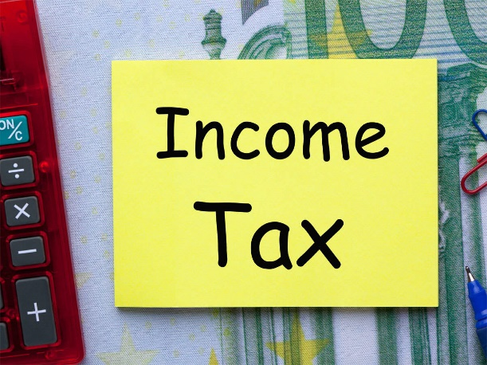
Progressive Tax
The higher one’s income, the higher the tax
Ex. Income Tax – the highest source of revenue for the Federal Government is income taxes

Slide 9
Regressive Tax
Taxes imposed at a flat rate
Ex. Sales Tax – Everyone pays 7.25% in North Carolina regardless of income

Slide 10
Federal Government Taxes and Social Programs
The Federal government collects huge sums of $ to pay for three social welfare programs
1. Social Security - $ for those retired
2. Medicare – medical care for the retired
3. Unemployment – payment for those without work

Slide 11
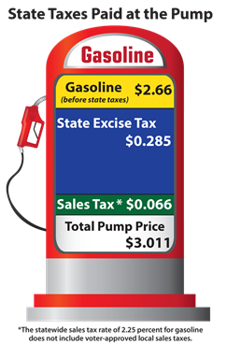
Excise Tax
Tax on the manufacture, sale and consumption of goods. These are often called “hidden Taxes”
Ex. Gasoline, Oil, Tires, Wine, Liquor, Firearms, Telephone services, and Airline tickets

Slide 12
Estate Tax
Tax placed on the assets (the estate) of one who dies

Slide 13
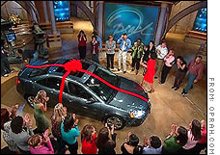
Gift Tax
Tax imposed on the gift of a living person

Slide 14
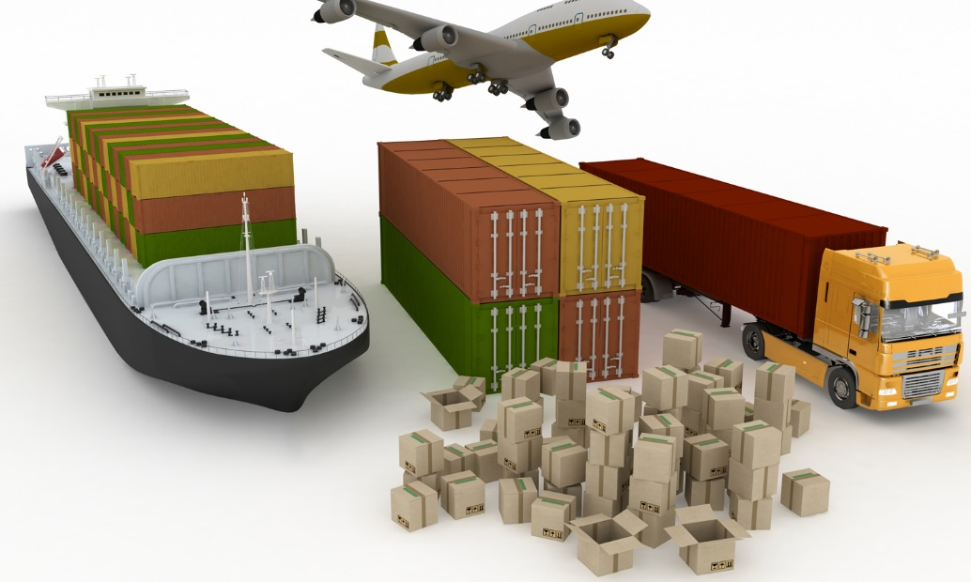
Custom Duty
Tax imposed on goods brought into the US

