Slide 1
EVENTS LEADING TO THE AMERICAN REVOLUTION

Slide 2
Native Americans
Native Americans were unhappy about the results of the French and Indians war and how the territories had changed.
The British now controlled the land west of the colonies
The British relationship with the Native Americans was bad as a result not paying for the land and raising all of the prices for goods.

Slide 3
Native Americans (cont.)
As a result violence began to occur between the Native Americans and the colonists on the western side of the colonies
Ultimately, the Native Americans would do just enough for the British government to step in with the Proclamation of 1763
This would lead to major problems with the colonists who began moving west to settle

Slide 4
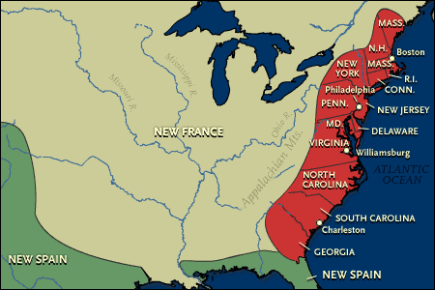
The Colonies before the French and Indian War

Slide 5
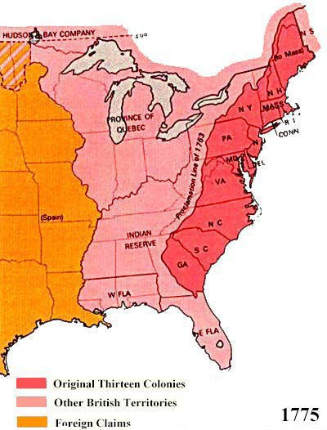
Colonies soon after the French and Indian War

Slide 6
Sons of Liberty
Founded by Samuel Adams
Organized protests against the acts passed by the British government
Organized other groups throughout the colonies to protest, boycott and overall give the British trouble until it would remove all of the taxes placed on the colonies or at least give them representation in Parliament

Slide 7
Major Acts that Taxed or annoyed the Americans
Stamp Act
Quartering Act
Tea Act
Sugar Act
Coercive (Intolerable) Acts
Proclamation of 1763

Slide 8
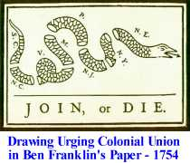

Slide 9
Stamp Act Congress
Met in October 1765 in New York
Delegates from nine states drafted a petition to the King and Parliament to repeal the act because only they could tax themselves
Resulted in the repeal of the act, but brought about the Declaratory Act of 1766

Slide 10
Boston Massacre
March 5, 1770
A group of British soldiers being taunted by colonists open fire on the crowd of Americans
Killed five Americans
Among the dead was Crispus Attucks, the supposed leader of the crowd

Slide 11
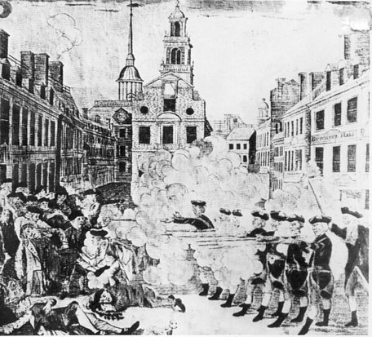
Boston Massacre

Slide 12
Committee of Correspondence
Revived in 1772 by Samuel Adams
Circulated writings about colonists grievances against Britain
Committees began to spring up all along the colonies bringing together the protesters opposed to the British

Slide 13
Boston Tea Party
December 16, 1773
When British ships carrying tea from the East India Company docked in Boston, many citizens wanted the tea sent back to England without the payment of taxes
The royal governor insisted on payment of all taxes and the ships stayed in the harbor

Slide 14
Boston Tea Party (cont.)
This sent the Sons of Liberty into action
Disguised as Native Americans, they boarded the ships and dumped 342 chests of tea into the harbor
This became one of the most popular and dramatic acts of defiance against the British and it rallied the Colonists.

Slide 15
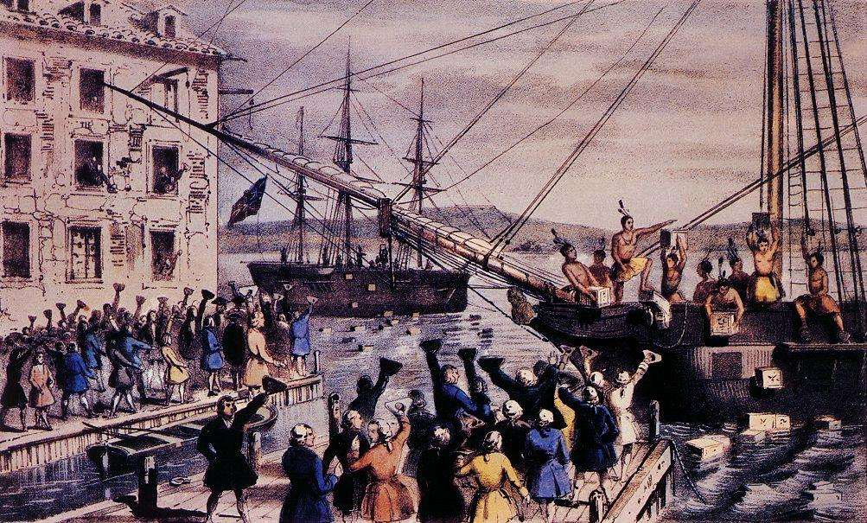
Boston Tea Party

Slide 16
First Continental Congress
Sept 4, 1774
Revolutionary political body made up of delegates from most American colonies
Some of the important figures
George Washington
Samuel Adams
John Adams
John Jay
Richard Henry Lee
Patrick Henry

Slide 17
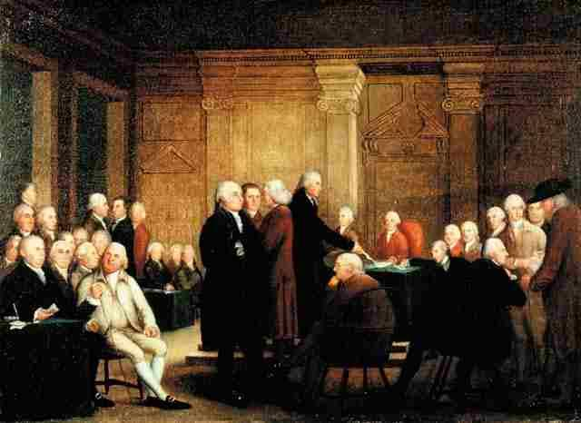
First Continental Congress

Slide 18
1st Continental Congress (cont.)
Drafted a statement of grievances calling for the repeal of 13 acts passed since 1763 claiming they violated the colonists rights
Also voted to boycott British goods and trade
Most important decision was to form a militia (group of citizen soldiers)

