Slide 1
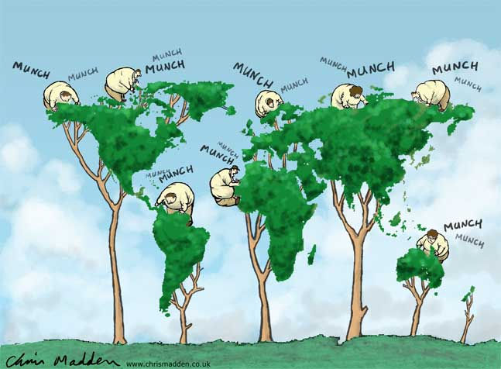
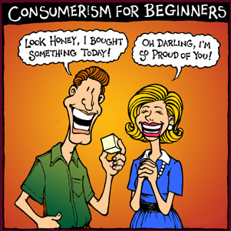
Consumerism

Slide 2
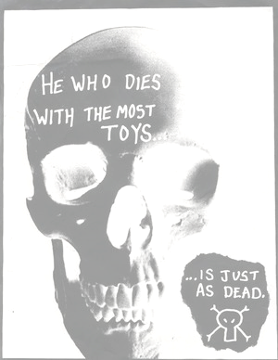
What is Consumerism?
Consumerism- an economic theory that links prosperity to consumer demand for goods and services, and that makes consumer behavior central to economic decision making.
What does that really mean?
the more YOU buy, the better the economy
the products you see on the shelves are based on what YOU bought in the past
more things = more wealth
more wealth= more happiness… or does it?

Slide 3
Consumerism
Consumerism is a theory of economics that encourages people to buy more “things” that they “need” to be happy
It creates a sense that you need to “Keep up with the Jones’”
It also encourages companies to be competitive… if their product is not good, their company won’t last long

Slide 4
Consumerism and Quality of Life
Quality of Life- a measure of personal and collective well-being; the conditions in a person’s life
How does consumerism affect YOUR quality of life?

Slide 5
How does YOUR consumerism affect you and others?
Why do you wear the clothes you do?
Why do you eat the food you do?
Who tells you to do the things you do?
What if everyone stopped wearing crocs? Buying iPhones? Playing Playstation? Eating meat?

Slide 6
Advertising and Consumerism
Maybe not for everything, but at least PART of your decisions come from the…
MEDIA

Slide 7
Advertising and Consumerism
Advertising is EVERYWHERE… from TV and radio, right into the bathroom stall with you.
Advertisements encourage you to buy products… even if you don’t need them
Advertisers use the following propaganda techniques to entice you use/buy their product
Bandwagon Effect (“everyone” has one)
Emotional Appeal (fears and desires)
Glittering Generalities (promises everything, delivers little)
Plain Folks Appeal (experience of everyday people)
Testimonials (celebrities or experts to speak for the product)
Scientific Appeal (stats or data to persuade)

Slide 8
Health and Safety as a consumer
Who regulates what you buy?
In a consumer society, don’t you have the right to decide if something is right for you without outside involvement?
Sometimes the government will step in when a product is deemed dangerous, or unhealthy to the average consumer
Cigarettes
Alcohol

Slide 9
Jobs, the Environment and consumerism
Every product you buy is connected to a chain of people and industries that produced that product
The more you buy, the more will be produced
Every product you buy is also linked to a chain of resources that are used to create the product
These resources may have an adverse effect on the environment
Packaging
Plastic (toxic to produce)

Slide 10
Consumer Power
What can you do if…
you find out your favorite shoe company uses slave labor?
the paper you use is not recycled?
the fruit you eat is sprayed with carcinogenic pesticides, or your meat is raised with hormones and antibiotics?
your make-up is tested on animals?
your iPhone was made in a country with no human rights?
What power do you have as a consumer?

Slide 11
Consumer Power
Raise awareness
Boycotts
As a consumer YOU are the demand… without it, there will be no supply

