Slide 1
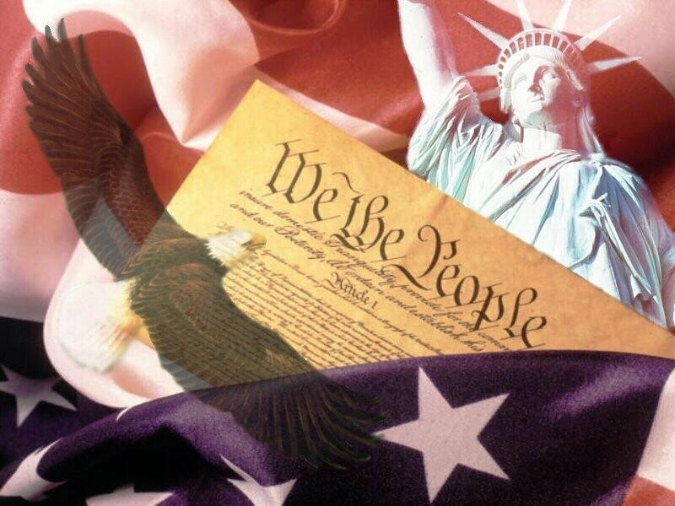
The Constitution: Structure

Slide 2
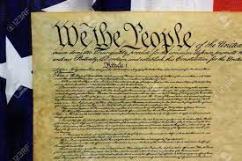
Structure of the Constitution
Introduction to the Constitution
Purpose of the Document
VERY clear that the power resides with the people
“We the people of the United States….do ordain and establish this Constitution for the United States of America.”

Slide 3
Six Purposes of government
*“ To form a more perfect union”
*“To establish Justice”
*“To ensure domestic Tranquility”
*“To provide for the Common Defense”
*“To promote the general Welfare”
*“To secure the Blessings of Liberty to ourselves and our Posterity”
Preamble
Notes:
To form a more perfect union…
Stronger national government
Promote loyalty
Unite people
Make the US one country
To establish justice…
Peaceful way to settle disputes
Fair, orderly system of justice
Consistent court system
To ensure domestic tranquility…
Protecting citizens from crime
Maintaining law and order

Slide 4
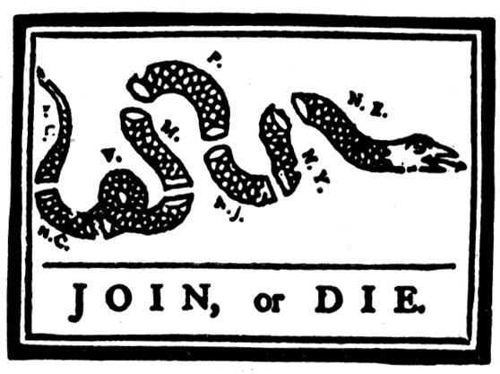
Preamble
To form a more perfect union…
Stronger national government
Promote loyalty
Unite people
Make the US one country

Slide 5
Preamble
To establish Justice…
Peaceful way to settle disputes
Fair, orderly system of justice
Consistent court system

Slide 6
Preamble
To ensure domestic tranquility…
Protecting citizens from crime
Maintaining law and order

Slide 7
Preamble
To provide for the common defense…
Defending against foreign enemies
Providing and using the military to protect citizens

Slide 8
Preamble
To promote the general welfare…
Providing needed services such as health care, education
Dealing with natural disasters
Helping citizens during times of need such as the elderly or disabled

Slide 9
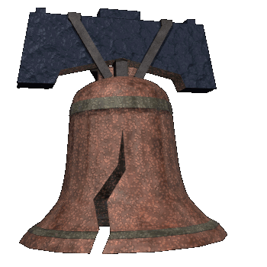
Preamble
Protect individual rights
Equal rights to all citizens
Equal protection and treatment
To secure the blessings of Liberty…

Slide 10
The Articles
Make and pass laws
Control government spending
Watchdog of the executive branch
Ability to impeach any federal official
Propose amendments
Override vetoes
Ratifies treaties
Declare war
Article I- The Legislative Branch

Slide 11
The Articles
Directs Foreign Policy
Commander – in – Chief of the Military
Representative of all Americans
Carry out and enforce the nations laws
Power of veto
Cabinet appointments
Federal justice appointments
Article II: The Executive Branch

Slide 12
The Articles
Supreme Court
Highest Court
Power of Judicial Review (it can review laws and decide whether the laws are constitutional)
Hear appeals
Federal Courts
Courts that hear cases that come under federal law
Appeal Courts
Consider district courts decision in which the losing side has asked for a review of the verdict
Article III- The Judicial Branch

Slide 13
The Articles
Article IV: Relations among states
Defines the relationship between the states and the federal government. The federal government guarantees a republican form of government in each state, protects the nation and the people from foreign or domestic violence, and determines how new states can join the Union. It also suggests that all the states are equal to each other and should respect each other’s laws and the judicial decisions made by other state court systems.
Article V: Amending the Constitution
Future generations can amend the Constitution if the society so requires it. Both the states and Congress have the power to initiate the amendment process.

Slide 14
The Articles
Article VI: National Debt, Supremacy of National Law, and Oaths of Office
Article VI determines that the US Constitution, and all laws made from it are the ‘supreme Law of the Land’, and all officials, whether members of the state legislatures, Congress, judiciary or the Executive have to swear an oath to the Constitution.
Article VII: Ratifying the Constitution
No longer requires unanimity. On June 21, 1788,the Constitution became the official framework of the government of the United States of America when New Hampshire became the ninth of 13 states to ratify it.

