Slide 1
ROLES OF THE PRESIDENT

Slide 2
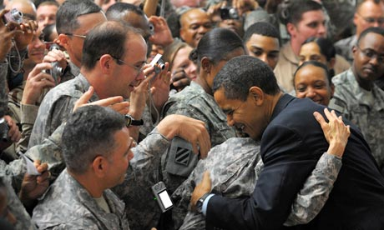
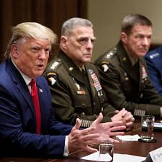
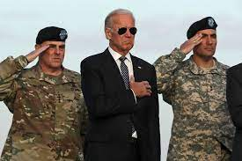
COMMANDER IN CHIEF:
Controls the nations military forces.
May send troops anywhere s/he pleases but only Congress can officially declare war.

Slide 3
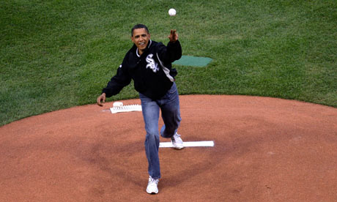
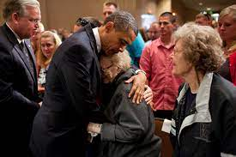
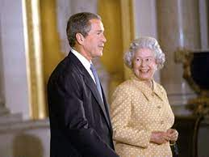
CHIEF OF STATE:
“The representative of all the people”
The president represents the United States of America. This means he consoles the people during times of crisis (9/11, natural disaster, etc.) and he celebrates with the people during good times (throwing the first pitch of the baseball season)

Slide 4
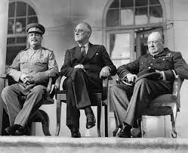
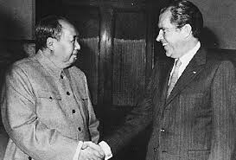
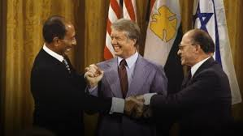
CHIEF DIPLOMAT:
The President designs the foreign policy for our country. This means he meets with leaders of other countries as the spokesman for the United States.

Slide 5
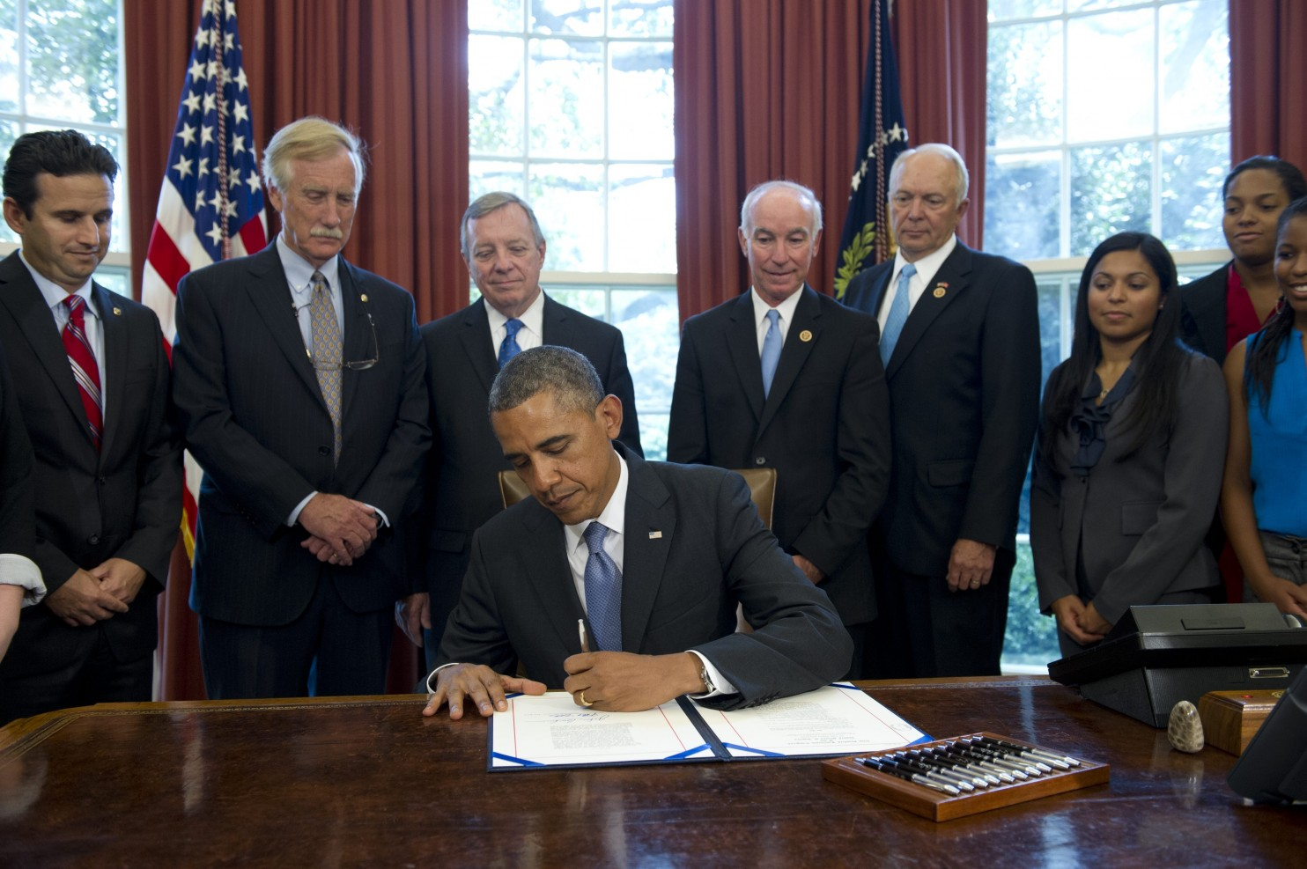
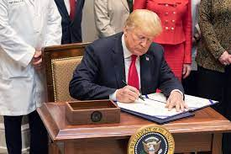
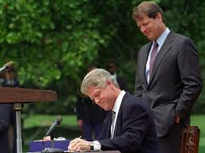
CHIEF LEGISLATOR:
The President is expected to shape the congressional agenda. This means he suggests legislation to Congress. (ex: Affordable Care Act)
Usually when the President gives the State of the Union address in January, s/he tells the country what major legislation s/he is planning on passing.

Slide 6
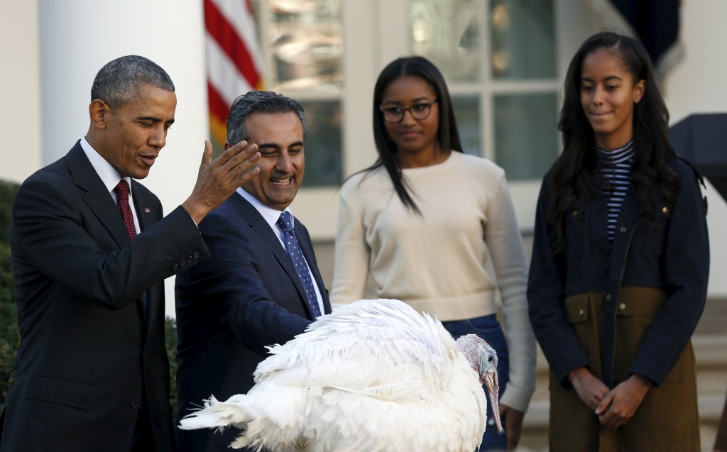
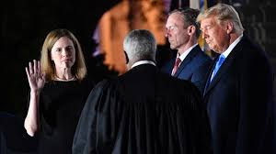
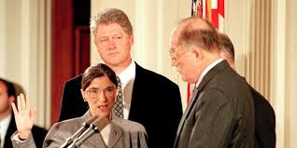
CHIEF JUDICIARY:
The President has the power to appoint Judges to federal judicial seats. Congress must approve appointments.
The President has the power to grant pardons, and reprieves.

Slide 7
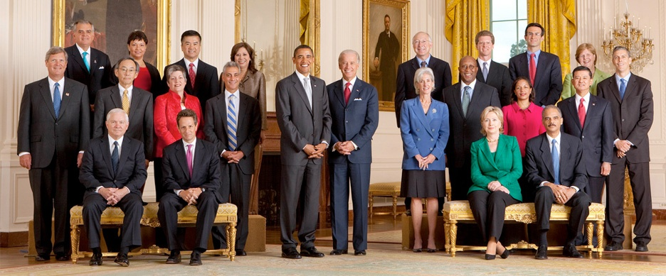
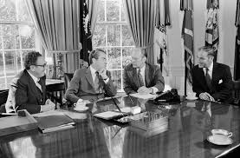
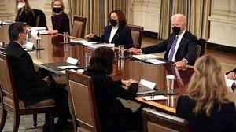
CHIEF EXECUTIVE:
The President is head of the Executive Branch. This means the heads of executive agencies answer directly to the President- this is called the President’s Cabinet. The Vice President is also a member of the Cabinet.

Slide 8
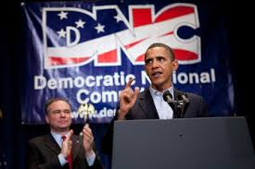
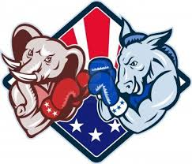
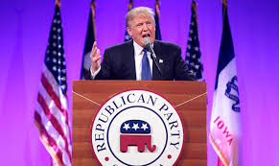
CHIEF OF PARTY:
The President represents their entire political party. This means everything the President does reflects on their party. This can be good and bad- how?

Slide 9
