Slide 1
Presidential Powers and Executive Orders
Article ii

Slide 2
Warm Up
We have examined the powers of the Legislative branch-What powers do we already know were left to the President?
What additional powers do we think should be given to the Executive Branch to (hint) enforce the law?

Slide 3
Enumerated Powers: US Constitution, Article II
The President:
Is the Commander in Chief of the armed forces. He or she has the power to call into service the state units of the National Guard, and in times of emergency may be given the power by Congress to manage national security or the economy.
has the power to make treaties with Senate approval. He or she can also receive ambassadors and work with leaders of other nations.
receives foreign dignitaries.

Slide 4
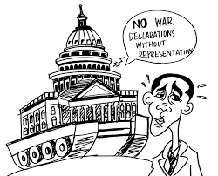
Spotlight: War Powers
Congress holds the power to declare war. As a result, the President cannot declare war without their approval. However, as the Commander in Chief of the armed forces, Presidents have sent troops to battle without an official war declaration (which happened in Vietnam and Korea).
The 1973 War Powers Act attempted to define when and how the President could send troops to battle by adding strict time frames for reporting to Congress after sending troops to war, in addition to other measures, however it has not had much effect

Slide 5
Enumerated Powers: US Constitution, Article II
The President…
can convene Congress for special sessions.
can veto legislation approved by Congress. However, the veto is limited. It is not a line-item veto, meaning that the President must veto the entire bill, rather than parts of it. Further, a presidential veto can be overridden by a two-thirds vote by Congress.
delivers the State of the Union address annually to a joint session of Congress.

Slide 6
Enumerated Powers: US Constitution, Article II
The President…
is responsible for nominating the heads of governmental departments, federal judges, and Supreme Court justices. The US Senate is charged with approving these nominations.
Merrick Garland was nominated to fill the 2016 Supreme Court vacancy on the Supreme created by the death that of conservative Justice Antonin Scalia by President Obama. He was never confirmed…

Slide 7
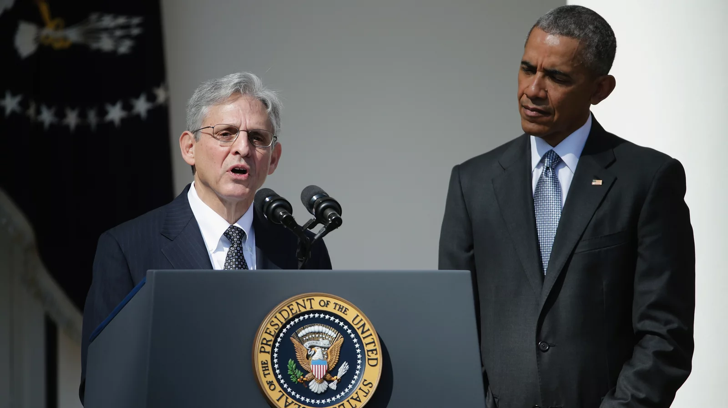
Spotlight: Garland nomination
Even before Obama had named Garland, and in fact only hours after Scalia's death was announced, Senate Majority Leader Mitch McConnell declared any appointment by the sitting president to be null and void. He said the next Supreme Court justice should be chosen by the next president — to be elected later that year.
Supreme Court picks have often been controversial. There have been contentious hearings and floor debates and contested votes. But to ignore the nominee entirely, as if no vacancy existed?
In a speech that August in Kentucky, McConnell would say: "One of my proudest moments was when I looked Barack Obama in the eye and I said, 'Mr. President, you will not fill the Supreme Court vacancy.’ “
Opinion? What is Garland’s job today?

Slide 8
Enumerated Powers: US Constitution, Article II
can issue pardons for federal offenses.
The U.S. Constitution gives the President almost limitless power to grant pardons to those convicted of federal crimes. While the President cannot pardon someone impeached by Congress, he or she can pardon anyone else without any Congressional involvement.
The president also exercises the power of pardon without conditions. Once used sparingly—apart from Andrew Johnson’s wholesale pardons of former Confederates during the Reconstruction period—the pardon power has become more visible in recent decades.

Slide 9
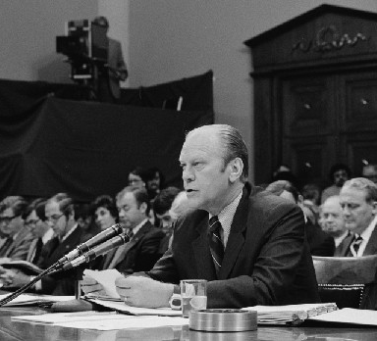
Spotlight: Pardons
President Gerald Ford has the unenviable reputation of being the only president to pardon another president (his predecessor Richard Nixon, who resigned after the Watergate scandal).
Here he is speaking before the House Judiciary Subcommittee on Criminal Justice meeting explaining his reasons. While the pardon was unpopular with many and may have cost Ford the election two years later, his constitutional power to issue it is indisputable. (Credit: modification of work by the Library of Congress)

Slide 10
Pardons
President Jimmy Carter also issued a great number of pardons, including several for draft dodging during the Vietnam War. President Reagan was reluctant to use the pardon, as was President George H. W. Bush. President Clinton pardoned few people for much of his presidency, but did make several last-minute controversial pardons.
Barack Obama made extensive use of commutations with a focus on reducing punishments for those convicted of certain drug crimes. In fact, Obama’s commutations were the most of any President in U.S. history.
Donald Trump used his pardon power 237 times.

Slide 11
Congressionally Delegated Powers
Implementation of laws and orders
Charged to “take care that the laws be faithfully executed,” the president receives considerable power by the authority delegated by the Constitution to implement laws passed by Congress, known as delegated power.
Carried out under auspices of the regulatory and oversight agencies. This power has enlarged greatly since the adoption of the Constitution.

Slide 12
Implied Powers
can issue executive orders, which have the force of law but do not have to be approved by Congress.
In times of emergency, the President can override Congress and issue executive orders with almost limitless power. Abraham Lincoln used an executive order in order to fight the Civil War, Woodrow Wilson issued numerous ones related to US involvement in World War I, and Franklin Roosevelt approved Japanese internment camps during World War II with an executive order.
Trump 220
Biden 55 to date

Slide 13
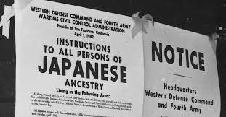
Spotlight: Executive Order 9066
Issued by President Franklin Roosevelt on February 19, 1942, this order authorized the evacuation of all persons deemed a threat to national security from the West Coast to relocation centers further inland. In the next 6 months, over 100,000 men, women, and children of Japanese ancestry were moved to assembly centers. They were then evacuated to and confined in isolated, fenced, and guarded relocation centers, known as internment camps. The Supreme Court addressed the issue in Korematsu v United States. 323 US 214 (1944)

Slide 14
Spotlight: 9066
In an opinion written by Justice Black, the Court ruled that the evacuation order violated by Korematsu was valid. The majority found that the Executive Order did not show racial prejudice but rather responded to the strategic imperative of keeping the U.S. and particularly the West Coast (the region nearest Japan) secure from invasion.
Justice Jackson dissented, arguing that the exclusion order legitimized racism that violated the Equal Protection Clause of the Fourteenth Amendment.
Opinion?

Slide 15
Spotlight: 9066 Aftermath-Reparations
In 1988, President Ronald Reagan signed into law the Civil Liberties Act of 1988 which officially apologized for the internment on behalf of the U.S. government and authorized a payment of $20,000 (equivalent to $44,000 in 2020) to each former internee who was still alive when the act was passed.
https://www.youtube.com/watch?v=kcaQRhcBXKY

Slide 16
Implied/Inherent Powers
Presidents further developed the concept of implied or inherent powers with the concept of executive privilege as the right to withhold information from Congress, the judiciary, or the public.
This right, not enumerated in the Constitution, was first asserted by George Washington to curtail inquiry into executive branch actions The more general defense of its use by White House officials and attorneys ensures that the president can secure candid advice from his advisers and staff members.

Slide 17
Spotlight: Executive Privilege-Richard Nixon
Nixon argued that the concept of executive privilege gave him the power to withhold sensitive information, such as tapes from his private meetings, from other government branches in order to maintain confidential communications within the executive branch and to secure the national interest.
On July 24, 1974, a unanimous Court (with Justice Rehnquist not taking part due to a prior role in the Nixon administration) ruled against the President. Chief Justice Warren Burger said that the President didn’t have an absolute, unqualified privilege to withhold information.
By late 1973, Watergate escalated, costing Nixon much of his political support. On August 9, 1974, facing almost certain impeachment and removal from office, he became the first American president to resign.
https://www.youtube.com/watch?v=ZEOGJJ7UKFM

Slide 18
Informal Powers: Persuasion Powers
Private Use
Informal communication
One-on-one negotiation with members of Congress
Public Use
Public Speaking engagements/advocating for public policy agenda
Political rallies
Use of media

Slide 19
Spotlight: Presidential Twitter?
Whatever the era, presidential leadership has recognized the importance of engaging civil society. Obama was also the first leader to go live on Facebook, use a filter on Snapchat, deliver his weekly national address on You Tube, and share photos on Instagram.
Trump’s use of technology, however, has baffled other domestic and global leaders, the media, and the public. President Trump’s daily online activity has alienated, rather than included citizens – especially those in disagreement with both his policies and opinions.
The storms of online impulsivity along with the reported actions to censor public agencies not only call into question the administration’s temperament toward opponents, but also its tolerance for the actors and agendas of those who broadly constitute civil society. The president is the leader of everyone, regardless of who voted for him.
What should be the role of online media sources in governance?
https://www.brookings.edu/blog/techtank/2017/02/16/how-the-presidents-twitter-account-affects-civil-society/

