Slide 1
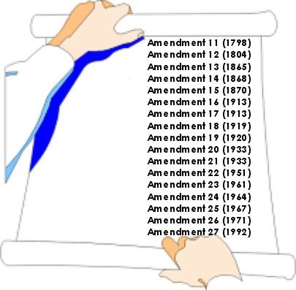
Amendments 11-27

Slide 2
11th Amendment
If you’re gonna sue Texas, you’ve gotta sue Texas in Texas.
Texas, I’m going to sue you
A citizen of one state can’t sue the government of another state unless it is done in the state being sued.

Slide 3
12th Amendment
Electoral College
Presidential Ballot
Electoral College
Vice-Presidential Ballot
Obama
McCain
Biden
Palin
Run as a Ticket!

Slide 4
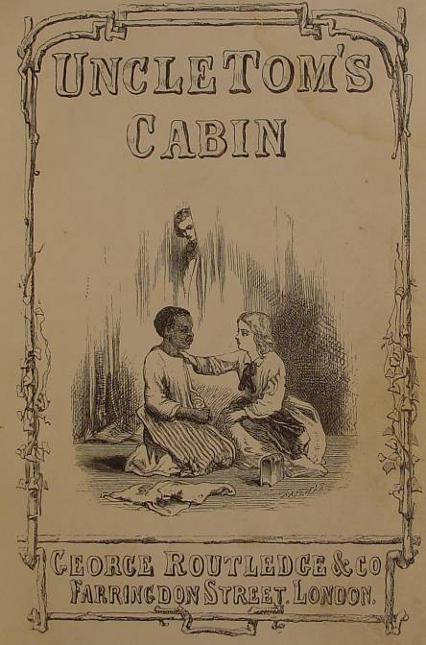
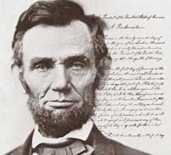
13th Amendment
Civil War Amendment
Abolished slavery!!!

Slide 5
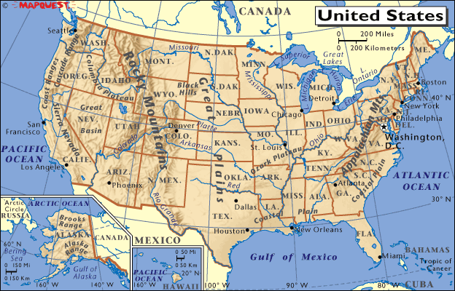
14th Amendment
Any one born in the U.S. is a citizen.
Civil War Amendment
? Me a ‘itzen?
And, we are all equally protected by the law.

Slide 6
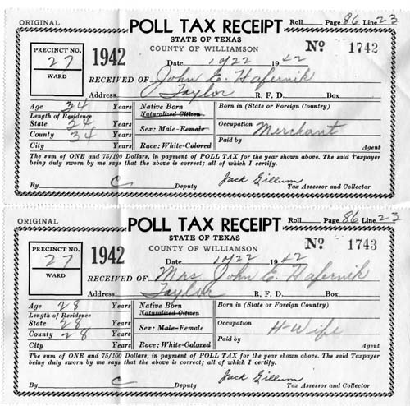
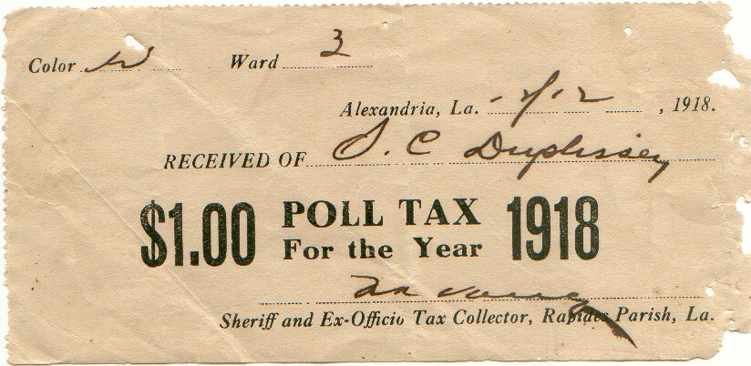
15th Amendment
Voting rights could not be denied because of race or color (or could it?).
Or, do I feed my family?
Should I vote?
Civil War Amendment

Slide 7
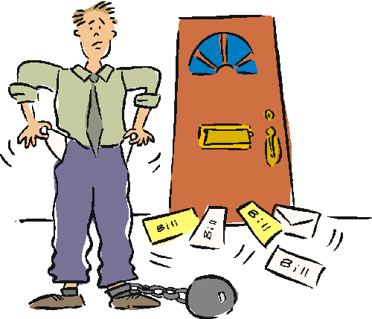
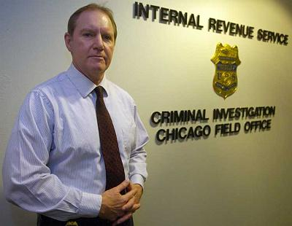
16th Amendment
Great, all I need is a bill from the IRS!
Don’t you worry, we will spend it on the common good!
The federal government can tax our income.

Slide 8
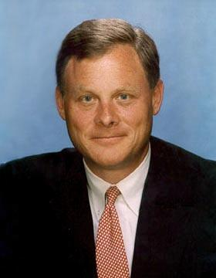
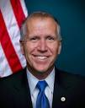
17th Amendment
Prior to the 17th Amendment, the state legislatures chose the senators, but…
N.C. Senators
Thom Tillis
Richard Burr
With the passage of the 17th, the PEOPLE directly elect their senators.

Slide 9
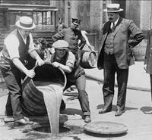
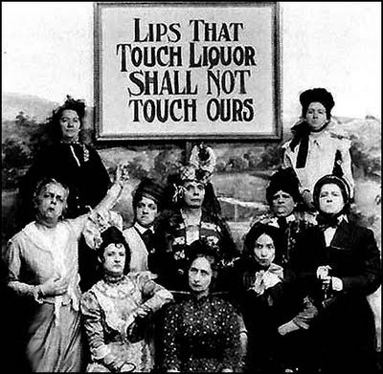
18th Amendment
Prohibited the sale of alcohol
This is known as prohibition.
See amendment 21.

Slide 10
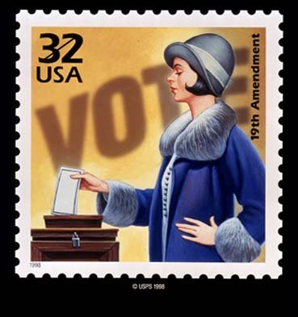
19th Amendment
Gives women the right to vote.
We finally have suffrage rights.

Slide 11
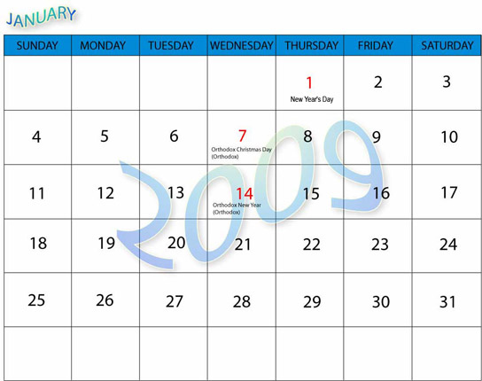
20th Amendment
Moves the presidential inauguration date from the month of March to January 20th. This amendment is also known as the “Lame Duck” amendment.

Slide 12
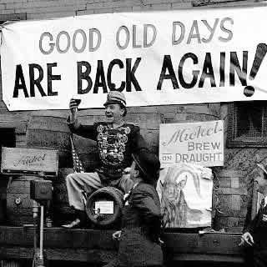
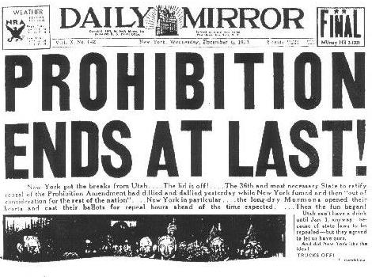
21st Amendment
18th repealed
Prohibition ends, , alcohol is legal again.
Break out the Champaign!!!!
Never Mind

Slide 13
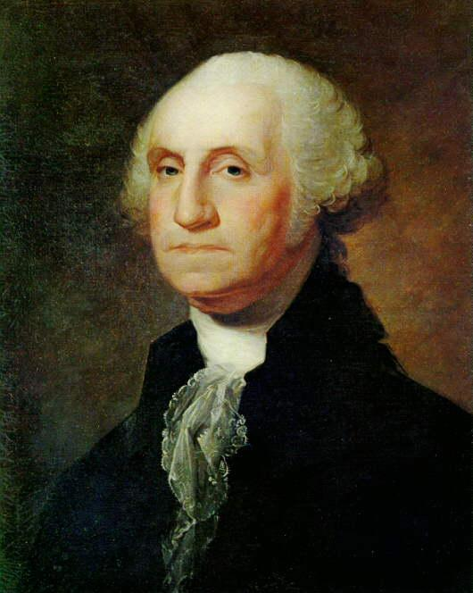
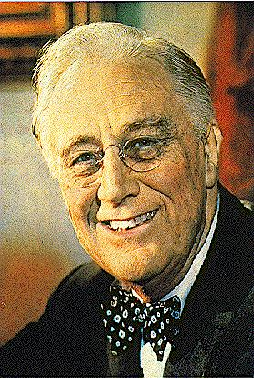
22nd Amendment
I know, I know, George, I broke your tradition of only serving two terms.wo terms
Franklin Roosevelt was elected four times, all presidents are now limited to two terms.
2 Terms, 2 Terms per president.

Slide 14
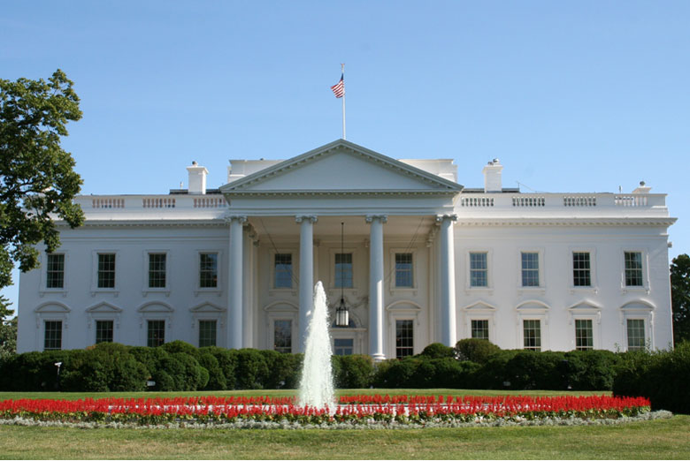
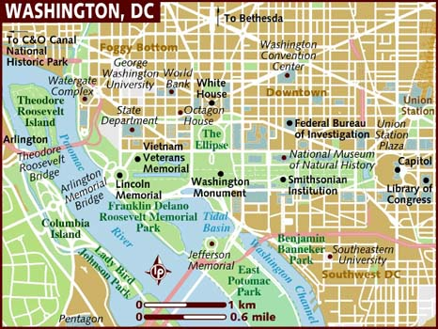
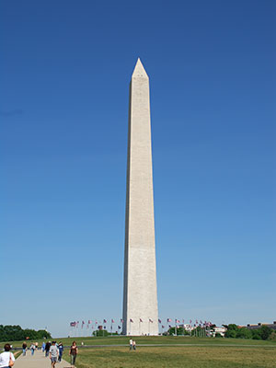
23rd Amendment
Citizens of Washington, D.C. (our U.S. Capital) receive the right to vote in presidential elections. Washington, D.C. is given 3 electoral votes. But no Congressional representation.

Slide 15
24th Amendment
Super!! Now I can vote and feed my family. One less thing I have to pay.
Outlaws Poll Taxes

Slide 16
25th Amendment
Outlines procedures for the succession to the presidency. The V.P. takes over as president if the president is unable to fulfill his/her job.
1. Vice President
2. Speaker of the House
3. President Pro Tem of the Sernate
4. Sec. of State

Slide 17
26th Amendments
Voting age is 18.
I

Slide 18
27th Amendment
Congress can give themselves a pay raise, but they have to wait until after the next election before they can get it.

