Slide 1
Electoral College Argumentative Writing Assignment

Slide 2
Is the Electoral College an outdated system for choosing the president? Does this Winner Take all System really reflect the will of the People? What type of alternatives might work?

Slide 3
Argumentative Writing Task
Is the Electoral College the best way to elect a President in a democratic republic?
After reading and analyzing informational texts (maps, articles, informational videos, etc.) on the Electoral College and alternative Presidential election methods, write a letter to the editor (no more than 500 words) that argues your position to the above question. Support your position with evidence from your research. Give an example from current events to illustrate or clarify your position. Be sure to acknowledge the two competing views giving strengths and weaknesses of all positions presented.
Conclude your letter with a clear and precise summary and evaluation.

Slide 4
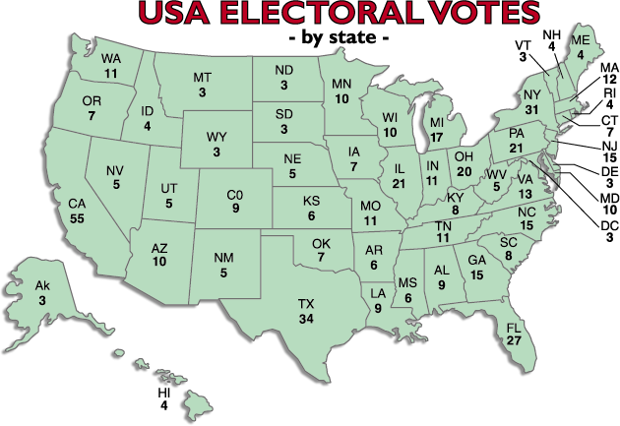
2000 – 2010 Electoral Map

Slide 5
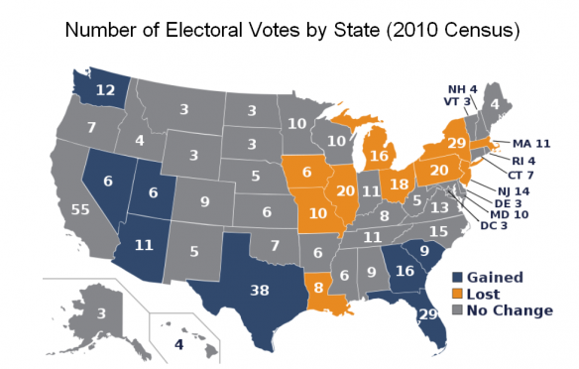

Slide 6
2000 Election Popular votes v. Electoral votes 205,815,000 of which 105,405,100 or 51% of eligible voters
Popular Vote
Total votes = 104,339,944
Gore – 50,999,897
48.3% of popular vote
Bush – 50,456,002
47.8% of popular vote
Nader – 2,883,955
2.7% of popular vote
Electoral Votes
Total votes = 538
* 1 abstained
Gore –266
49% of Electoral Votes
Bush–271
51% of Electoral Votes
Nader – 0
0% of Electoral votes

Slide 7
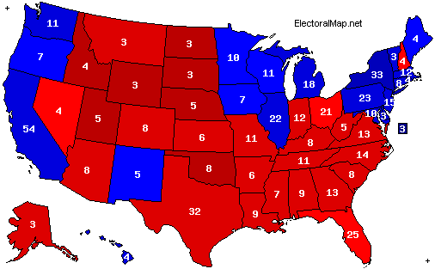
2000 Presidential Election
Electoral Votes Bush – 271 Gore – 266
Popular Vote Bush – 50,460,110 (47.87%) Gore 51,003,926 (48.38%)

Slide 8
1996 Election
Popular votes v. Electoral votes 196,511,000 of which 96,277,634 or
49% of eligible voters
Popular Vote
Total votes =103,758,177
Clinton – 44,909,806
43% of popular vote
Bush – 39,104,550
37% of popular vote
Perot – 19,743,821
19% of popular vote
Electoral Votes
Total votes = 538
Clinton – 370
69% of Electoral votes
Bush -168
31% of Electoral votes
Perot – 0
0% of Electoral votes

Slide 9
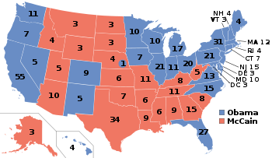
2008 Presidential Election
Electoral Votes Obama – 365 McCain – 173
Popular Vote Obama - 69,499,428 (52.87%) McCain 59,950,323 (45.60%)

Slide 10
2016 Election
Popular votes v. Electoral votes
Popular Vote
Clinton – 65,853,625
48% of the Popular Vote
Trump – 62,985,106
45.9% of the Popular Vote
Electoral Votes
Clinton – 227
39% of the Electoral Vote
(5 voters pledged to her voted for someone else)
Trump - 304
57% of the Electoral Vote
(2 voters pledged to him voted for someone else)

Slide 11
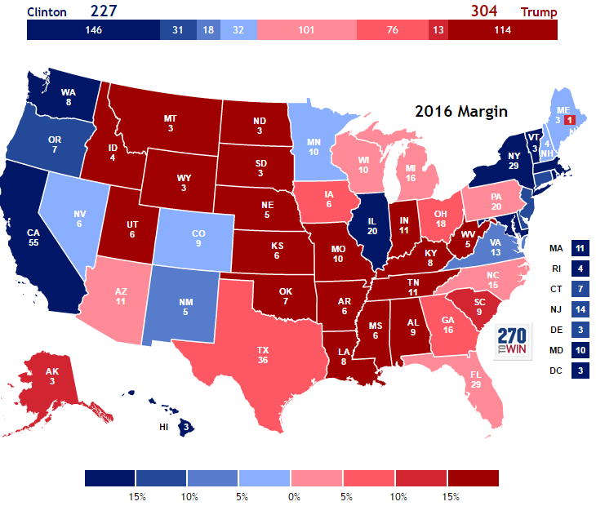

Slide 12
Electoral College Videos
http://www.youtube.com/watch?v=OUS9mM8Xbbw (Explanation of Electoral College)
http://www.youtube.com/watch?v=bCjWPo70XZY (Explanation of Electoral College)
http://www.youtube.com/watch?v=7wC42HgLA4k (Concerns with the Electoral College)

Slide 13
Alternative Election Options
http://archive.fairvote.org/e_college/reform.htm (Alternative Election Options)

Slide 14
Electoral College Concepts
 | Republic Representative Democracy Intent Compromise Amendment House of Representatives Senate Rogue Tradition Rubber Stamp Binding and Non-Binding Electors 23rd Amendments Elitism Informed
Popular Sovereignty
Plurality
Representative
Apathy
Majority
Winner Take All
Popular Vote
Electors
Proportional
Direct Election
Indirect Election
Two-Party System
270
12th Amendment
Campaigning
Swing State
Small vs. Large State
Apportionment
Democracy

Slide 15
Rubric
1st Paragraph - Opening Paragraph
Define – Electoral College (5 point)
Explain “How the Electoral College works” (15 points)
2nd Paragraph
Identify issues and your position with regards to the Electoral College system (must have at least ONE issue but preferably TWO or more) (10 Points)
Give an explanation as to why this issue is a problem (10 points)
3rd Paragraph
Offer a solution to the issues or explain why we should keep the system as it is (10 points)
Support your position with evidence from your research (10 points)
Give an example from current events to illustrate or clarify your position(5 points)
4th Paragraph - Conclusion
Be sure to acknowledge the two competing views giving strengths and weaknesses of all positions presented (10 Points)
Conclude your letter restating your position on the Electoral College (10 points)
Overall Focus of your letter (15 points)

